Slide 1
Methods of Industrial Mathematics – Session 2
Extended LTCC Advanced Course – Feb-Mar 2018
John Curtis, UCL Mathematics Department
© British Crown Owned Copyright 2018/AWE.

Slide 2
Session 2
A reminder of the diffusion equation.
Applications including heat transfer and diffusion of substances.
Common boundary conditions.
Some analytical solutions in steady state and time-dependent cases.
Numerical solution schemes including finite differences.
Brief introduction to the finite element method describing the huge role of the latter in engineering.

Slide 3
Industrial Mathematics Encountered by JC
ELECTROMAGNETIC THEORY
MECHANICS
HEAT TRANSFER
APPLIED PHYSICS
CONTROL THEORY
INDUSTRIAL MATHEMATICS USED BY JC
SIGNAL PROCESSING
SIMULATION
ENGINEERING
STATISTICS
NUMERICAL ANALYSIS
CHEMISTRY
PROBABILITY
OPTIMISATION
Arrows join most of the above subjects
N.B. No attempt at definitive list of Industrial Mathematics , e.g. Image Processing, Big Data, Formal Methods, Financial Mathematics are missing.

Slide 4
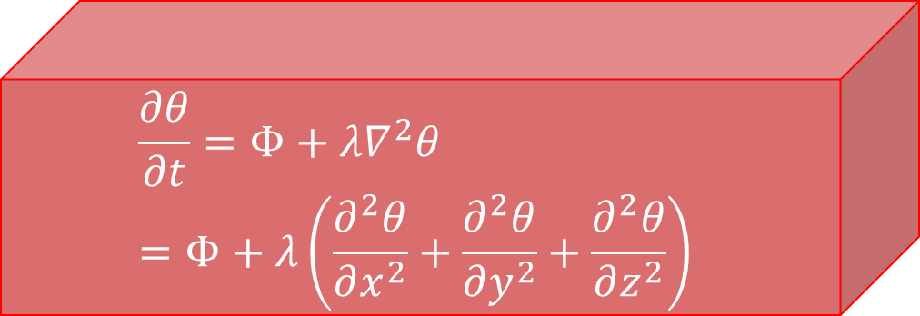
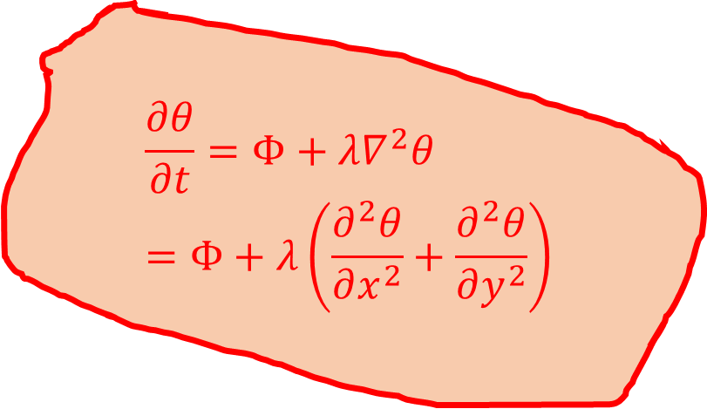
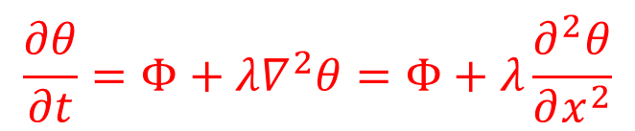
The Diffusion Equation
y
$${\frac{∂θ}{∂t}=Φ+λ∇}^{2}θ=Φ+λ\frac{∂^{2}θ}{∂x^{2}}$$
1-D
z
x
$${\frac{∂θ}{∂t}=Φ+λ∇}^{2}θ =Φ+λ\left(\frac{∂^{2}θ}{∂x^{2}}+\frac{∂^{2}θ}{∂y^{2}}\right)$$
$${\frac{∂θ}{∂t}=Φ+λ∇}^{2}θ=Φ+λ\left(\frac{∂^{2}θ}{∂x^{2}}+\frac{∂^{2}θ}{∂y^{2}}+\frac{∂^{2}θ}{∂z^{2}}\right)$$
2-D
3-D

Slide 5
Diffusion Equation – Applications
Heat transfer – derivation to come.
  Heat flow from higher temperature locations to lower temperature locations
Very slow diffusion of substances, e.g. air from a tyre.
  Slow flow from high concentration to low concentrations.
Diffusion of probability of crime.
Financial mathematics

Slide 6
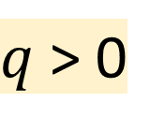

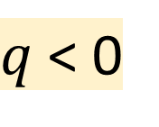
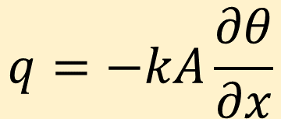



Derivation (1-D) - 1
Flux Equation (e.g. Fourier’s Law for heat conduction, Fick’s Law for diffusion)
$$q=−kA\frac{∂θ}{∂x}$$
A
$$θ$$
$$θ$$
$$x$$
$$x$$
$q$ < 0
$q$ > 0

Slide 7
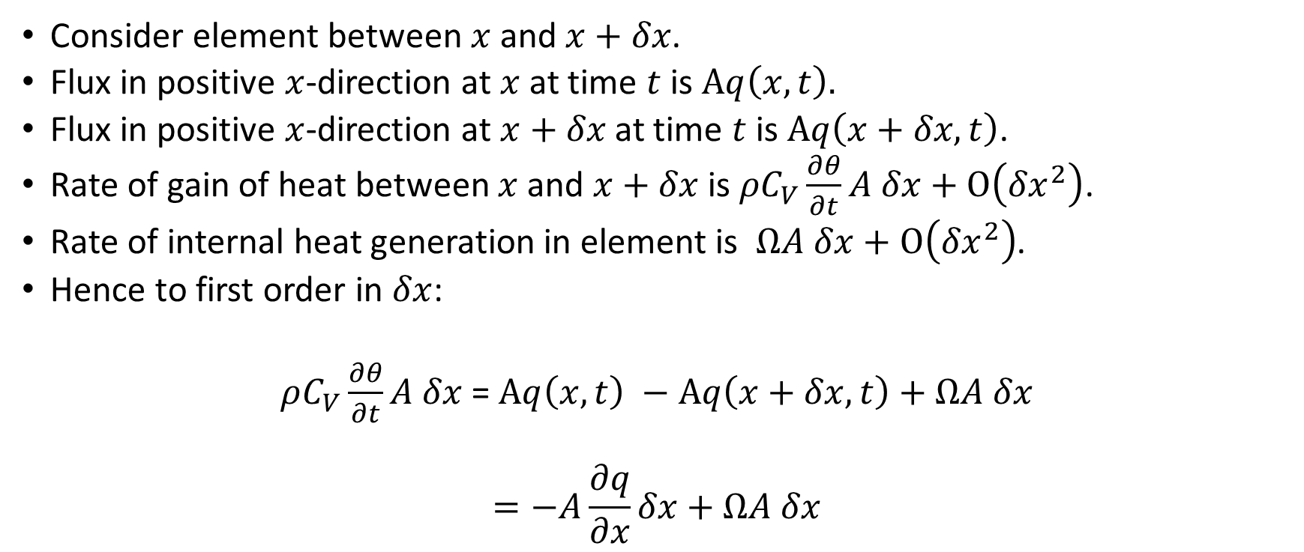
Derivation (1-D) - 2
Consider element between $x$ and $x+δx$.
Flux in positive $x$-direction at $x$ at time $t$is $Aq\left(x,t\right).$
Flux in positive $x$-direction at $x+δx$ at time $t$is $Aq\left(x+δx,t\right)$.
Rate of gain of heat between $x$ and $x+δx$ is $ρC_{V}\frac{∂θ}{∂t}A δx+O\left({δx}^{2}\right)$.
Rate of internal heat generation in element is $ΩA δx+O\left({δx}^{2}\right)$.
Hence to first order in $δx$:
$ρC_{V}\frac{∂θ}{∂t}A δx$= $Aq\left(x,t\right) −Aq\left(x+δx,t\right)+ΩA$ $δx$
$$=−A\frac{∂q}{∂x}δx+ΩA δx$$

Slide 8
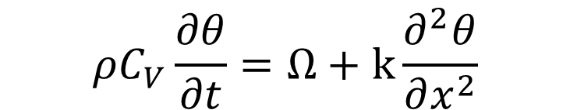
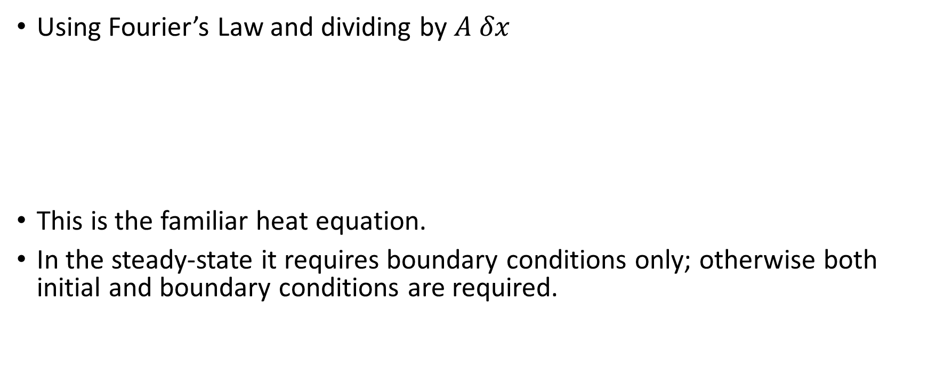
Derivation (1-D) - 3
Using Fourier’s Law and dividing by $A δx$
This is the familiar heat equation.
In the steady-state it requires boundary conditions only; otherwise both initial and boundary conditions are required.
$$ρC_{V}\frac{∂θ}{∂t}=Ω+k\frac{∂^{2}θ}{∂x^{2}}$$

Slide 9

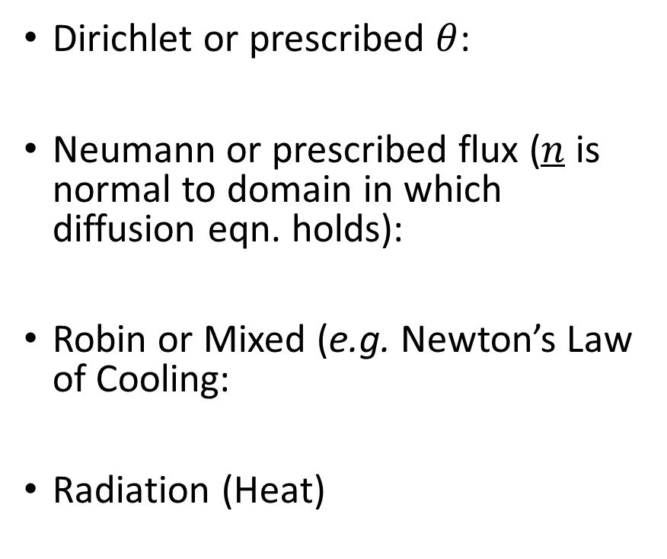
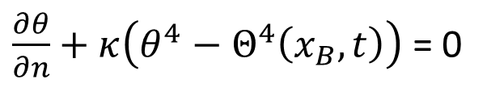
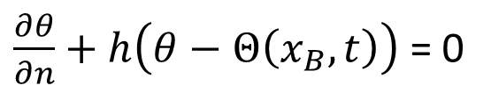
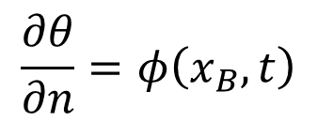
Common Boundary Conditions
Dirichlet or prescribed $θ$:
Neumann or prescribed flux ($n$ is normal to domain in which diffusion eqn. holds):
Robin or Mixed (e.g. Newton’s Law of Cooling:
Radiation (Heat)
$$θ=Θ\left(x_{B},t\right)$$
$$\frac{∂θ}{∂n}=φ\left(x_{B},t\right)$$
$\frac{∂θ}{∂n}+h\left(θ−Θ\left(x_{B},t\right)\right)$ = 0
$\frac{∂θ}{∂n}+κ\left(θ^{4}−Θ^{4}\left(x_{B},t\right)\right)$= 0

Slide 10

Steady-State
Dependence on $x$ only so in 1-D:
$$\frac{d^{2}θ}{dx^{2}}=0.$$
General solution is simple:
$$θ=Cx+D,$$
where $C, D$ are constants found by use of the boundary conditions.

Slide 11






Two Dirichlet Conditions
$$θ=\frac{\left(θ_{B}−θ_{A}\right)x+\left(θ_{A}b−θ_{B}a\right)}{\left(b−a\right)}$$
$$θ=θ_{A}$$
$$θ=θ_{B}$$
$$x$$
$$x=a$$
$$x=b$$

Slide 12


One Dirichlet, One Flux Condition
$$θ= λ_{B}\left(x−a\right)+θ_{A}$$
$$\frac{∂θ}{∂x}= λ_{B}$$
$$θ=θ_{A}$$
$$x$$
$$x=a$$
$$x=b$$

Slide 13
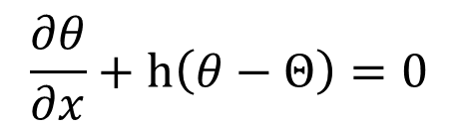


One Dirichlet, One Robin Condition
$$θ= \frac{xh\left(Θ−θ_{A}\right)+θ_{A}\left(1+bh\right)−ahΘ}{\left[1+h\left(b−a\right)\right]}$$
$$\frac{∂θ}{∂x}+h\left(θ−Θ\right)=0$$
$$θ=θ_{A}$$
$$x$$
$$x=a$$
$$x=b$$

Slide 14
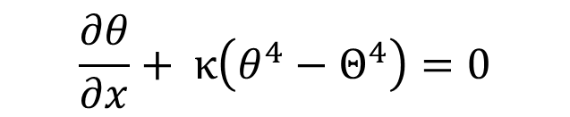





One Dirichlet, One Radiation Condition - 1
$$\frac{∂θ}{∂x}+ κ\left(θ^{4}−Θ^{4}\right)=0$$
$$θ=Cx+D,$$
where $C$ is the correct root (physically sensible) of
$$C+κ\left[{\left\{C\left(b−a\right)+θ_{A}\right\}}^{4}−Θ^{4}\right]=0$$
and $D=θ_{A}−Ca$.
$$θ=θ_{A}$$
$$x$$
$$x=a$$
$$x=b$$

Slide 15
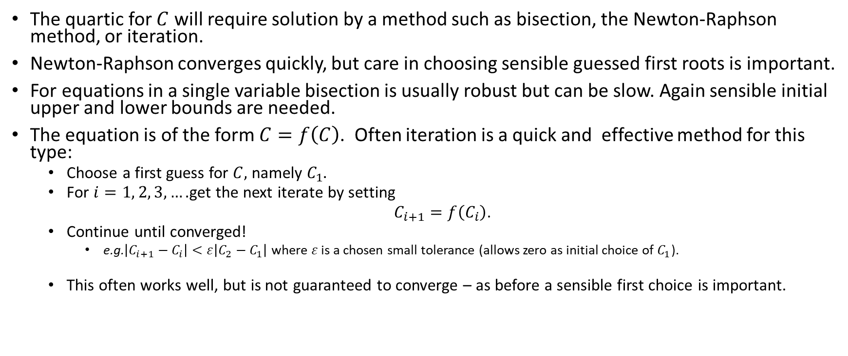
One Dirichlet, One Radiation Condition - 2
The quartic for $C$ will require solution by a method such as bisection, the Newton-Raphson method, or iteration.
Newton-Raphson converges quickly, but care in choosing sensible guessed first roots is important.
For equations in a single variable bisection is usually robust but can be slow. Again sensible initial upper and lower bounds are needed.
The equation is of the form $C=f\left(C\right)$. Often iteration is a quick and effective method for this type:
  Choose a first guess for $C,$ namely $C_{1}.$
  For $i=1, 2, 3, ….$get the next iterate by setting
  $C_{i+1}=f\left(C_{i}\right)$.
  Continue until converged!
    e.g.$\left|C_{i+1}−C_{i}\right|<ε\left|C_{2}−C_{1}\right|$ where $ε$ is a chosen small tolerance (allows zero as initial choice of $C_{1}$).
  This often works well, but is not guaranteed to converge – as before a sensible first choice is important.

Slide 16







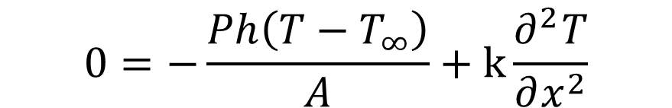
A 1-D Model of a Fin - 1
$$T_{0}$$
$$T_{∞}$$
Heat generation in an element in this instance is negative - the loss by convection:
$$ΩAδx=−Pδxh\left(T−T_{∞}\right)$$
Steady-state heat equation becomes
$$δx$$
P
A
$$T_{∞}$$
$$x$$
$$T_{∞}$$
$$0=−\frac{Ph\left(T−T_{∞}\right)}{A}+k\frac{∂^{2}T}{∂x^{2}}$$
cf. Holman (1981)

Slide 17
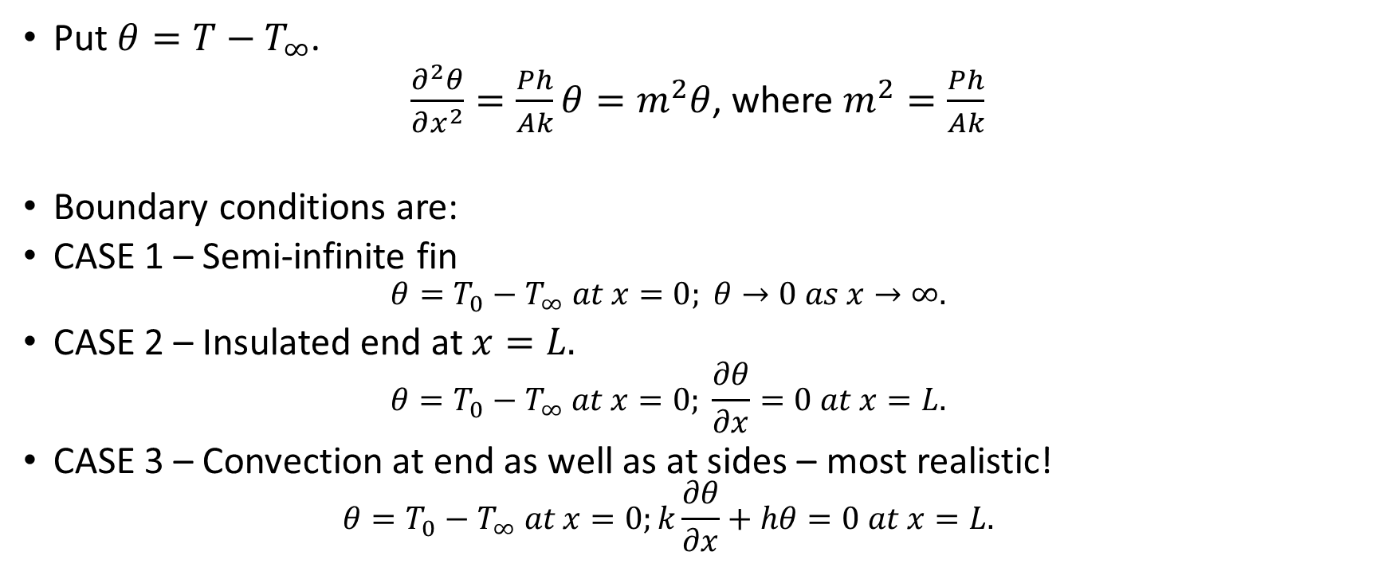
1-D Model of a Fin - 2
Put $θ=T−T_{∞}$.
$\frac{∂^{2}θ}{∂x^{2}}=\frac{Ph}{Ak}θ=m^{2}θ$, where $m^{2}=\frac{Ph}{Ak}$
Boundary conditions are:
CASE 1 – Semi-infinite fin
  $$θ=T_{0}−T_{∞} at x=0; θ→0 as x→∞.$$
CASE 2 – Insulated end at $x=L.$
  $$θ=T_{0}−T_{∞} at x=0; \frac{∂θ}{∂x}=0 at x=L.$$
CASE 3 – Convection at end as well as at sides – most realistic!
  $$θ=T_{0}−T_{∞} at x=0;k\frac{∂θ}{∂x}+hθ=0 at x=L.$$

Slide 18

1-D Model of a Fin - 3
General Solution
$$θ=C_{1}e^{−mx}+C_{2}e^{mx}$$
CASE 1
$$\frac{θ}{θ_{0}}=\frac{T−T_{∞}}{T_{0}−T_{∞}}{=e}^{−mx}$$
CASE 2
  B.c. give:
  $$C_{1}+C_{2}=θ_{0}$$
  $$−mC_{1}e^{−mL}+mC_{2}e^{mL}=0$$

Slide 19
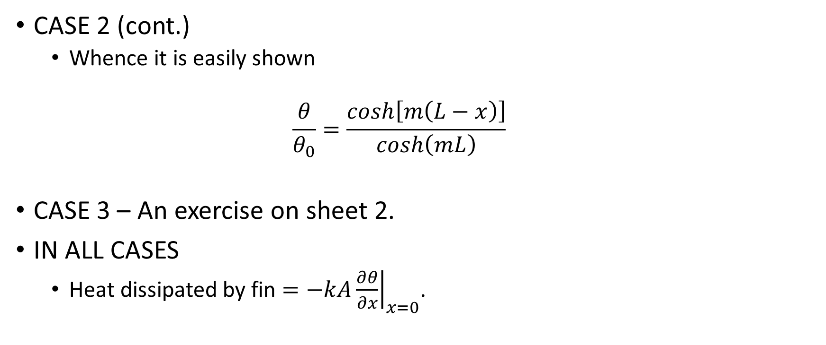
1-D Model of a Fin - 4
CASE 2 (cont.)
  Whence it is easily shown
  $$\frac{θ}{θ_{0}}=\frac{cosh\left[m\left(L−x\right)\right]}{cosh\left(mL\right)}$$
CASE 3 – An exercise on sheet 2.
IN ALL CASES
  Heat dissipated by fin $={\left.−kA\frac{∂θ}{∂x}\right|}_{x=0}$.

Slide 20
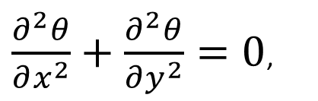

2-D Steady-State – A Special Solution - 1
No internal heat generation
Seek solution
$$θ=X\left(x\right)Y\left(y\right)$$
$\frac{∂^{2}θ}{∂x^{2}}+\frac{∂^{2}θ}{∂y^{2}}=0$,

Slide 21
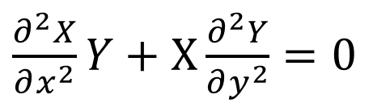

2-D Steady-State –Special Solutions - 1
Separation of variables
$$\frac{\frac{∂^{2}X}{∂x^{2}}}{X}=−\frac{\frac{∂^{2}Y}{∂y^{2}}}{Y}= {±Μ}^{2}$$
Solution for $M=0$
$X=cx+d, Y=ey+f, θ=\left(cx+d\right)\left(ey+f\right)$
$\frac{∂^{2}X}{∂x^{2}}Y+$ $X\frac{∂^{2}Y}{∂y^{2}}=0$

Slide 22
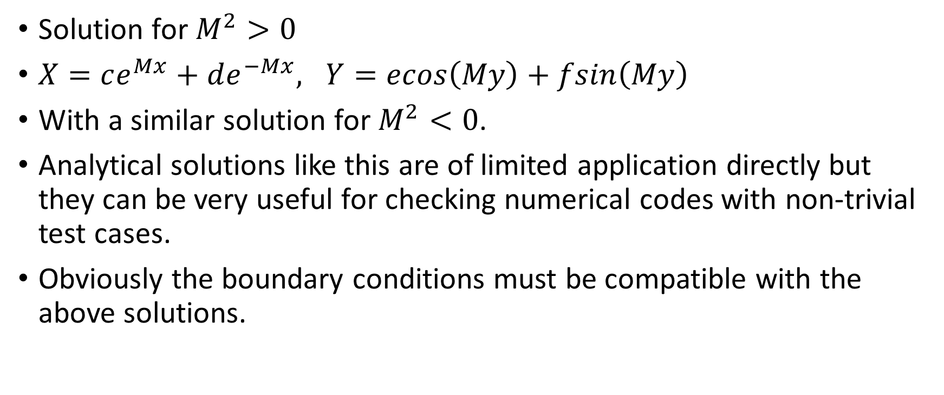
2-D Steady-State –Special Solutions - 2
Solution for $M^{2}>0$
$X=ce^{Mx}+de^{−Mx}, Y=ecos\left(My\right)+fsin\left(My\right)$
With a similar solution for $M^{2}<0$.
Analytical solutions like this are of limited application directly but they can be very useful for checking numerical codes with non-trivial test cases.
Obviously the boundary conditions must be compatible with the above solutions.

Slide 23



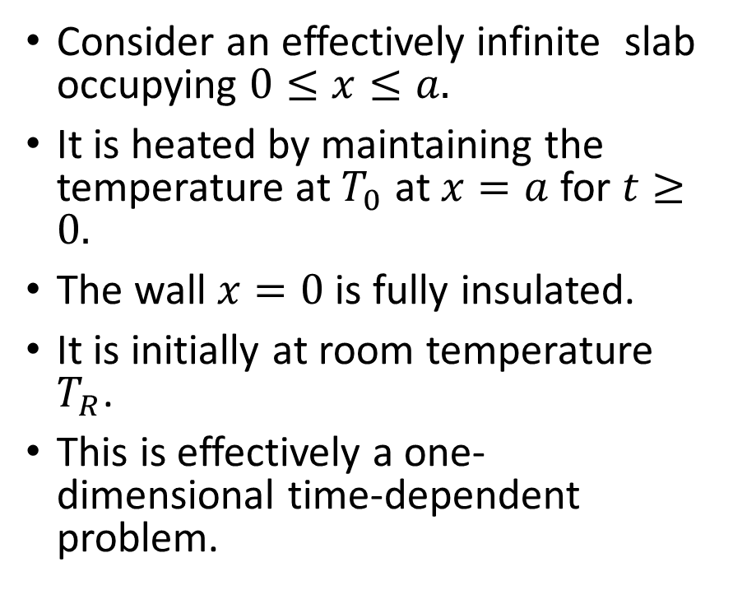




Time-Dependent Heat Conduction – The Slab -1
Consider an effectively infinite slab occupying $0≤x≤a.$
It is heated by maintaining the temperature at $T_{0}$ at $x=a$ for $t≥0.$
The wall $x=0$ is fully insulated.
It is initially at room temperature $T_{R}$.
This is effectively a one-dimensional time-dependent problem.
$T_{R} at t=0$
$$−k\frac{∂T}{∂x}=0$$
$$T_{0}$$
$$x$$
$$ρC_{V}\frac{∂T}{∂t}=k\frac{∂^{2}T}{∂x^{2}}$$
$$x=0$$
$$x=a$$

Slide 24
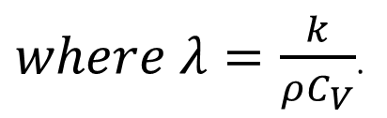
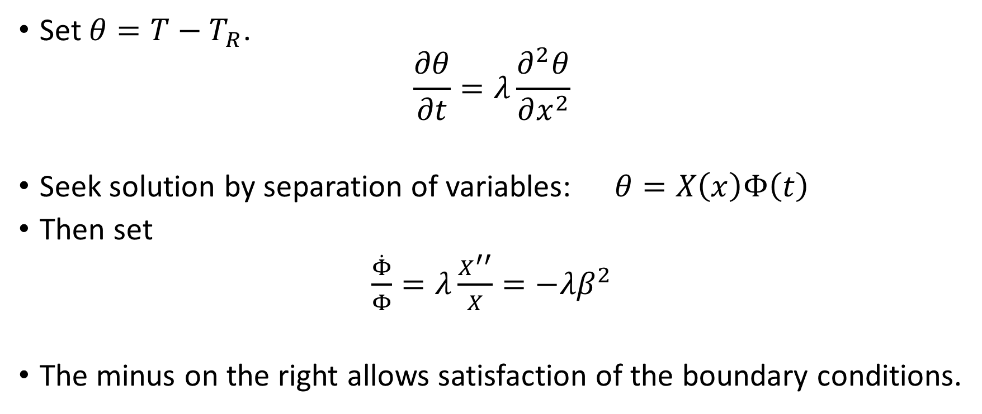
The Slab - 2
Set $θ=T−T_{R}$.
$$\frac{∂θ}{∂t}=λ\frac{∂^{2}θ}{∂x^{2}}$$
Seek solution by separation of variables:$θ=X\left(x\right)Φ\left(t\right)$
Then set
$\frac{\dot{Φ}}{Φ}=λ\frac{X^{′′}}{X}={−λβ}^{2}$
The minus on the right allows satisfaction of the boundary conditions.
$where λ=\frac{k}{ρC_{V}}$.

Slide 25
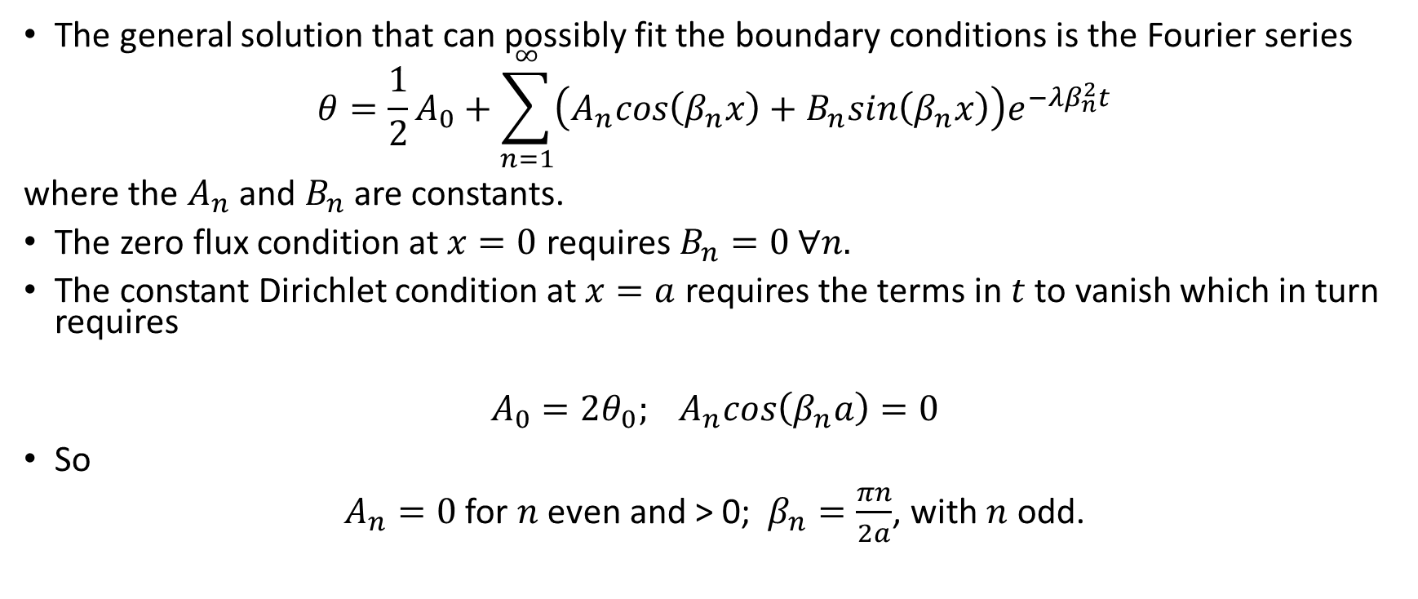
The Slab – 4
The general solution that can possibly fit the boundary conditions is the Fourier series
$$θ=\frac{1}{2}A_{0}+\sum_{n=1}^{∞}{\left(A_{n}cos\left(β_{n}x\right)+B_{n}sin\left(β_{n}x\right)\right)e^{−λβ_{n}^{2}t}}$$
where the $A_{n}$ and $B_{n}$ are constants.
The zero flux condition at $x=0$ requires $B_{n}=0 ∀n.$
The constant Dirichlet condition at $x=a$ requires the terms in $t$ to vanish which in turn requires
$$A_{0}={2θ_{0}; A}_{n}cos\left(β_{n}a\right)=0$$
So
$A_{n}=0$ for $n$ even and > 0; $β_{n}=\frac{πn}{2a}$, with $n$ odd.

Slide 26
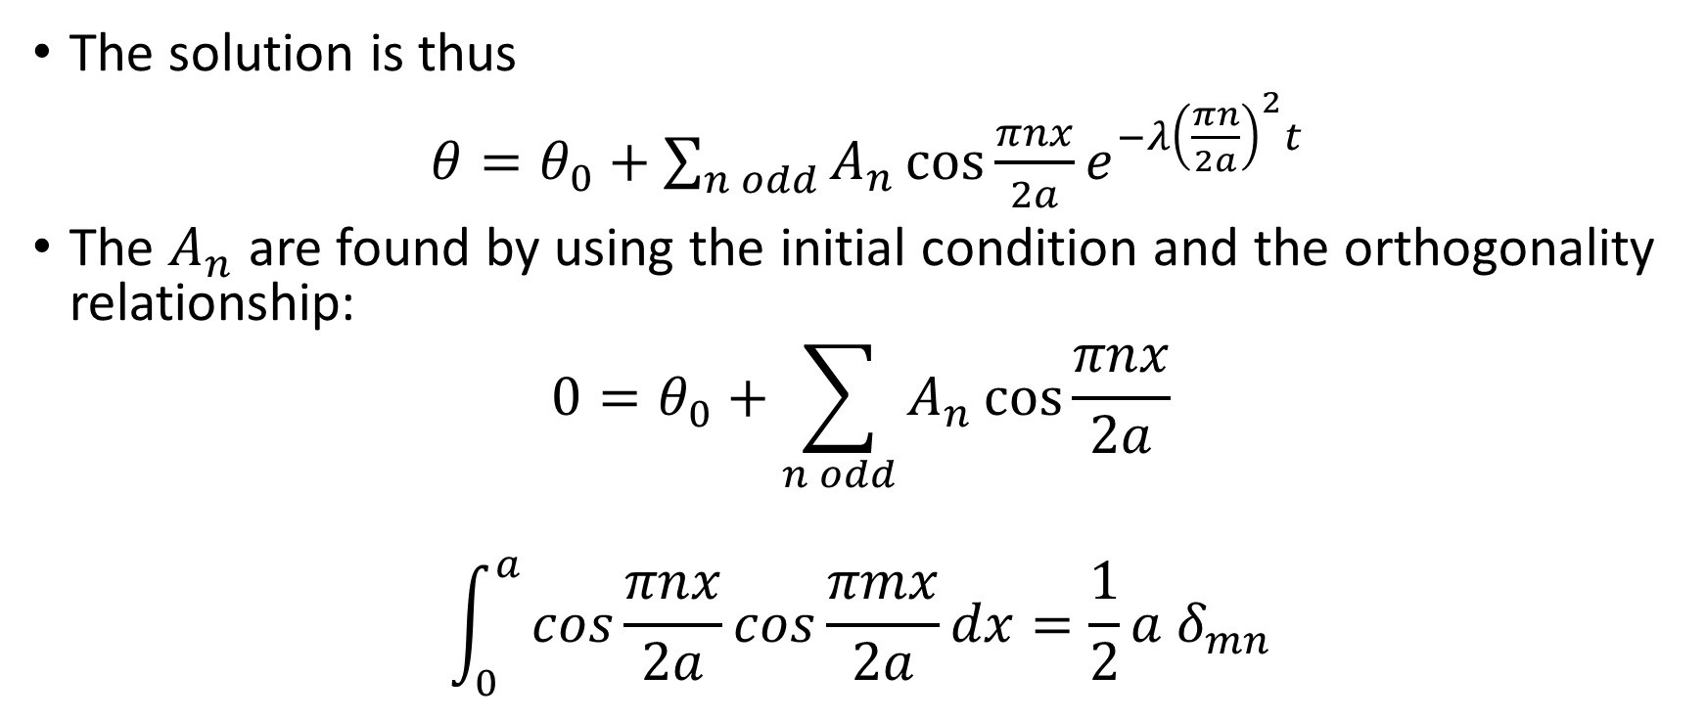
The Slab – 5
The solution is thus
$θ=θ_{0}+\sum_{n odd}{A_{n}\cos{\frac{πnx}{2a}e^{−λ{\left(\frac{πn}{2a}\right)}^{2}t}}}$
The $A_{n}$ are found by using the initial condition and the orthogonality relationship:
$$0=θ_{0}+\sum_{n odd}{A_{n}\cos{\frac{πnx}{2a}}}$$
$$\int_{0}^{a}{cos\frac{πnx}{2a}cos\frac{πmx}{2a}}dx={\frac{1}{2}a δ}_{mn}$$

Slide 27

The Slab – 6
$$A_{n}=\frac{−4θ_{0}}{πn}sin\left(\frac{πn}{2}\right)$$
The full solution is thus
$$θ=θ_{0}\left\{1−\frac{4}{π}\sum_{n odd}{\frac{1}{n}\sin{\frac{πn}{2}cos\left(\frac{πnx}{2a}\right)e^{−λ{\left(\frac{πn}{2a}\right)}^{2}t}}}\right\}$$

Slide 28




The Slab - 7
Carslaw and Jaeger gives this solution and show how the temperature as a function of $x$evolves with time.
The figure shows the evolution schematically.
Actual calculation for another case in a moment.
$$θ$$
TIME
$$x$$
0
$$a$$

Slide 29
Heat Conduction
THE Book is Carslaw and Jaeger, which gives a host of solutions for different geometries and boundary conditions (including the slab problem we have just done).
Astonishingly the solutions were undertaken by hand calculation – probably using mechanical adding machines.
The special solutions presented in such detail remain a permanent means of validating today’s numerical codes – I have used the book for just this purpose for a spherically symmetric problem (to come)

Slide 30
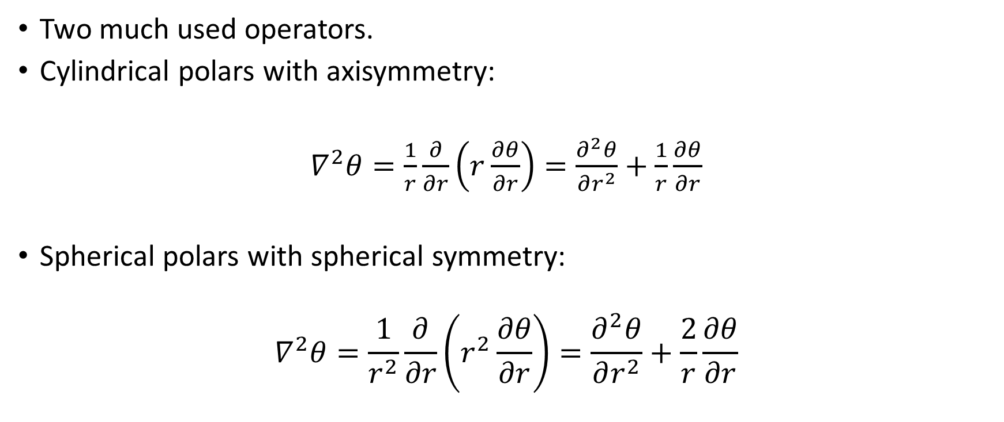
Cylindrical and Spherical Polars with Symmetry
Two much used operators.
Cylindrical polars with axisymmetry:
$∇^{2}θ=\frac{1}{r}\frac{∂}{∂r}\left(r\frac{∂θ}{∂r}\right)=\frac{∂^{2}θ}{∂r^{2}}+\frac{1}{r}\frac{∂θ}{∂r}$
Spherical polars with spherical symmetry:
$$∇^{2}θ=\frac{1}{r^{2}}\frac{∂}{∂r}\left(r^{2}\frac{∂θ}{∂r}\right)=\frac{∂^{2}θ}{∂r^{2}}+\frac{2}{r}\frac{∂θ}{∂r}$$

Slide 31
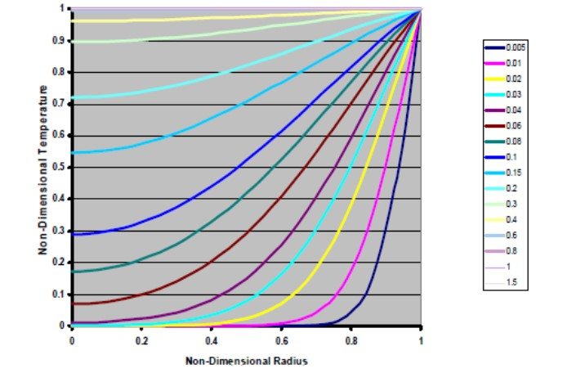
Heating of Sphere from Room Temperature by Applying Higher Temperature at Surface
This is the example I have used myself in developing a model of the reaction of a sphere of explosive whose surface is held at a fixed temperature.
Carslaw and Jaeger plot non-dimensional temperature against non-dimensional radius at non-dimensional times.
Solution is essentially the same for any material, any imposed temperature!
There is an analogous solution for a cylinder.

Slide 32
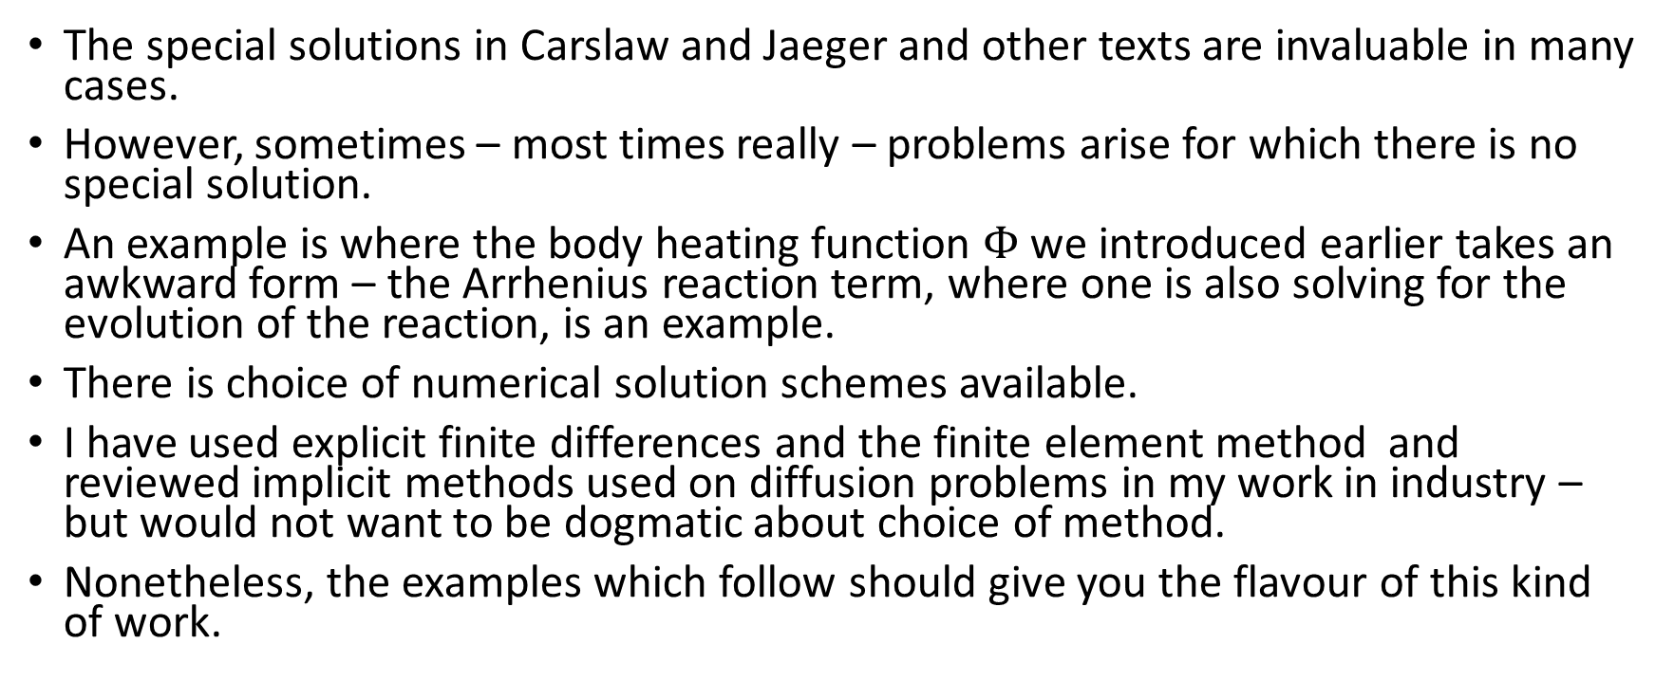
Finite Difference Schemes for the Diffusion Equation.
The special solutions in Carslaw and Jaeger and other texts are invaluable in many cases.
However, sometimes – most times really – problems arise for which there is no special solution.
An example is where the body heating function $Φ$ we introduced earlier takes an awkward form – the Arrhenius reaction term, where one is also solving for the evolution of the reaction, is an example.
There is choice of numerical solution schemes available.
I have used explicit finite differences and the finite element method and reviewed implicit methods used on diffusion problems in my work in industry – but would not want to be dogmatic about choice of method.
Nonetheless, the examples which follow should give you the flavour of this kind of work.

Slide 33
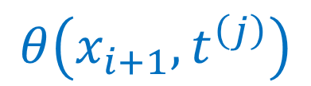

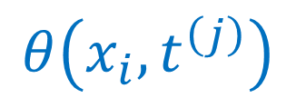
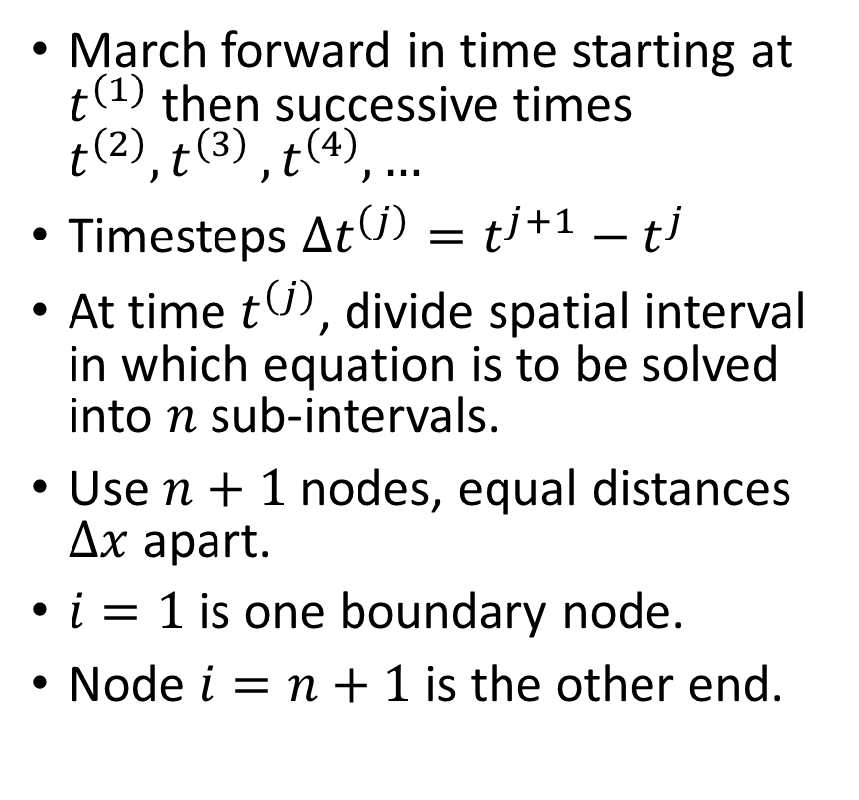
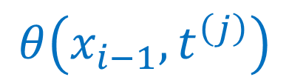





Finite Difference Scheme - 1-D - 1
March forward in time starting at $t^{\left(1\right)}$ then successive times $t^{\left(2\right)}{,t}^{\left(3\right)},t^{\left(4\right)},…$
Timesteps ${Δt}^{\left(j\right)}=t^{j+1}−t^{j}$
At time $t^{\left(j\right)}$, divide spatial interval in which equation is to be solved into $n$ sub-intervals.
Use $n+1$ nodes, equal distances $Δx$ apart.
$i=1$ is one boundary node.
Node $i=n+1$ is the other end.
$$θ\left(x_{i−1},t^{\left(j\right)}\right)$$
$$θ\left(x_{i},t^{\left(j\right)}\right)$$
$$θ\left(x_{i+1},t^{\left(j\right)}\right)$$
$$x$$
$$Δx$$
$$Δx$$
$$x_{i−1}$$
$$x_{i}$$
$$x_{i+1}$$

Slide 34
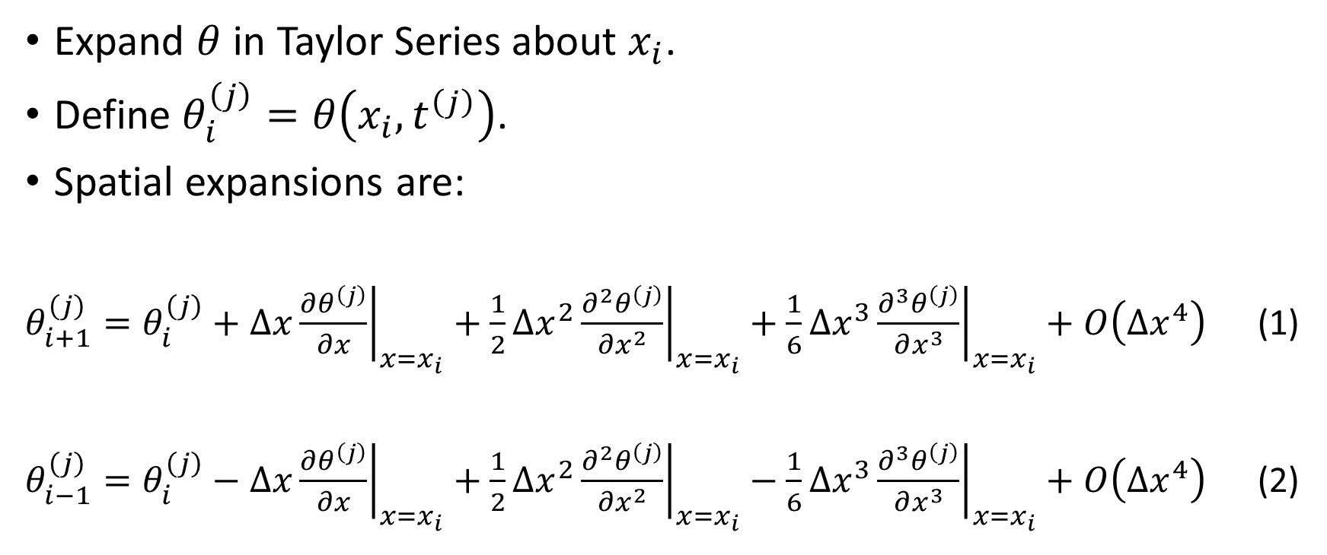
Finite Difference Scheme - 1-D - 2
Expand $θ$ in Taylor Series about $x_{i}$.
Define $θ_{i}^{\left(j\right)}=θ\left(x_{i},t^{\left(j\right)}\right)$.
Spatial expansions are:
$θ_{i+1}^{\left(j\right)}=θ_{i}^{\left(j\right)}+∆x{\left.\frac{∂θ^{\left(j\right)}}{∂x}\right|}_{x=x_{i}}+\frac{1}{2}{\left.{∆x}^{2}\frac{∂^{2}θ^{\left(j\right)}}{∂x^{2}}\right|}_{x=x_{i}}+\frac{1}{6}{\left.{∆x}^{3}\frac{∂^{3}θ^{\left(j\right)}}{∂x^{3}}\right|}_{x=x_{i}}+O\left({∆x}^{4}\right)$ (1)
$θ_{i−1}^{\left(j\right)}=θ_{i}^{\left(j\right)}−∆x{\left.\frac{∂θ^{\left(j\right)}}{∂x}\right|}_{x=x_{i}}+\frac{1}{2}{\left.{∆x}^{2}\frac{∂^{2}θ^{\left(j\right)}}{∂x^{2}}\right|}_{x=x_{i}}−\frac{1}{6}{\left.{∆x}^{3}\frac{∂^{3}θ^{\left(j\right)}}{∂x^{3}}\right|}_{x=x_{i}}+O\left({∆x}^{4}\right)$ (2)

Slide 35
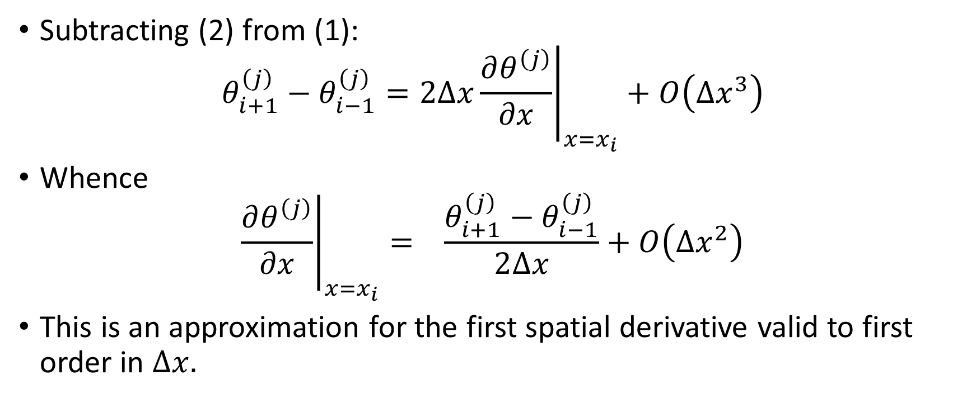
Finite Difference Scheme - 1-D - 3
Subtracting (2) from (1):
$$θ_{i+1}^{\left(j\right)}−θ_{i−1}^{\left(j\right)}=2∆x{\left.\frac{∂θ^{\left(j\right)}}{∂x}\right|}_{x=x_{i}}+O\left({∆x}^{3}\right)$$
Whence
$${\left.\frac{∂θ^{\left(j\right)}}{∂x}\right|}_{x=x_{i}}= \frac{θ_{i+1}^{\left(j\right)}−θ_{i−1}^{\left(j\right)}}{2∆x}+O\left({∆x}^{2}\right)$$
This is an approximation for the first spatial derivative valid to first order in $∆x.$

Slide 36

Finite Difference Scheme - 1-D - 4
Adding (1) to (2), we get:
$$θ_{i+1}^{\left(j\right)}+θ_{i−1}^{\left(j\right)}=2θ_{i}^{\left(j\right)}+{\left.{∆x}^{2}\frac{∂^{2}θ^{\left(j\right)}}{∂x^{2}}\right|}_{x=x_{i}}+O\left({∆x}^{4}\right)$$
Whence
$${\left.\frac{∂^{2}θ^{\left(j\right)}}{∂x^{2}}\right|}_{x=x_{i}}=\frac{θ_{i+1}^{\left(j\right)}−2θ_{i}^{\left(j\right)}+θ_{i−1}^{\left(j\right)}}{{∆x}^{2}}+O\left({∆x}^{2}\right)$$
This is an approximation for the second spatial derivative also valid to first order in $∆x.$

Slide 37

Finite Difference Scheme - 1-D - 5
Expand $θ$ in Taylor Series about $t^{\left(j\right)}$.
$θ_{i}^{\left(j+1\right)}=θ_{i}^{\left(j\right)}+∆t{\left.\frac{∂θ^{\left(j\right)}}{∂t}\right|}_{t=t^{\left(j\right)}}+O\left({∆t}^{2}\right)$ (3)
$θ_{i}^{\left(j−1\right)}=θ_{i}^{\left(j\right)}−∆t{\left.\frac{∂θ^{\left(j\right)}}{∂t}\right|}_{t=t^{\left(j\right)}}+O\left({∆t}^{2}\right)$ (4)
It is not uncommon to use the zero-th order approximation for the first derivative in time:

Slide 38

Finite Difference Scheme - 1-D - 6
$${\left.\frac{∂θ^{\left(j\right)}}{∂t}\right|}_{t=t^{\left(1\right)}}=\frac{θ_{i}^{\left(j+1\right)}− θ_{i}^{\left(j\right)}}{∆t}+O\left(∆t\right)$$
This seems odd given that it is not too difficult to set up a Runge-Kutta scheme to higher accuracy.
Anyway the most common explicit discretisation of the one-dimensional heat equation resulting is:
$ρC_{V}\left(\frac{θ_{i}^{\left(j+1\right)}− θ_{i}^{\left(j\right)}}{∆t}\right)=$ $k\left(\frac{θ_{i+1}^{\left(j\right)}−2θ_{i}^{\left(j\right)}+θ_{i−1}^{\left(j\right)}}{{∆x}^{2}}\right)$
Ozisik is a good readable reference. It gives a proof that for stability of this scheme $\frac{ρC_{V}{∆x}^{2}}{k∆t}≥2,$ i.e. $∆t$ must be kept small enough.
The wise user checks for convergence by reducing his or her time-steps and checking the results are sufficiently close.

Slide 39


Finite Difference Scheme - 1-D - 7
A common alternative is the so-called implicit or backward difference method.
This method exhibits very great stability even for much larger time-steps, at cost of requiring matrix inversion to find the values at time $t^{j+1}$.
Note the user still needs to check for convergence of his or her result – stability does not always imply accuracy.
Other hybrid methods interpolate linearly between the fully explicit and fully implicit methods – I have never tried these.
$ρC_{V}\left(\frac{θ_{i}^{\left(j+1\right)}− θ_{i}^{\left(j\right)}}{∆t}\right)=$ $k\left(\frac{θ_{i+1}^{\left(j+1\right)}−2θ_{i}^{\left(j+1\right)}+θ_{i−1}^{\left(j+1\right)}}{{∆x}^{2}}\right)$

Slide 40

Finite Difference Scheme - 1-D - 8
Different approximations to flux boundary condition at e.g. node 1
$$\frac{∂θ}{∂x}=ψ$$
Zero-th order:
$${\left.\frac{∂θ}{∂x}\right|}_{x=x_{1}}=\frac{θ_{2}^{\left(j\right)}−θ_{1}^{\left(j\right)}}{Δx}$$
First order:
$${\left.\frac{∂θ}{∂x}\right|}_{x=x_{1}}=\frac{{4θ}_{2}^{\left(j\right)}−{3θ}_{1}^{\left(j\right)}−θ_{3}^{\left(j\right)}}{2Δx}$$

Slide 41

Symmetric Spherical Polar Schemes
Explicit scheme:
$ρC_{V}\left(\frac{θ_{i}^{\left(j+1\right)}− θ_{i}^{\left(j\right)}}{∆t}\right)=$ $k\left\{\left(\frac{θ_{i+1}^{\left(j\right)}−2θ_{i}^{\left(j\right)}+θ_{i−1}^{\left(j\right)}}{{∆r}^{2}}\right)+\left(\frac{θ_{i+1}^{\left(j\right)}−θ_{i−1}^{\left(j\right)}}{r_{i}Δr}\right)\right\}$
Here $r_{i}$ is the $i$-th radial node, with $i=1$ at the centre.
The corresponding implicit scheme is:
$ρC_{V}\left(\frac{θ_{i}^{\left(j+1\right)}− θ_{i}^{\left(j\right)}}{∆t}\right)=$ $k\left\{\left(\frac{θ_{i+1}^{\left(j+1\right)}−2θ_{i}^{\left(j+1\right)}+θ_{i−1}^{\left(j+1\right)}}{{∆r}^{2}}\right)+\left(\frac{θ_{i+1}^{\left(j+1\right)}−θ_{i−1}^{\left(j+1\right)}}{r_{i}Δr}\right)\right\}$

Slide 42
Finite Differences – Some Drawbacks
If the geometry of the solution domain is not easily made coincident with the mesh then there is a need for special treatment at places where the boundary cuts across the mesh.
This kind of situation can lead to inaccuracies, because difference operators with unequal arms are needed to approximate the boundary conditions.
Coding becomes very messy – application of the boundary conditions can be very complicated, especially in 3-D.

Slide 43
The Finite Element Method (A Quick Look)
Approximate Boundary
Typical element
The finite element method can offer a convenient way of addressing such situations.
It divides the field in which the equations are to be solved into separate elements.
For 2-D these can be triangular as shown or quadrilateral.
For 3-D tetragonal or hexahedronal elements.
Sizes of elements may vary.
Irregular boundaries may be as closely approximated as desired by using sufficient elements.
Typical Node
Actual Boundary

Slide 44
Background
Originally applied as a non-rigorous method for structural problems.
Application to simple steady-state field problems (e.g. Laplace’s and Poisson’s equations) where variational extremum principles apply.
Piecewise polynomial approximation allowed use of the classical Rayleigh-Ritz Method for variational principles. We show an example of this.
Extended to other cases where no extremum principle applied by use of Galerkin’s and other weighted residual methods.
Applications now included time-dependent problems, such as the parabolic heat equation, Helmholtz’s equation for sound propagation, electromagnetic applications among many others.
Many mathematicians are now working on the theory and investigating extensions of it.

Slide 45
The Finite Element Method
I will give some motivation for it and show you some example applications I have done.
The introductory text by A. J. Davies is very good. The classic text is by the originator of the method, Zienkiewicz.
We will work with elements the same size but that does not have to be the case in many applications, where often only areas ‘where things are happening’ are finely meshed.
Review Calculus of Variations first and then present a simple example from heat conduction where a variational principle exists.
How this is formulated as a Finite Element problem – indication of the link to the structural method.
Then some material showing actual work with a Finite Element Package.

Slide 46

Calculus of Variations - 1
Minimise the functional:
$$I\left[u\right]=\int_{a}^{b}{F\left(x, u, u′\right)}dx$$
Subject to Dirichlet conditions: $u\left(a\right)=U_{A}, u\left(b\right)=U_{B}.$
Consider the variation about the minimum $u_{0 }$which satisfies these boundary conditions:
$u=u_{0}+εu_{1}+o\left(ε\right)$, where $ε$ is very small.
To first order in $ε,$
$$u_{0}\left(a\right)=U_{A}, { u}_{0}\left(b\right)=U_{B}, u_{1}\left(a\right)=u_{1}\left(b\right)=0.$$

Slide 47

Calculus of Variations - 2
$$I\left[u\right]=\int_{a}^{b}{F\left(x,u_{0}+εu_{1}+o\left(ε\right), u_{0}^{′}+εu_{1}^{′}+o\left(ε\right)\right)}$$
$=\int_{a}^{b}{\left\{F\left(x, u_{0}, u_{0}^{′}\right)+ε{u_{1}F}_{u_{0}}+εu_{1}^{′}F_{u_{0}^{′}}\right\}}dx+o\left(ε\right)$
Here
$$F_{u_{0}}={\left.\frac{∂F}{∂u}\right|}_{u=u_{0}},{ F}_{u_{0}^{′}}={\left.\frac{∂F}{∂u′}\right|}_{u=u_{0}}$$

Slide 48

Calculus of Variations - 3
Integrate third term by parts:
$$I\left[u\right]=I\left[u_{0}\right]+ε\int_{a}^{b}{u_{1}\left\{F_{u_{0}}−\frac{d}{dx}\left(F_{u_{0}^{′}}\right)\right\}dx+{\left[u_{1}F_{u_{0}^{′}}\right]}_{a}^{b}+o\left(ε\right)}$$
Arbitrariness of $u_{1}$ and the boundary conditions yield the Euler Equation:
$$F_{u_{0}}−\frac{d}{dx}\left(F_{u_{0}^{′}}\right)=0,$$
This to be solved subject to $u_{0}\left(a\right)=U_{A}, { u}_{0}\left(b\right)=U_{B}.$

Slide 49

Variational Principle for the Steady-State Heat Equation - 1
Set $u=θ,$ and define the functional
$I\left[θ\right]=k\int_{a}^{b}{θ^{′2}dx}$.
So $F\left(x, θ, θ^{′}\right)=θ^{′2}$.
The Euler Equation is
$−k\frac{d}{dx}\left(2θ_{0}^{′}\right)=0$,
Or
$k\frac{d^{2}θ}{dx^{2}}=0$.
This is to be solved subject to boundary conditions – we look at Dirichlet conditions
$$θ\left(a\right)=θ_{a}, θ\left(b\right)=θ_{b}.$$

Slide 50

Variational Principle for the Steady-State Heat Equation - 2
Proof that $I\left[θ\right]≥I\left[θ_{0}\right]$
$${θ^{′2}−2θ^{′}θ_{0}^{′}+θ}_{0}^{′2}≥0$$
$${{∴θ}^{′2}−θ}_{0}^{′2}−2\left(θ′−θ_{0}^{′}\right)θ_{0}^{′}≥0$$
$$∴\int_{a}^{b}{{θ′}^{2}dx−\int_{a}^{b}{θ_{0}^{′2}dx−2\int_{a}^{b}{\left(θ^{′}−θ_{0}^{′}\right)}θ_{0}^{′}dx≥0}}$$
$$∴I\left[θ\right]−I\left[θ_{0}\right]−2{\left[\left(θ−θ_{0}\right)θ_{0}^{′}\right]}_{a}^{b}+2\int_{a}^{b}{\left(θ−θ_{0}\right)θ_{0}^{′′}dx≥0}$$
Since $θ\left(b\right)−θ_{0}\left(b\right)=θ\left(a\right)−θ_{0}\left(a\right)=$0 and${ θ}_{0}^{′′}=0$ the result follows.

Slide 51

Finite Element Formulation - 1
Divide interval $\left[a, b\right]$into $n$ elements with (for now) $n+1$equally spaced nodes $h$ apart. So $nh=\left(b−a\right)$.
Let the $i−th$ node be at $x_{i}$.
For element $j$ from point A at $x_{j}$to point B at $x_{j+1}$ introduce the interpolating shape function row matrix
$N^{\left(j\right)}\left(ξ\right)=\left[{N_{A}^{\left(j\right)}\left(ξ\right), N}_{B}^{\left(j\right)}\left(ξ\right)\right]$,
with non-zero components defined by:
$$N_{A}^{\left(j\right)}\left(ξ\right)= \frac{1}{2}\left(1−ξ\right), N_{B}^{\left(j\right)}\left(ξ\right)=\frac{1}{2}\left(1+ξ\right), ξ=\frac{2}{h}\left[x−\frac{1}{2}\left(x_{j}+x_{j+1}\right)\right]$$
only for $−1≤ξ≤1.$

Slide 52

Finite Element Formulation - 2
Plainly $ξ=−1$ corresponds to A and $ξ=1$ corresponds to B.
In element $j$ we interpolate between the values of the trial function $θ$ we are putting into $I\left[θ\right]$ at A and B by writing
$θ^{\left(j\right)}\left(x\right)=N^{\left(j\right)} δ^{\left(j\right)}$,
where the analogues of the displacements in structural calculations are given by
$$δ^{(j)}=\left({θ_{A}^{\left(j\right)} \atop θ_{B}^{\left(j\right)}}\right)$$
We build a trial function $θ$ given by
$$θ=\sum_{j=1}^{n}{θ^{\left(j\right)}\left(x\right)}$$

Slide 53

Finite Element Formulation - 3
Put this into the functional to get
$$I\left[θ\right]=\int_{a}^{b}{{\left\{\sum_{j=1}^{n}{\left(\frac{dθ^{\left(j\right)}}{dx}\right)}\right\}}^{2}dx}$$
$$=\sum_{j=1}^{n}{\int_{x_{j}}^{x_{j+1}}{{\left(\frac{dθ^{\left(j\right)}}{dx}\right)}^{2}dx}}$$
because $θ^{\left(j\right)}$ is non-zero only in element $j.$

Slide 54

Finite Element Formulation - 4
Denoting $θ_{i}=θ\left(x_{i}\right)$ it follows that
$$θ_{A}^{\left(j\right)}=θ\left(x_{j}\right)=θ_{j},{ θ}_{B}^{\left(j\right)}=θ\left(x_{j+1}\right)=θ_{j+1}.$$
Thus
$I\left[θ\right]=\sum_{j=1}^{n}{\int_{x_{j}}^{x_{j+1}}{{\left(\frac{dN_{A}^{\left(j\right)}}{dx} θ_{j}+\frac{dN_{B}^{\left(j\right)}}{dx} θ_{j+1}\right)}^{2}dx}}$.
We know from the Dirichlet conditions that$θ_{1}=θ_{a}, θ_{n+1}=θ_{b}$ but that in the trial function the other values of the trial function $θ_{i}, i=2, 3, …n$ may be freely prescribed.
In this case the variational principle allows minimisation using the Rayleigh-Ritz method.
We know our solution is the minimum of $I\left[θ\right]$ so it must be at least a local minimum of minimising with respect to all the $θ_{i}$.

Slide 55

Finite Element Formulation - 5
Hence we solve
$$\frac{∂I\left[θ\right]}{∂θ_{i}}=0, i=2, 3,….n.$$
Only terms dependent on $θ_{i}$ are
$$\int_{x_{i−1}}^{x_{i}}{{\left(\frac{dN_{A}^{\left(i−1\right)}}{dx} θ_{i−1}+\frac{dN_{B}^{\left(i−1\right)}}{dx} θ_{i}\right)}^{2}dx}+\int_{x_{i}}^{x_{i+1}}{{\left(\frac{dN_{A}^{\left(i\right)}}{dx} θ_{i}+\frac{dN_{B}^{\left(i\right)}}{dx} θ_{i+1}\right)}^{2}dx}$$

Slide 56

Finite Element Formulation - 6
Hence
$$\int_{x_{i−1}}^{x_{i}}{2\left(\frac{dN_{A}^{\left(i−1\right)}}{dx} θ_{i−1}+\frac{dN_{B}^{\left(i−1\right)}}{dx} θ_{i}\right)\frac{dN_{B}^{\left(i−1\right)}}{dx}dx}+\int_{x_{i}}^{x_{i+1}}{2\left(\frac{dN_{A}^{\left(i\right)}}{dx} θ_{i}+\frac{dN_{B}^{\left(i\right)}}{dx} θ_{i+1}\right)\frac{dN_{A}^{\left(i\right)}}{dx}dx=0, i=2, 3,…n}.$$
Or
$k_{AB}^{\left(i−1\right)}θ_{i−1}+\left(k_{BB}^{(i−1)}+k_{AA}^{\left(i\right)}\right)θ_{i}+k_{BA}^{\left(i\right)}θ_{i+1}=0, i=2, 3,…n,$ (*)
where
$k_{CD}^{\left(j\right)}=\int_{x_{j}}^{x_{j+1}}{\left(\frac{dN_{C}^{\left(j\right)}}{dx} \frac{dN_{D}^{\left(j\right)}}{dx} \right)dx=0, j=1, 2, 3,…n;C,D=A,B}$.

Slide 57

Finite Element Formulation - 7
Equations (*) together are of the form of a structural stiffness matrix K times the displacement vector $θ$ equals a loading F, here in this very simple case the zero vector
K $θ$ = F = 0.
The link of the method to structural analysis is thereby shown.
For the simple linear shape functions
$\frac{dN_{A}^{\left(i\right)}}{dx}$ = $\frac{dN_{A}^{\left(i\right)}}{dξ}\frac{dξ}{dx}=\left(−\frac{1}{2}\right)\left(\frac{2}{h}\right)=−\frac{1}{h}$
$\frac{dN_{B}^{\left(i\right)}}{dx}$ = $\frac{dN_{B}^{\left(i\right)}}{dξ}\frac{dξ}{dx}=\left(\frac{1}{2}\right)\left(\frac{2}{h}\right)=\frac{1}{h}$

Slide 58

Finite Element Formulation - 8
In (*) we therefore have
$$k_{AB}^{\left(i−1\right)}=−\frac{1}{h},{ k}_{BB}^{\left(i−1\right)}=\frac{1}{h},k_{AA}^{\left(i\right)}=\frac{1}{h},k_{BA}^{\left(i\right)}=−\frac{1}{h}.$$
And after manipulation(*) reduces to
$$\frac{θ_{i−1}−2θ_{i}+θ_{i+1}}{h^{2}}=0, i=2, 3,…n.$$
This is simply the finite difference scheme for the Laplacian we saw earlier – arrived at by quite different method.

Slide 59
Finite Element Packages
Most industrial usage of the method is in applying established commercial packages which offer helpful mesh generation and graphics post-processing – writing one’s own scheme would take far too long for industry to pay. One important code has something like 600 man years of development invested in it!
New developments once proven will tend to be included in one of the packages. But something powerful and new could break into niche areas of the market.
LS-Dyna is one I have used quite extensively. Others include NASTRAN, ANYSYS, COMSOL, FlexPDE, FLUENT for fluid dynamics etc.

