Slide 1
Methods of Industrial Mathematics
Extended LTCC Advanced Course – Feb-Mar 2018
John Curtis, UCL Mathematics Department
© British Crown Owned Copyright 2018/AWE.

Slide 2
Session 1
A personal overview of where mathematics is applied in industry.
Some problems of applied dynamics resulting in ordinary differential equations.
Solution by explicit Runge-Kutta methods.
Modelling friction.

Slide 3
Industrial Mathematics Encountered by JC
ELECTROMAGNETIC THEORY
MECHANICS
HEAT TRANSFER
APPLIED PHYSICS
CONTROL THEORY
INDUSTRIAL MATHEMATICS USED BY JC
SIGNAL PROCESSING
SIMULATION
ENGINEERING
STATISTICS
NUMERICAL ANALYSIS
CHEMISTRY
PROBABILITY
OPTIMISATION
Arrows join most of the above subjects
N.B. No attempt at definitive list of Industrial Mathematics , e.g. Image Processing, Big Data, Formal Methods, Financial Mathematics are missing.

Slide 4
Hilbert
Space

Slide 5
Mechanics Applications
Dynamics of rigid bodies as applied to spacecraft
Vehicle Dynamics and Flow
Mechanics of solids, including plastic flow of jets as applied in oil well perforators
Continuum and fluid mechanics:
  Jet formation
  Jet dynamics and break-up
  Jet penetration
  Impact and resulting deformation including shocks
  Explosive safety applications including fragmentation

Slide 6
Heat Transfer and Diffusion Applications
Conduction in, and reaction of, explosives
Minimisation of heat loss
Diffusion modelling

Slide 7
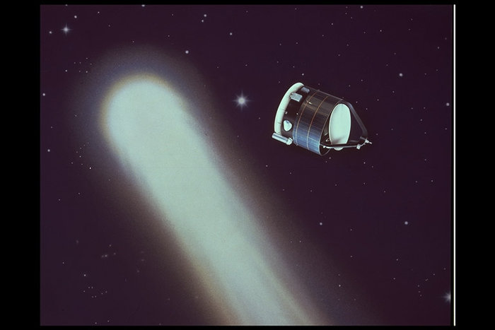
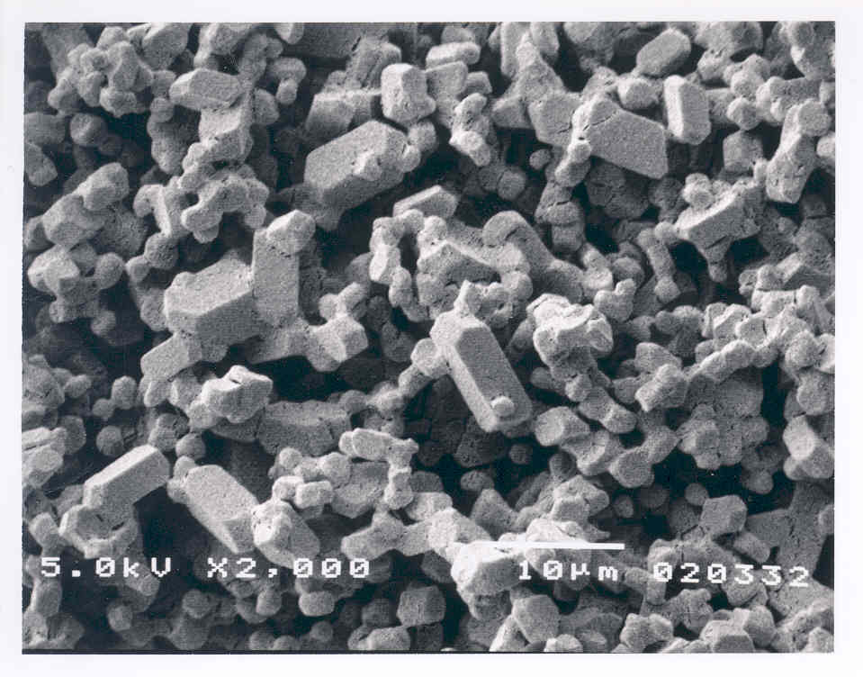
Simulation Examples
Spacecraft mission modelling
Mechanics – oil well perforators
Chemical reactions
Ageing of powders
Traffic modelling
Staff Modelling
Top Dog
Manager 1
Minion 1
Minion 2
Manager 2
Minion 3
The CEO
Middle Management
Workers

Slide 8
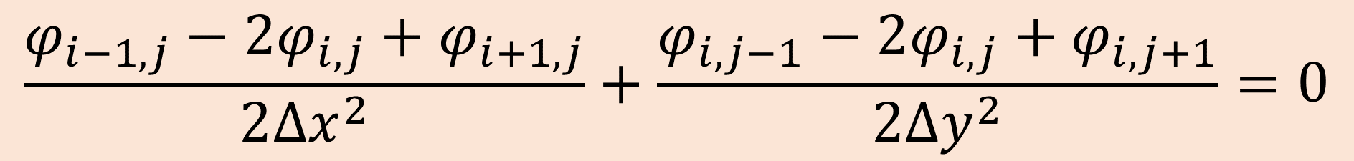
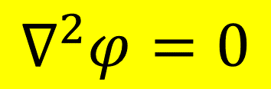
Numerical Modelling
Nonlinear ODEs
Finite difference methods for boundary-value problems
The finite element method
$$∇^{2}φ=0$$
$$\frac{φ_{i−1,j}−2φ_{i,j}+φ_{i+1,j}}{2{∆x}^{2}}+\frac{φ_{i,j−1}−2φ_{i,j}+φ_{i,j+1}}{2{∆y}^{2}}=0$$

Slide 9
Optimisation
Optimisation of speed, momentum and energy of an explosively projected plate.
Minimisation of heat loss
Maintaining orthogonality of axes

Slide 10







Spacecraft Dynamics
Frame Definitions
Simplest satellite is a rigid body.
Let the c. of g. be at position $x=\left\{x_{1},x_{2},x_{3}\right\}$in fixed co-ordinates.
Let $\left\{x_{1}^{′},x_{2}^{′},x_{3}^{′}\right\}$ be body-fixed (i.e. translating and rotating) co-ordinates.
$$x_{3}^{′}$$
$$x_{3}$$
$$x_{2}$$
$$x_{2}^{′}$$
$$x_{1}^{′}$$
$$x_{1}$$

Slide 11
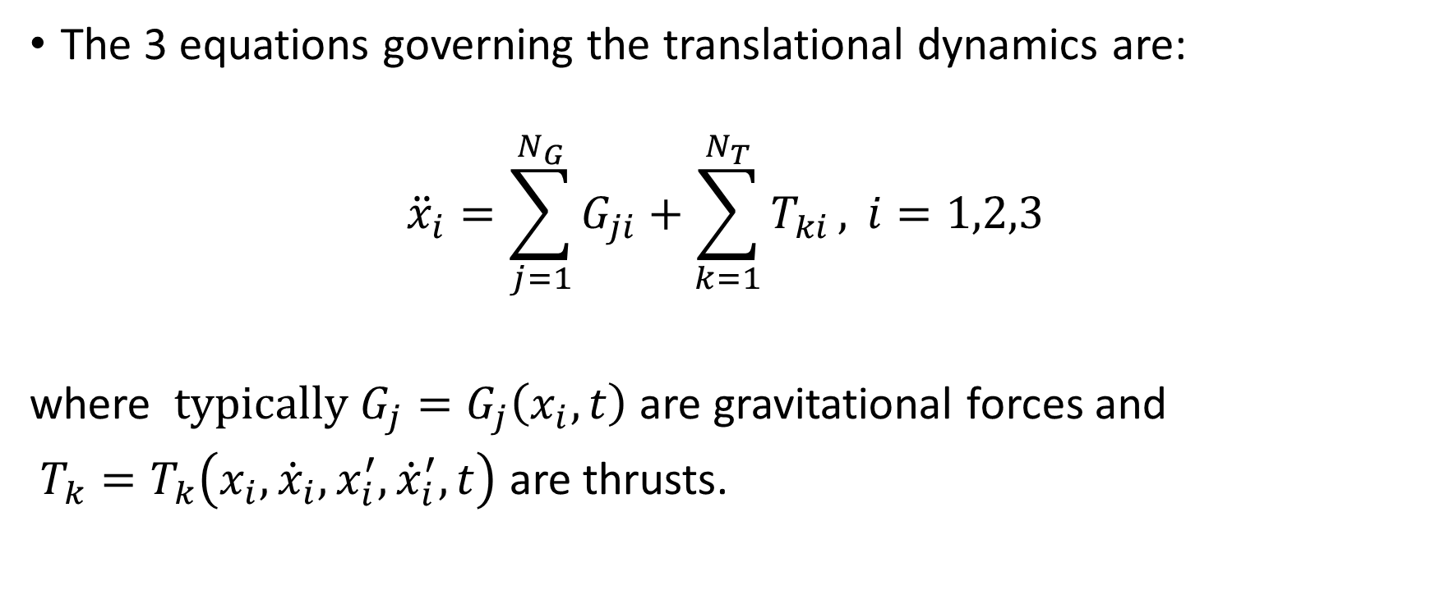
Translation
The 3 equations governing the translational dynamics are:
$${\ddot{x}}_{i}=\sum_{j=1}^{N_{G}}{G_{ji}+\sum_{k=1}^{N_{T}}{T_{ki}}, }i=1,2,3$$
where $typically G_{j}=G_{j}\left(x_{i}, t\right)$ are gravitational forces and
$T_{k}=T_{k}\left(x_{i},{\dot{x}}_{i}, x_{i}^{′},{\dot{x}}_{i}^{′},t\right)$ are thrusts.

Slide 12
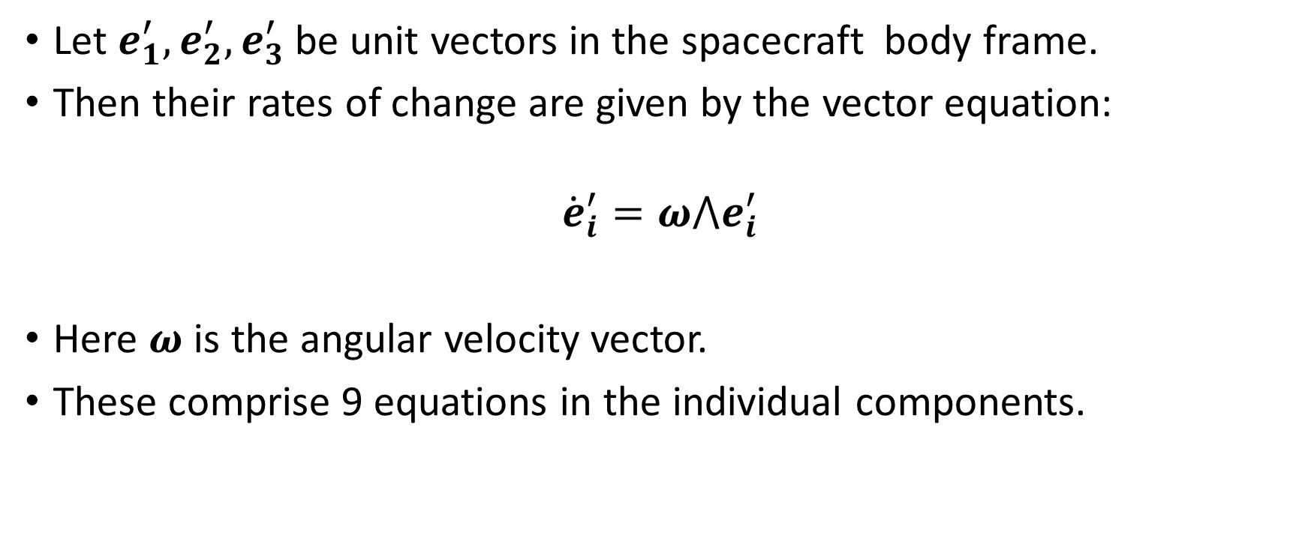
Body Frame Rotation
Let $e_{1}^{′},e_{2}^{′},e_{3}^{′}$ be unit vectors in the spacecraft body frame.
Then their rates of change are given by the vector equation:
$${\dot{e}}_{i}^{′}=ω⋀e_{i}^{′}$$
Here $ω$ is the angular velocity vector.
These comprise 9 equations in the individual components.

Slide 13
Spacecraft Dynamics – Angular Momentum
The equations of angular momentum govern the rotation of the spacecraft.
These are the Euler equations – traditionally introduced in modelling the spinning top. [There is much theory on this – cf. Goldstein for a comprehensive treatment]
It is convenient to make the spacecraft fixed axes coincident with the principal axes of inertia so that the inertia tensor is diagonalized.
Under these circumstances the Euler equations simplify to the following:

Slide 14
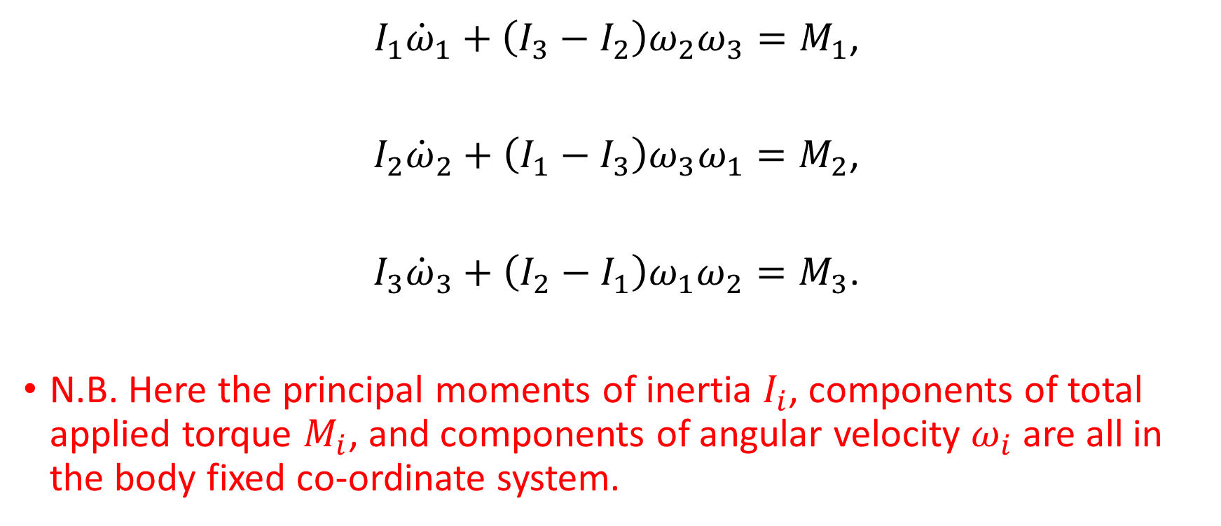
Euler Equations
$I_{1}{\dot{ω}}_{1}+\left(I_{3}−I_{2}\right)ω_{2}ω_{3}=M_{1}$,
$I_{2}{\dot{ω}}_{2}+\left(I_{1}−I_{3}\right)ω_{3}ω_{1}=M_{2}$,
$I_{3}{\dot{ω}}_{3}+\left(I_{2}−I_{1}\right)ω_{1}ω_{2}=M_{3}$.
N.B. Here the principal moments of inertia $I_{i}$, components of total applied torque $M_{i}$, and components of angular velocity $ω_{i}$ are all in the body fixed co-ordinate system.

Slide 15
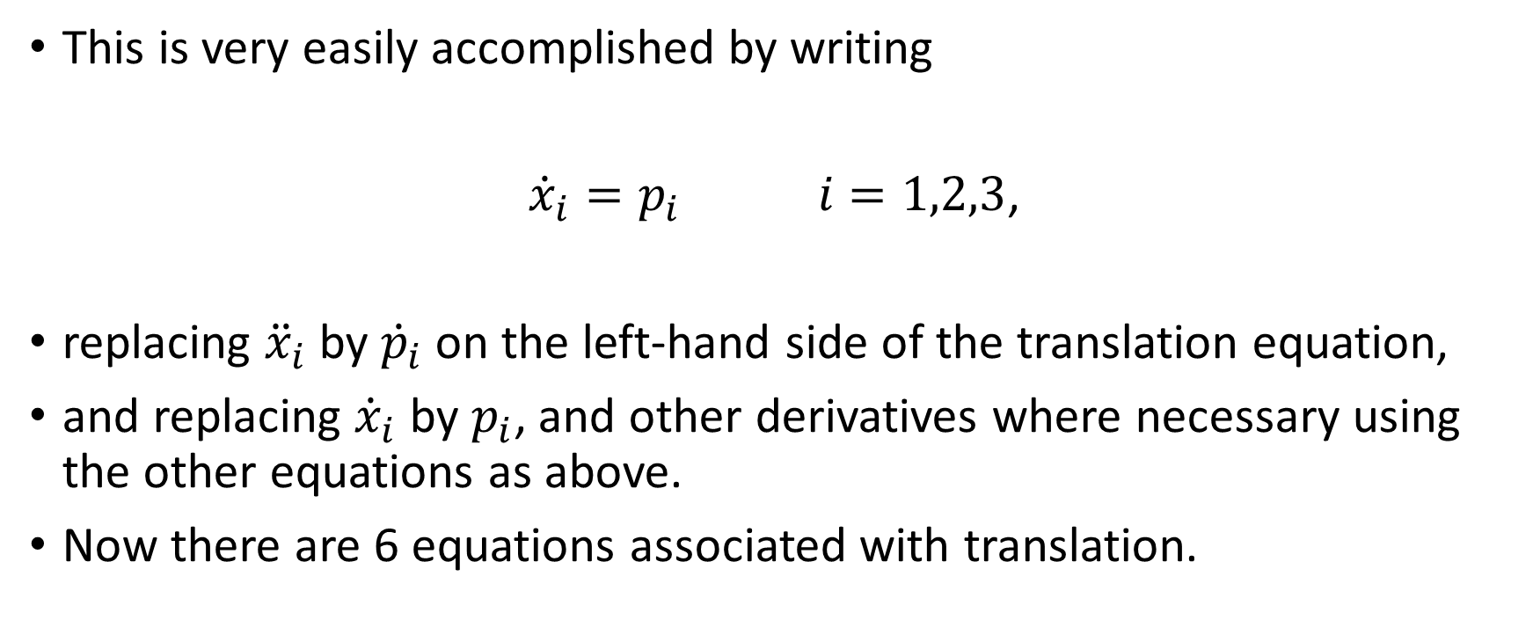
Reduction of Translation Equations to First Order Equations
This is very easily accomplished by writing
${\dot{x}}_{i}=p_{i} i=1,2,3$,
replacing ${\ddot{x}}_{i}$ by ${\dot{p}}_{i}$ on the left-hand side of the translation equation,
and replacing ${\dot{x}}_{i}$ by $p_{i}$, and other derivatives where necessary using the other equations as above.
Now there are 6 equations associated with translation.

Slide 16
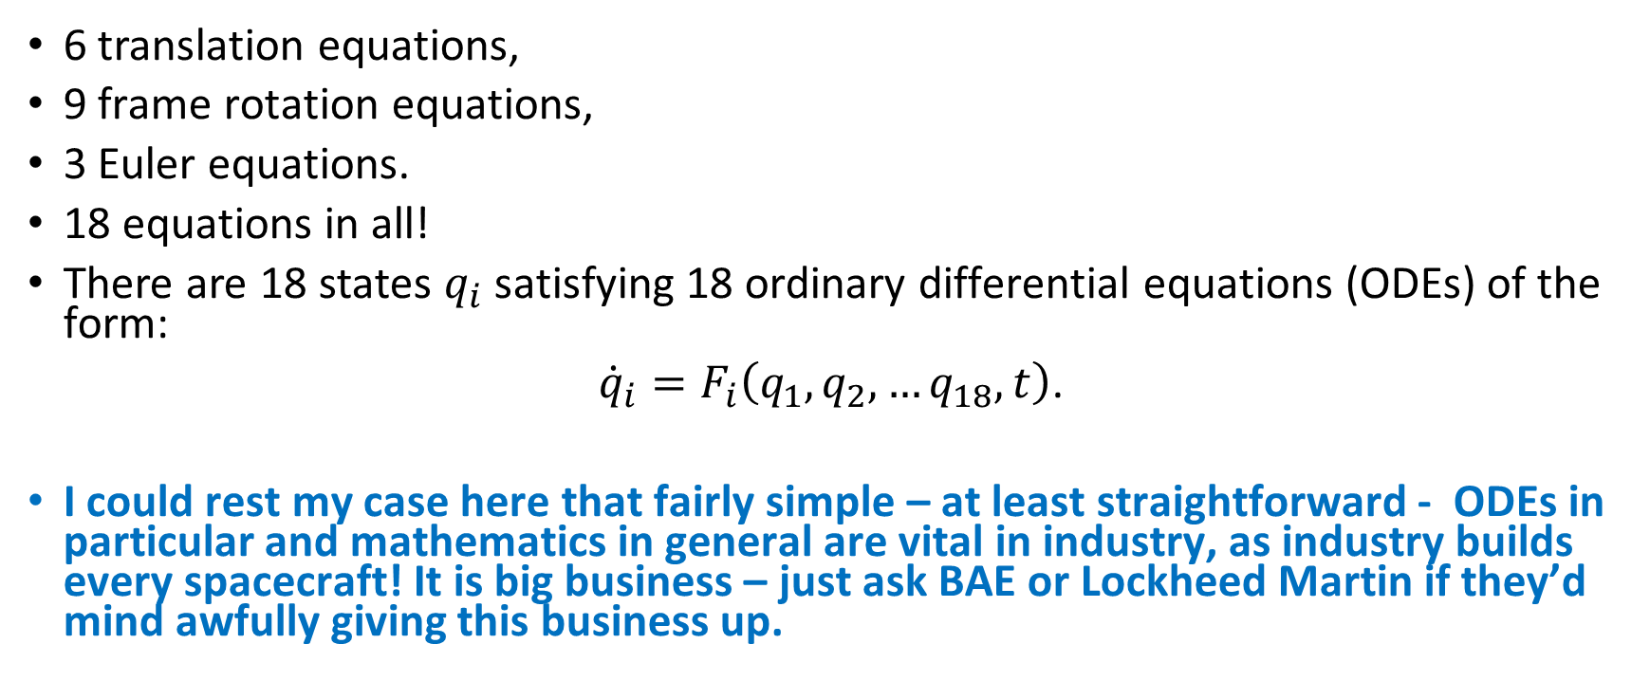
Spacecraft Dynamics Summary
6 translation equations,
9 frame rotation equations,
3 Euler equations.
18 equations in all!
There are 18 states $q_{i}$ satisfying 18 ordinary differential equations (ODEs) of the form:
${\dot{q}}_{i}=F_{i}\left(q_{1}, q_{2}, …q_{18}, t\right)$.
I could rest my case here that fairly simple – at least straightforward - ODEs in particular and mathematics in general are vital in industry, as industry builds every spacecraft! It is big business – just ask BAE or Lockheed Martin if they’d mind awfully giving this business up.

Slide 17
Spacecraft I Have Modelled
While with British Aerospace back in 1979-1983.
Early electronic computer screens.
Some additional maths needed in some cases – friction and beam theory.
Giotto comet rendezvous
ESA/Giotto

Slide 18
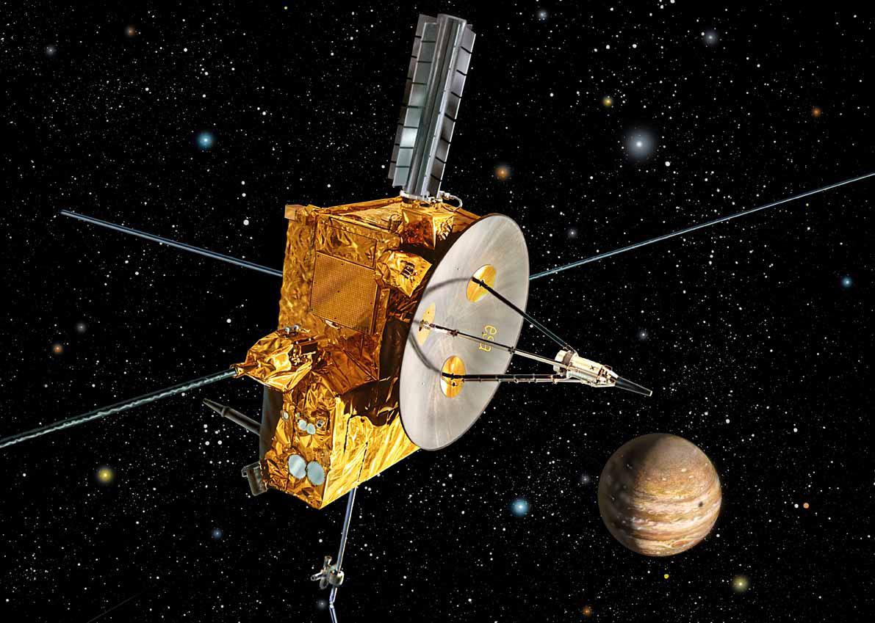
Ulysses Mission
Ulysses Mission (formerly International Solar Polar Mission).
Out to Jupiter to use its gravitational field to come out of the Solar System ecliptic plane and fly over the poles of the sun.
Spacecraft rotating at 5 rpm carrying a 5 m axial flexible beam antenna and two radial 30 m long wire booms. These complicated the Euler equations a fair bit as you may guess!
ESA/Ulysses

Slide 19
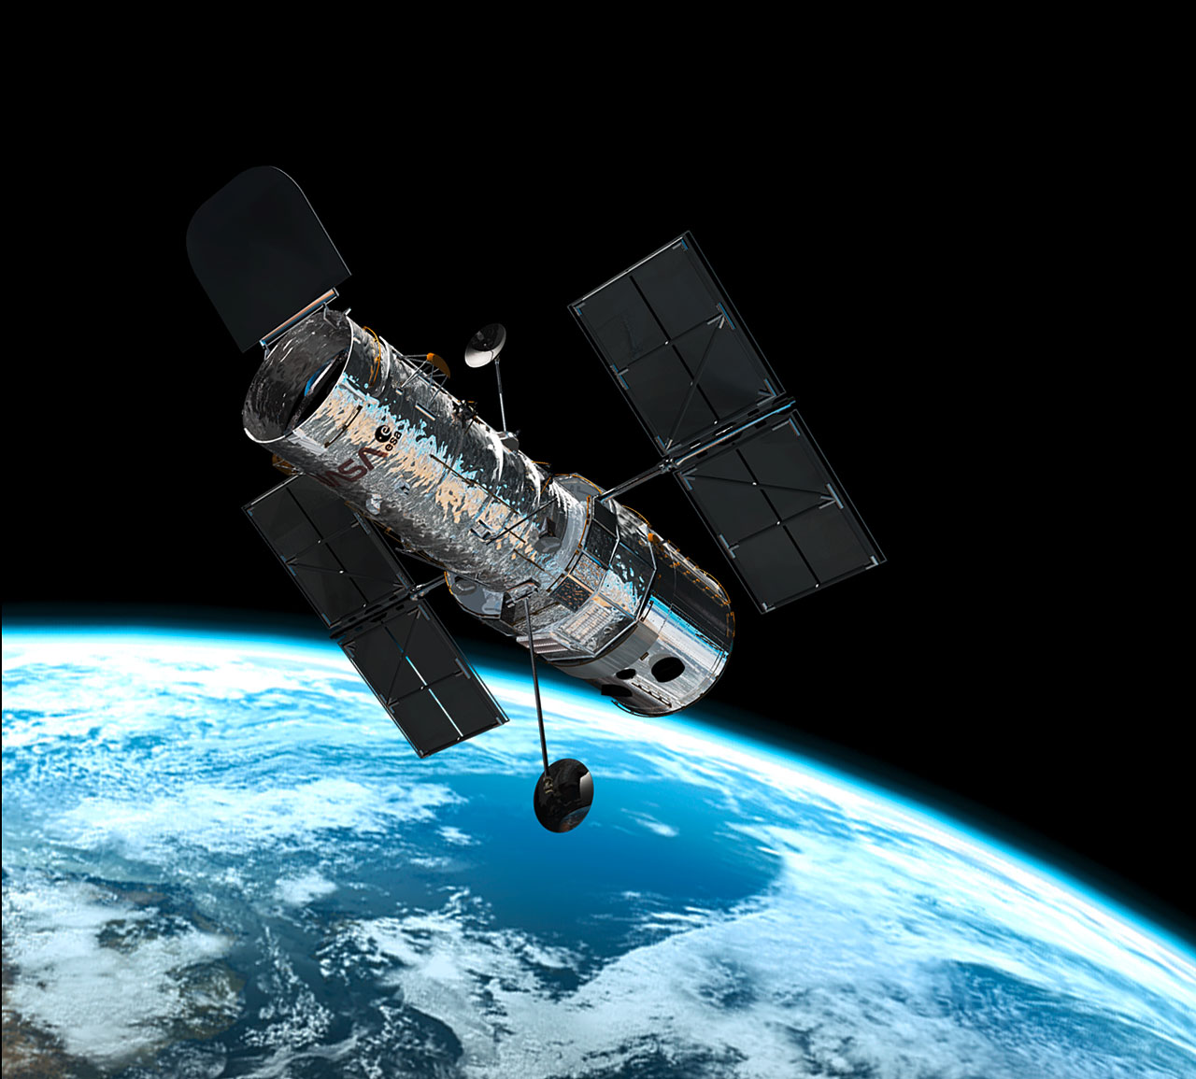
Hubble Space Telescope
Modelled the dynamics and control system of the solar arrays.
Included modelling the beam-like deformation of the array as it turned
and hysteresis torques from twisting the cables to the solar arrays.
ESA/Hubble

Slide 20
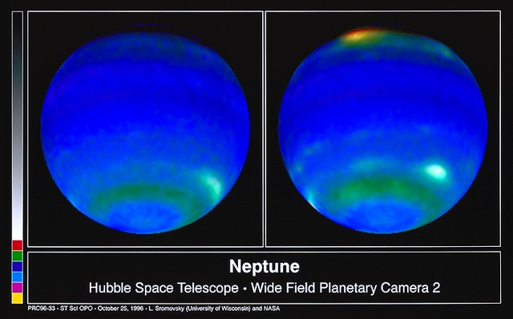
Images from Hubble!
NASA Hubble Telescope Compilation: ©1997 Finley Holiday Film Corporation

Slide 21

NASA Hubble Telescope Compilation: ©1997 Finley Holiday Film Corporation

Slide 22
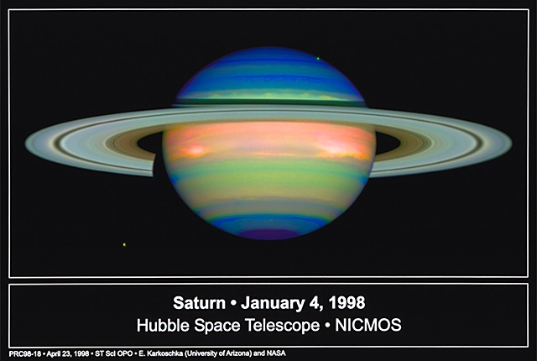
NASA Hubble Telescope Compilation: ©1997 Finley Holiday Film Corporation

Slide 23
Oil Well Perforators
Used by oil companies to get oil wells to yield oil.
Oil well perforators are fired radially from the well bore through the cement well bore casing and into the oil-bearing rock.
Generally, the deeper the penetration the greater the amount of oil that flows and hence the greater the return on the investment in drilling.
Literally millions of perforators are fired every year.
The mechanism how the jet is formed is described very well in G.K. Batchelor’s classic text ‘An Introduction to Fluid Mechanics.’

Slide 24
Perforator Jet Formation
z_{S}
z₁
Casing
Explosive
Liner
z
Jet

Slide 25
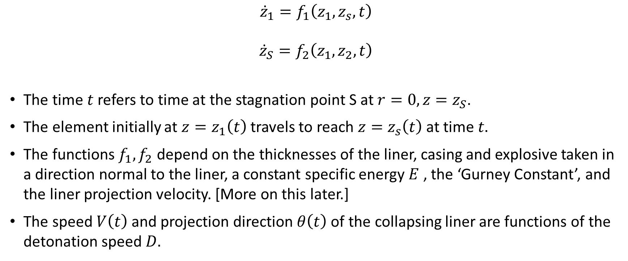
ODEs Governing Jet Formation
$${\dot{z}}_{1}=f_{1}\left(z_{1},z_{s},t\right)$$
$${\dot{z}}_{S}=f_{2}\left(z_{1},z_{2},t\right)$$
The time $t$ refers to time at the stagnation point S at $r=0, z=z_{S}$.
The element initially at $z=z_{1}\left(t\right)$ travels to reach $z=z_{s}\left(t\right)$ at time $t.$
The functions $f_{1},f_{2}$ depend on the thicknesses of the liner, casing and explosive taken in a direction normal to the liner, a constant specific energy $E$ , the ‘Gurney Constant’, and the liner projection velocity. [More on this later.]
The speed $V\left(t\right)$ and projection direction $θ\left(t\right)$of the collapsing liner are functions of the detonation speed $D.$

Slide 26
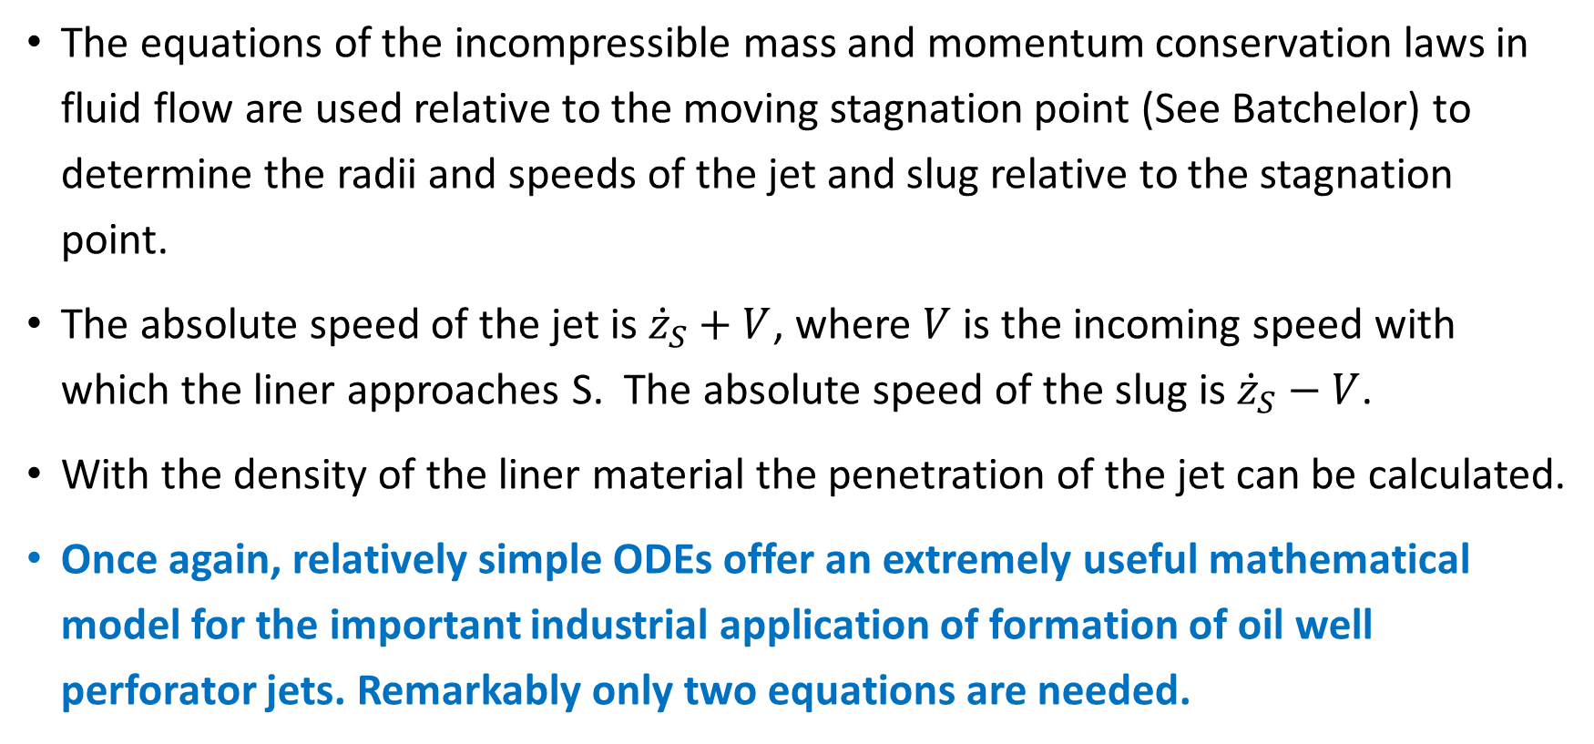
Jet Properties
The equations of the incompressible mass and momentum conservation laws in fluid flow are used relative to the moving stagnation point (See Batchelor) to determine the radii and speeds of the jet and slug relative to the stagnation point.
The absolute speed of the jet is ${\dot{z}}_{S}+V$, where $V$ is the incoming speed with which the liner approaches S. The absolute speed of the slug is ${\dot{z}}_{S}−V$.
With the density of the liner material the penetration of the jet can be calculated.
Once again, relatively simple ODEs offer an extremely useful mathematical model for the important industrial application of formation of oil well perforator jets. Remarkably only two equations are needed.

Slide 27
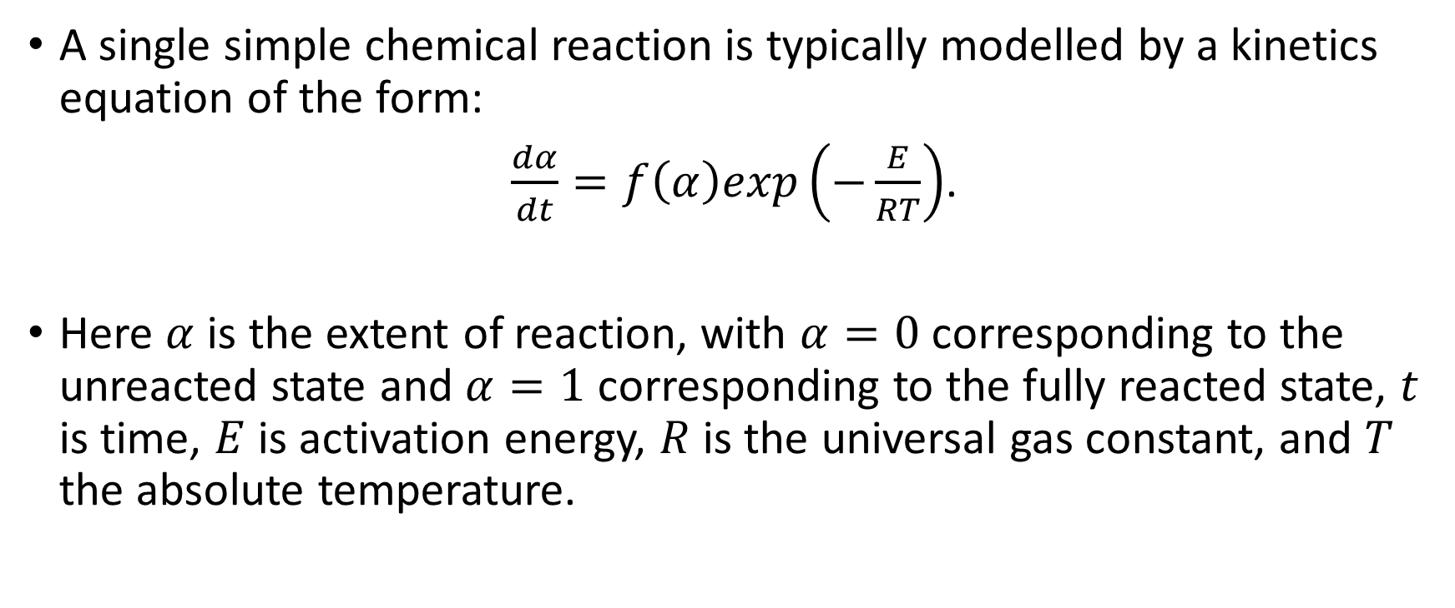
Chemical Reactions
A single simple chemical reaction is typically modelled by a kinetics equation of the form:
$\frac{dα}{dt}=f\left(α\right)exp\left(−\frac{E}{RT}\right)$.
Here $α$ is the extent of reaction, with $α=0$ corresponding to the unreacted state and $α=1$ corresponding to the fully reacted state, $t$ is time, $E$ is activation energy, $R$ is the universal gas constant, and $T$ the absolute temperature.

Slide 28
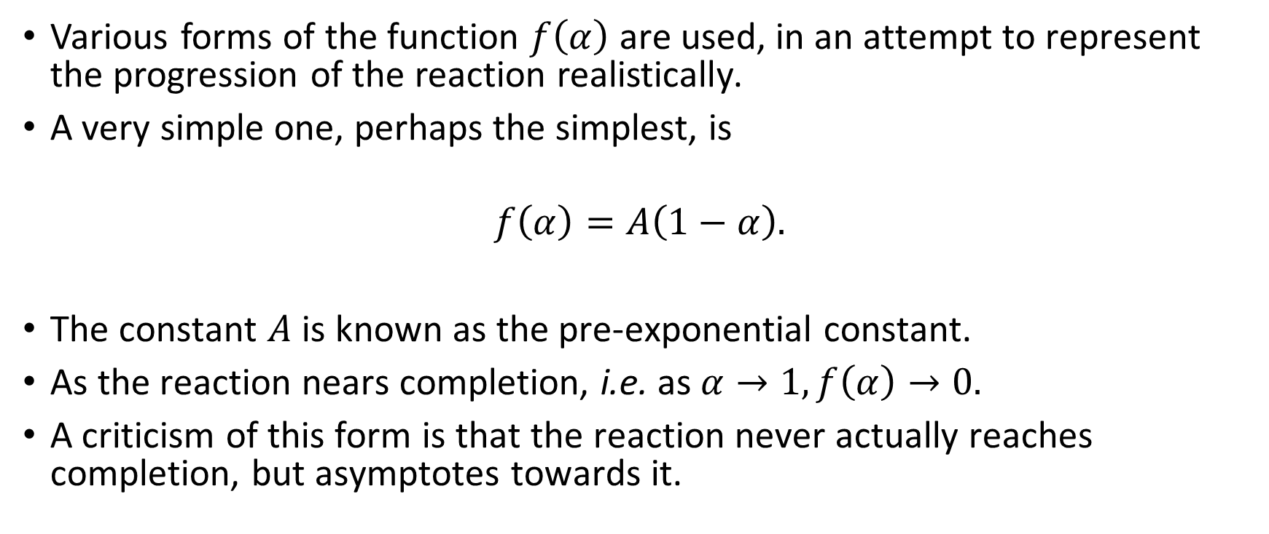
Models of Kinetics - 1
Various forms of the function $f\left(α\right)$ are used, in an attempt to represent the progression of the reaction realistically.
A very simple one, perhaps the simplest, is
$$f\left(α\right)=A\left(1−α\right).$$
The constant $A$ is known as the pre-exponential constant.
As the reaction nears completion, i.e. as $α→1, f\left(α\right)→0.$
A criticism of this form is that the reaction never actually reaches completion, but asymptotes towards it.

Slide 29
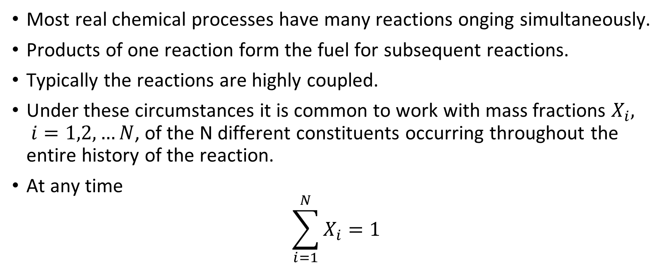
Models of Kinetics -2
Most real chemical processes have many reactions onging simultaneously.
Products of one reaction form the fuel for subsequent reactions.
Typically the reactions are highly coupled.
Under these circumstances it is common to work with mass fractions $X_{i}, i=1,2,…N$, of the N different constituents occurring throughout the entire history of the reaction.
At any time
$$\sum_{i=1}^{N}{X_{i}}=1$$

Slide 30

Multiple Step Reactions
Equations are typically of the form:
$${\dot{X}}_{i}=f\left(X_{1}, X_{2},…X_{N},T\right)$$

Slide 31
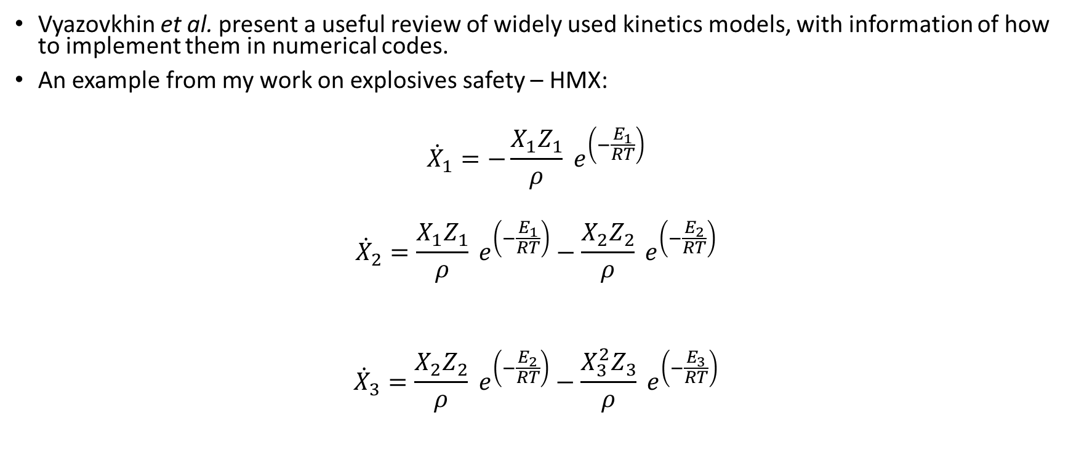
Example Reaction Models
Vyazovkhin et al. present a useful review of widely used kinetics models, with information of how to implement them in numerical codes.
An example from my work on explosives safety – HMX:
$${\dot{X}}_{1}=−\frac{X_{1}Z_{1}}{ρ} e^{\left(−\frac{E_{1}}{RT}\right)}$$
$${\dot{X}}_{2}=\frac{X_{1}Z_{1}}{ρ} e^{\left(−\frac{E_{1}}{RT}\right)}−\frac{X_{2}Z_{2}}{ρ} e^{\left(−\frac{E_{2}}{RT}\right)}$$
$${\dot{X}}_{3}=\frac{X_{2}Z_{2}}{ρ} e^{\left(−\frac{E_{2}}{RT}\right)}−\frac{X_{3}^{2}Z_{3}}{ρ} e^{\left(−\frac{E_{3}}{RT}\right)}$$

Slide 32
Powder Coarsening Model
PETN is both an explosive and heart drug!
PETN is required to have a high specific surface area (SSA) to facilitate the desired reactions in both applications, and therefore, is manufactured with a small average particle size.
High surface area PETN is thermodynamically unstable (high Gibbs Free Energy) and coarsens undesirably with time through evaporation and condensation.
An understanding of PETN growth processes is required in order to predict changes, both in the loose powder, and more importantly when it is compacted as an explosive or drug.
Loose powder is simpler to model than compacted powder.
Maiti and Gee’s simple condensation-evaporation model has been incorporated by AWE into the MAGIC (FORTRAN) code.
Output from MAGIC has been compared with previously obtained experimental data.

Slide 33
Expt: Specific Surface Area by Lötzsch Permeammetry
PETN Heating Study - SSA vs Time at 98°C
Initial rapid particle growth
Particle size equilibrium reached

Slide 34
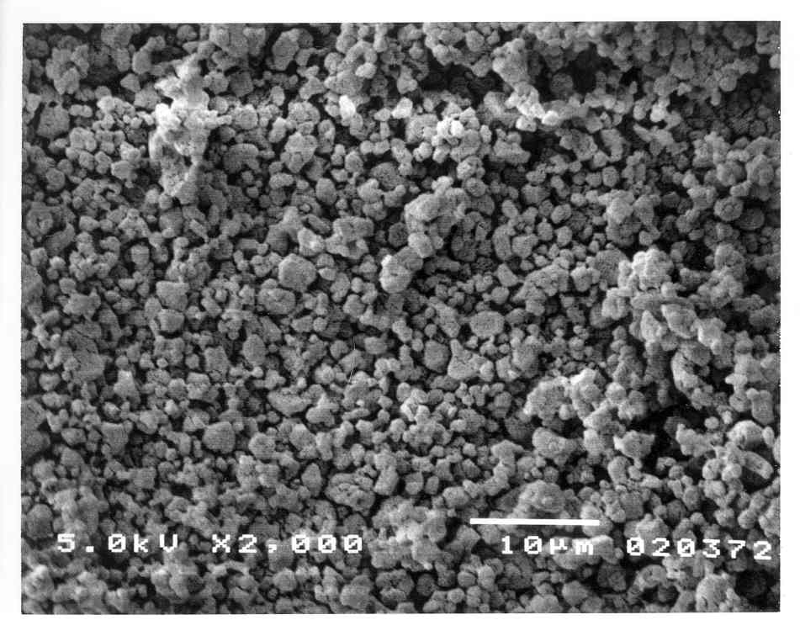
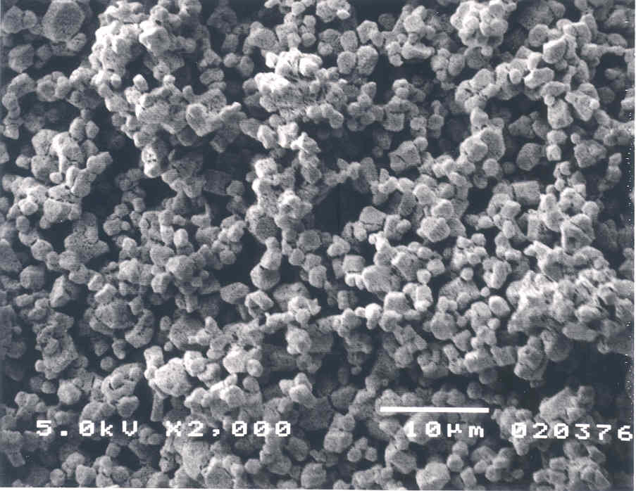
Scanning Electron Microscopy
Significant growth in initial ½ hour
Large angular tetragonal crystals develop eventually (nb. not very spherical!)
0 hours
0.5 hours
18 hours
High SSA and small “blocky” particles.
Reduction in SSA & increase in particle size.
Much reduced SSA & significant increase in particle size. Tetragonal crystals.

Slide 35
The Maiti and Gee model
The Maiti and Gee model
  assumes spherical, detached particles
  assumes the driving force behind coarsening process is evaporation - condensation, driven by the Gibbs-Thompson effect.
The Gibbs-Thompson Effect
Take a collection of spherical particles of varying sizes
Small particles with higher degree of curvature have a higher vapour pressure
  Molecules detach from a particle surface, diffuse through the gas phase and condense of the surface of a different molecule.
  Over time, the larger particles increase in size, at the expense of the smaller particles which eventually disappear.
Gibbs - Thompson
r = radius of particle
P_{r} = equilibrium pressure of particle, radius r
P∞ = equilibrium pressure of bulk PETN
ν = volume of molecule in the solid phase
σ = surface energy density
T = temperature
k = Boltzmann constant
Notes:
Gibbs-Thompson Effect refers to variations in vapour pressure across a curved surface. Small particles with a high curvature will have a higher vapour pressure than larger particles with low curvature (Ostwald-Freunlich)
Molecules break away from the surface of the small particle. Will then attached to whichever particle they come into contact with, but more likely to stay attached to a larger one. Over time, large particles increase in time, and small particles shrink and eventually disappear

Slide 36
Mathematical Model
Equations derived by Maiti and Gee
  Net addition of molecules per unit time from the surrounding gas phase onto a particle of radius r_{j} (j=1,2,….N) is given by:
  And rate of change of radius is given by:
Assuming N sets of {N_{j}} particles with radii {r_{j}}
and where:
m = mass of a PETN molecule
s = size independent roughness factor
P_{eq} = equilibrium pressure
α =
Ref: A. Maiti, et al., PETN Coarsening - Predictions from Accelerated Aging Data. Propellants, Explosives, Pyrotechnics, 2011. 36: p. 124 - 130.
Notes:
Starting with Gibbs Thompson as the basis, Maiti and Gee have derived equations to govern the change in particle size with time.
Equation (1) governs the net addition per unit time of molecules from the surrounding gas phase, onto a particle of radius r.
Equation (2) gives the rate of change of the radius of a particle and this is the basis of programme MAGIC

Slide 37
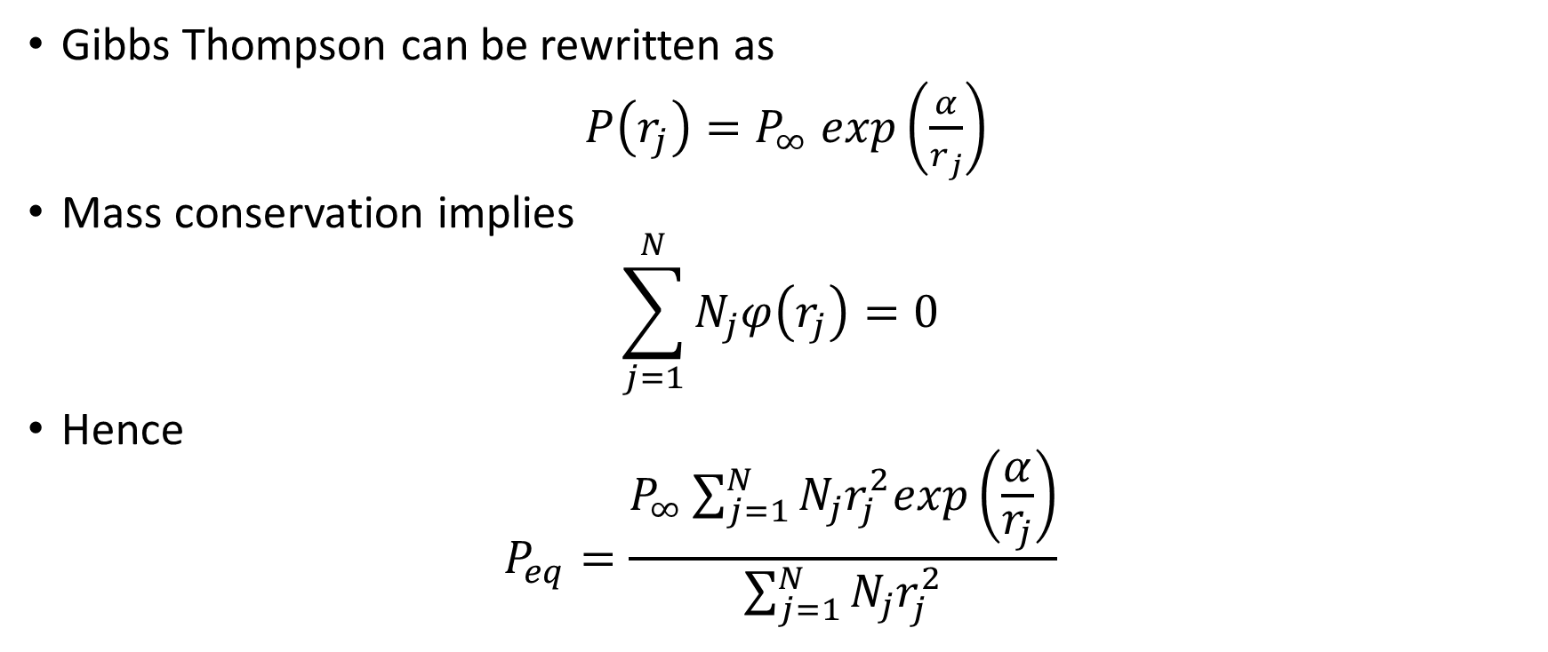
Gibbs-Thompson and Equilibrium Pressure
Gibbs Thompson can be rewritten as
$P\left(r_{j}\right)=P_{∞} exp\left(\frac{α}{r_{j}}\right)$
Mass conservation implies
$$\sum_{j=1}^{N}{N_{j}φ\left(r_{j}\right)=0}$$
Hence
$$P_{eq}=\frac{P_{∞}\sum_{j=1}^{N}{N_{j}r_{j}^{2}exp\left(\frac{α}{r_{j}}\right)}}{\sum_{j=1}^{N}{N_{j}r_{j}^{2}}}$$

Slide 38
Coarsening Modelled by ODEs
To predict time the evolution of particle size of PETN bulk powder, these equations are solved using a variable time step Runge-Kutta scheme developed in FORTRAN.
This provides a particle size histogram for each time step.
SSA at each step is then calculated using:
(3)
Ref: A. Maiti, et al., PETN Coarsening - Predictions from Accelerated Aging Data. Propellants, Explosives, Pyrotechnics, 2011. 36: p. 124 - 130.
Notes:
Second order Runge Kutta - standard differential scheme.

Slide 39
Calculated fit vs experimental fit
Constant values of s found which bound the experimental data.
No single constant value for s which enables the calculated SSA - time profile to match the experimental data.
PETN Heating Study - experimental vs calculated data
Calculated fit, s = 0.007
Calculated fit, s = 0.1

Slide 40
Calculated fit vs experimental fit
s varied with time to minimise difference between experimental and calculated SSAs.
Calculated fit

Slide 41
Conclusion of Powder Modelling
It has been possible to describe the experimental data using the Maiti and Gee model with a modification to incorporate time dependent surface roughness.
The result is a partially empirical fit – progress, but…
The physical interpretation of s is not yet properly understood – agreement could be fortuitous.
Further work is still definitely required to understand what goes on in a compacted explosive.

Slide 42
Challenges
Experimental - Gain more experimental data with
  particle size determination at each time step
  varying temperature
Modelling – investigate enhancements to Maiti and Gee model to address:
  Surface diffusion
  Time dependency
  Curvature dependency
  Particle shape dependency and shape evolution
  Continuous distributions of dimension, e.g. radius to start
  Sintering (merging) of particles and awkward resulting shapes
  Loss of SSA by compaction as function of applied stress (Hertz-type problems across whole powder, permeability etc.)
Variety of modelling challenges of varying complexity – which ones matter most?

Slide 43
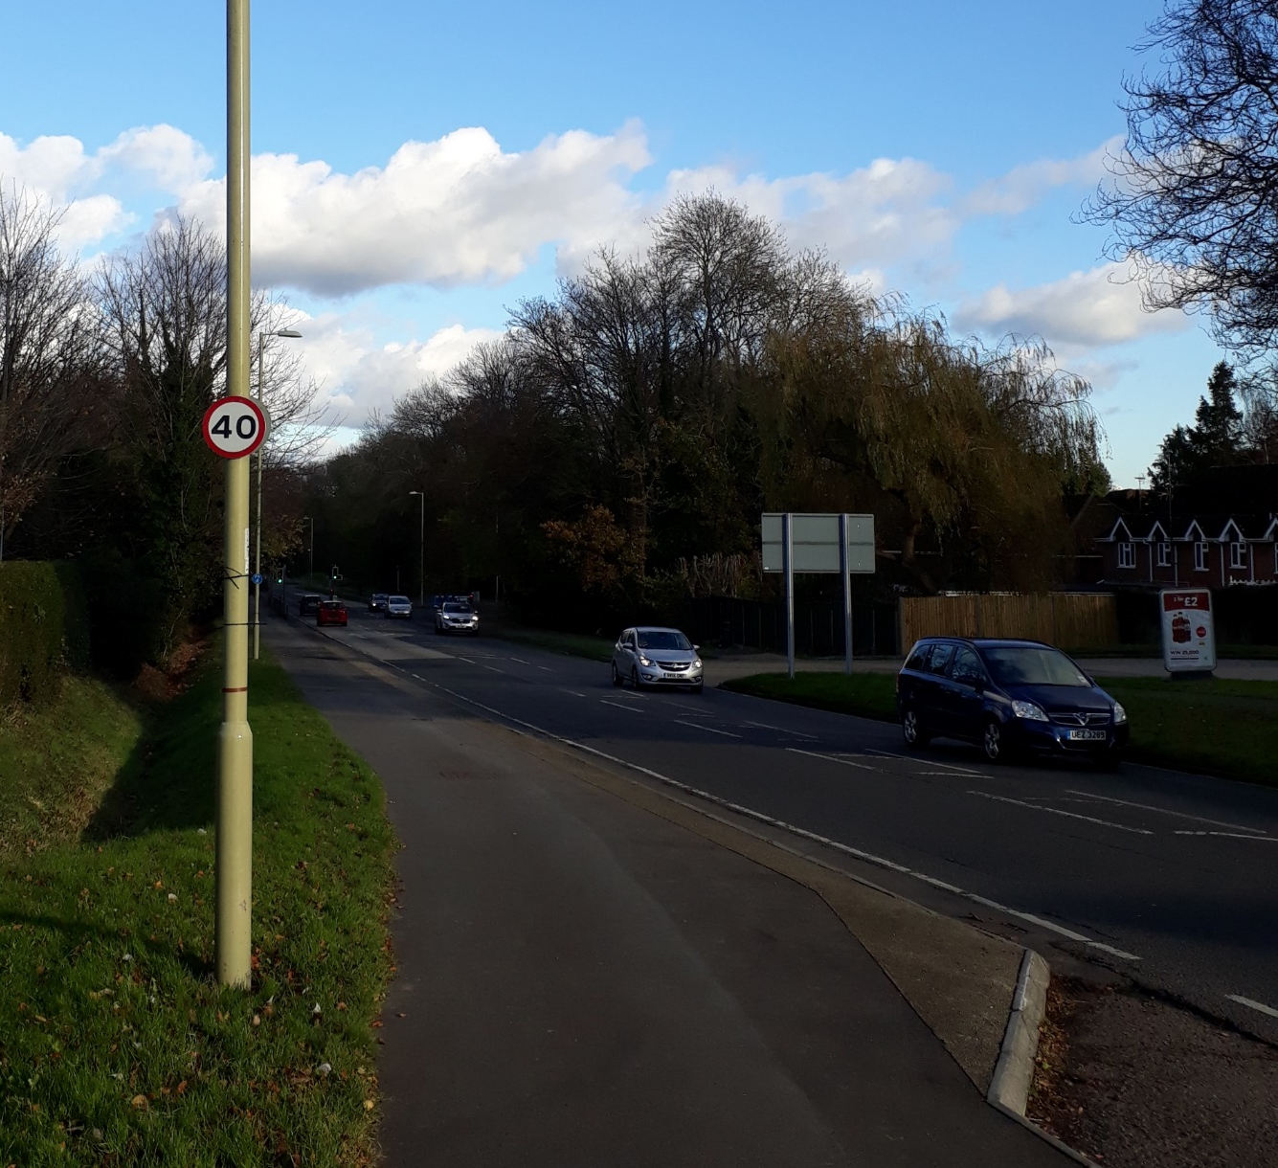
Traffic Modelling - 1

Slide 44
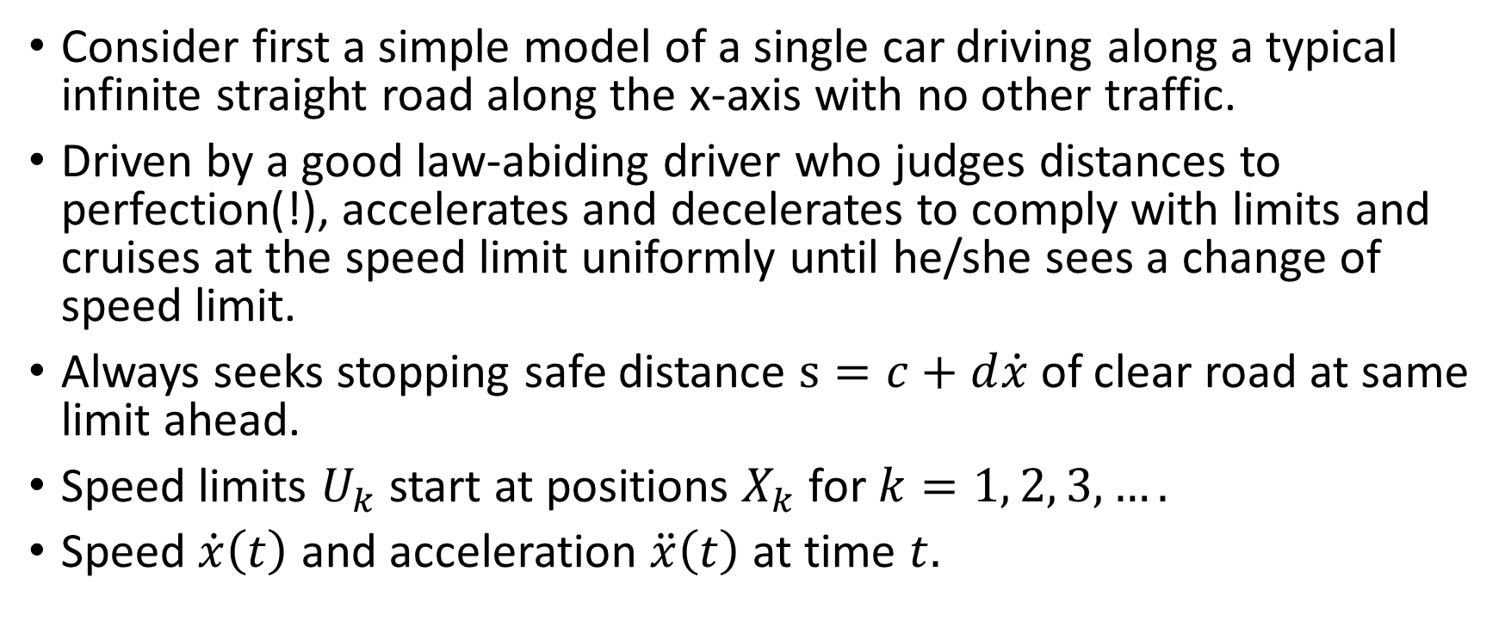
Traffic Modelling - 2
Consider first a simple model of a single car driving along a typical infinite straight road along the x-axis with no other traffic.
Driven by a good law-abiding driver who judges distances to perfection(!), accelerates and decelerates to comply with limits and cruises at the speed limit uniformly until he/she sees a change of speed limit.
Always seeks stopping safe distance $s=c+d\dot{x}$ of clear road at same limit ahead.
Speed limits $U_{k}$ start at positions $X_{k}$ for $k=1, 2, 3,….$
Speed $\dot{x}\left(t\right)$ and acceleration $\ddot{x}\left(t\right)$ at time $t.$

Slide 45
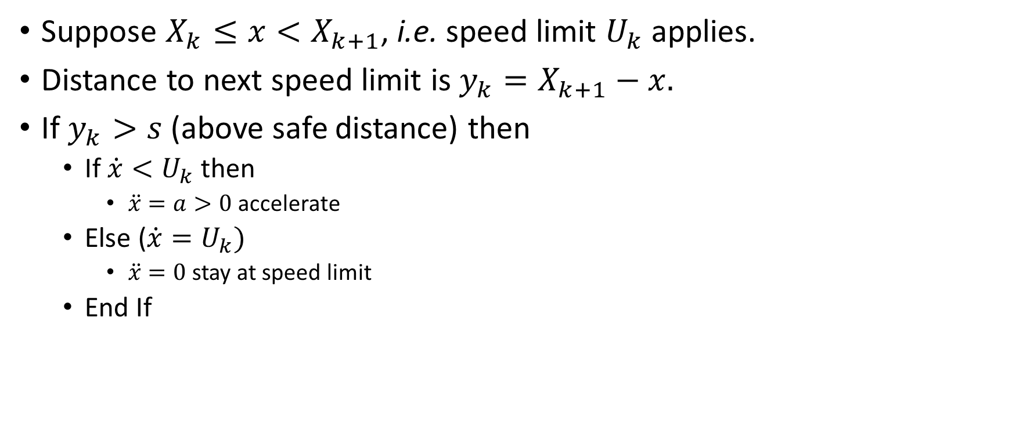
Traffic Modelling - 3
Suppose $X_{k}≤x<X_{k+1}$, i.e. speed limit $U_{k}$ applies.
Distance to next speed limit is ${y_{k}=X}_{k+1}−x.$
If $y_{k}>s$ (above safe distance) then
  If $\dot{x}<U_{k}$ then
    $\ddot{x}=a>0$ accelerate
  Else ($\dot{x}=U_{k})$
    $\ddot{x}=0$ stay at speed limit
  End If

Slide 46
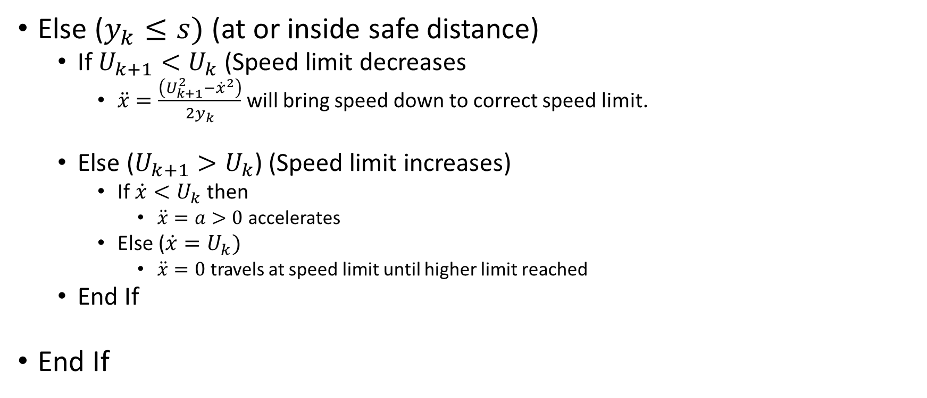
Traffic Modelling - 4
Else ($y_{k}≤s)$ (at or inside safe distance)
  If $U_{k+1}<U_{k}$ (Speed limit decreases
    $\ddot{x}=\frac{\left(U_{k+1}^{2}−{\dot{x}}^{2}\right)}{2y_{k}}$ will bring speed down to correct speed limit.
  Else ($U_{k+1}>U_{k}$) (Speed limit increases)
    If $\dot{x}<U_{k}$ then
      $\ddot{x}=a>0$ accelerates
    Else ($\dot{x}=U_{k})$
      $\ddot{x}=0$ travels at speed limit until higher limit reached
  End If
End If

Slide 47
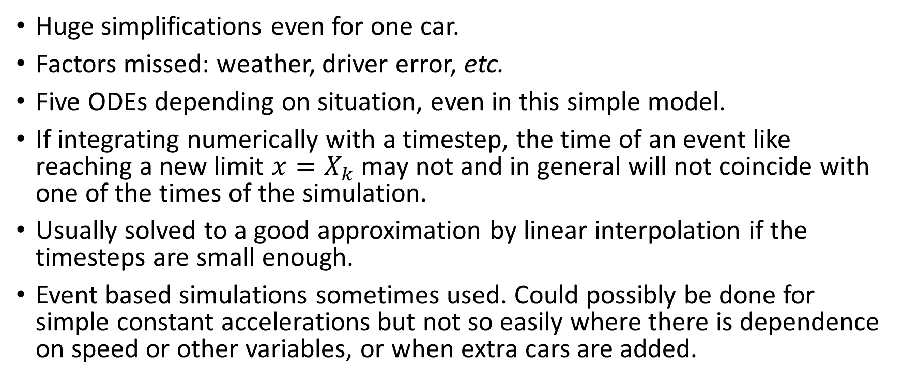
Traffic Modelling - 5 : Issues
Huge simplifications even for one car.
Factors missed: weather, driver error, etc.
Five ODEs depending on situation, even in this simple model.
If integrating numerically with a timestep, the time of an event like reaching a new limit $x=X_{k}$ may not and in general will not coincide with one of the times of the simulation.
Usually solved to a good approximation by linear interpolation if the timesteps are small enough.
Event based simulations sometimes used. Could possibly be done for simple constant accelerations but not so easily where there is dependence on speed or other variables, or when extra cars are added.

Slide 48
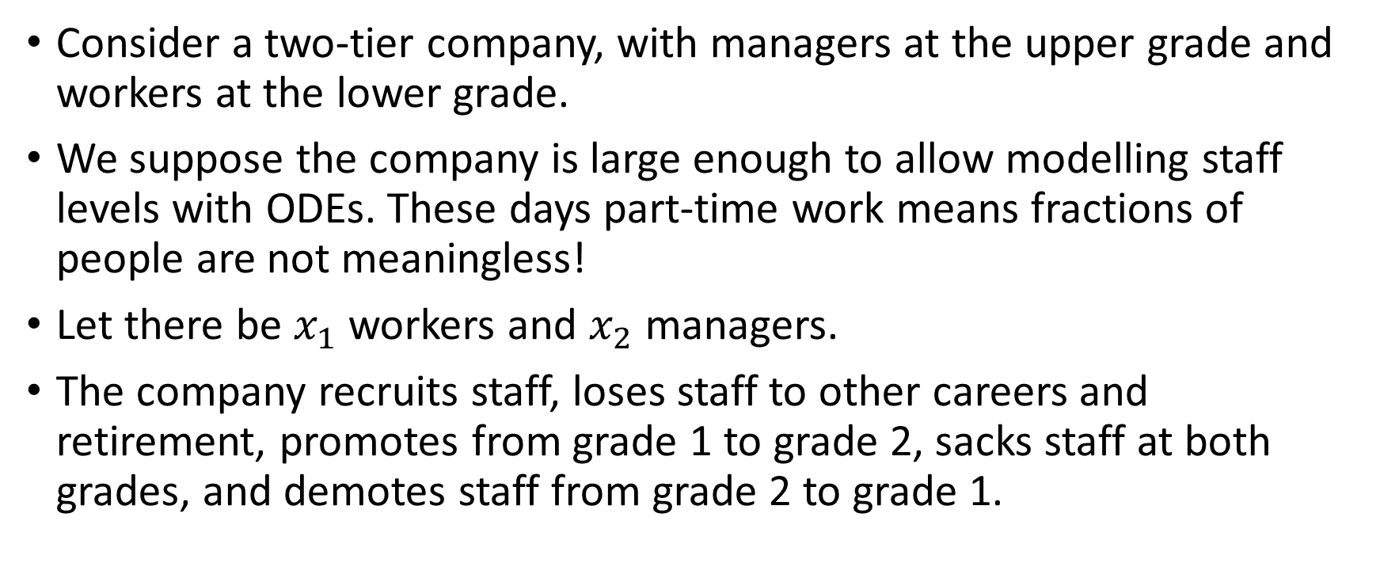
Staff Modelling
Consider a two-tier company, with managers at the upper grade and workers at the lower grade.
We suppose the company is large enough to allow modelling staff levels with ODEs. These days part-time work means fractions of people are not meaningless!
Let there be $x_{1}$ workers and $x_{2}$ managers.
The company recruits staff, loses staff to other careers and retirement, promotes from grade 1 to grade 2, sacks staff at both grades, and demotes staff from grade 2 to grade 1.

Slide 49
A Possible Staffing Model
$${\dot{x}}_{1}=r_{1}x_{1}−l_{1}x_{1}−p_{1}x_{1}−s_{1}x_{1}+d_{2}x_{2}$$
Recruitment
Leavers
Promotions to 2
Sackings
Demotions From 2
$${\dot{x}}_{2}=r_{2}x_{2}−l_{2}x_{2}{+ p}_{1}x_{1}−s_{2}x_{2}{−d}_{2}x_{2}$$

Slide 50
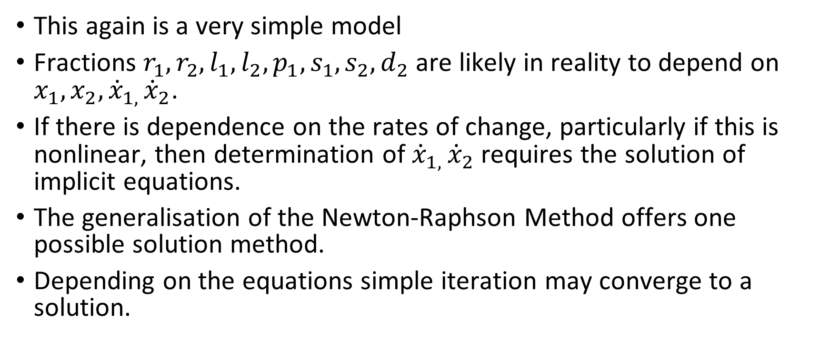
Staff Modelling - Issues
This again is a very simple model
Fractions $r_{1}, r_{2}, l_{1},l_{2}, p_{1}, s_{1}, s_{2}, d_{2}$ are likely in reality to depend on $x_{1}, x_{2}, {\dot{x}}_{1, }{\dot{x}}_{2}$.
If there is dependence on the rates of change, particularly if this is nonlinear, then determination of ${\dot{x}}_{1, }{\dot{x}}_{2}$ requires the solution of implicit equations.
The generalisation of the Newton-Raphson Method offers one possible solution method.
Depending on the equations simple iteration may converge to a solution.

Slide 51
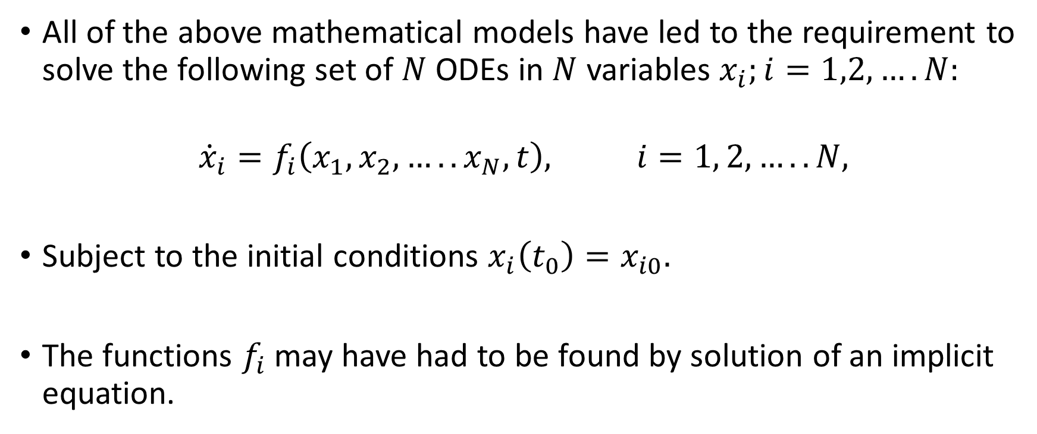
4th Order Runge-Kutta Method
All of the above mathematical models have led to the requirement to solve the following set of $N$ODEs in $N$ variables $x_{i};i=1,2,….N:$
$${\dot{x}}_{i}=f_{i}\left(x_{1}, x_{2}, …..x_{N},t\right), i=1, 2,…..N,$$
Subject to the initial conditions $x_{i}\left(t_{0}\right)=x_{i0}.$
The functions $f_{i}$may have had to be found by solution of an implicit equation.

Slide 52
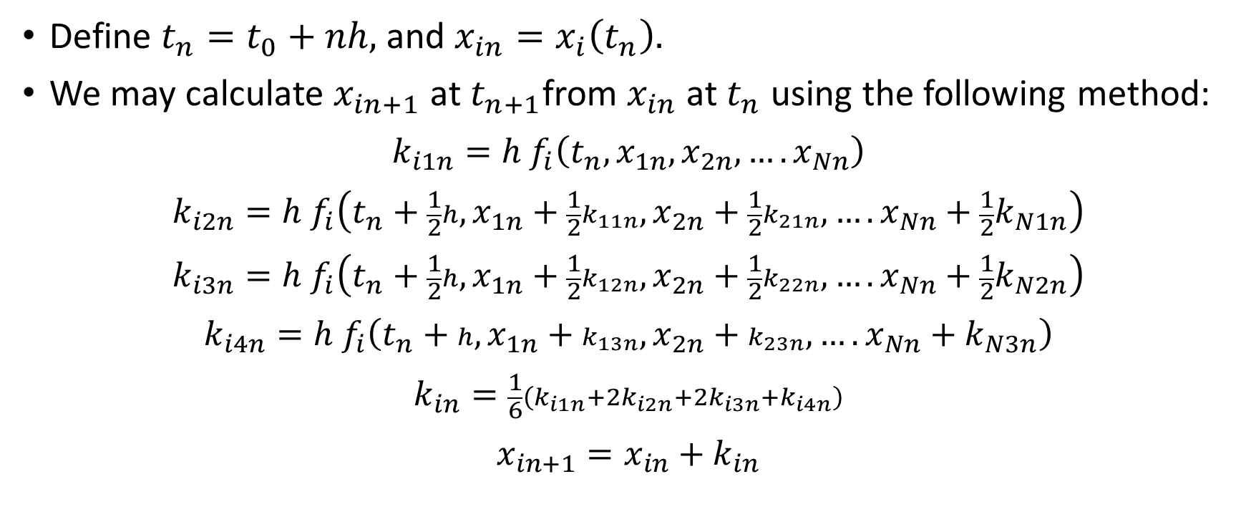
4th Order Runge-Kutta Method for Multiple States
Define $t_{n}=t_{0}+nh,$ and $x_{in}=x_{i}\left(t_{n}\right).$
We may calculate $x_{in+1}$ at $t_{n+1}$from $x_{in}$ at $t_{n}$ using the following method:
$$k_{i1n}=h f_{i}\left(t_{n}, x_{1n}, x_{2n}, ….x_{Nn}\right)$$
$$k_{i2n}=h f_{i}\left(t_{n}+\frac{1}{2}h, x_{1n}+\frac{1}{2}k_{11n}, x_{2n}+\frac{1}{2}k_{21n}, ….x_{Nn}+\frac{1}{2}k_{N1n}\right)$$
$$k_{i3n}=h f_{i}\left(t_{n}+\frac{1}{2}h, x_{1n}+\frac{1}{2}k_{12n}, x_{2n}+\frac{1}{2}k_{22n}, ….x_{Nn}+\frac{1}{2}k_{N2n}\right)$$
$$k_{i4n}=h f_{i}\left(t_{n}+h, x_{1n}+k_{13n}, x_{2n}+k_{23n}, ….x_{Nn}+k_{N3n}\right)$$
$$k_{in}=\frac{1}{6}\left(k_{i1n}+2k_{i2n}+2k_{i3n}+k_{i4n}\right)$$
$$x_{in+1}=x_{in}+k_{in}$$

Slide 53
Comments on the Runge Kutta Method
Robust method
4th-order accurate is great for most ODE applications. On MATLAB etc.
Combined with variable time-step methods it is very flexible.
I have also found second-order Runge-Kutta methods useful particularly in solving partial differential equations (see exercise and next lecture).
References:
  Alan Jeffrey, Linear Algebra and ODEs, Blackwell Scientific Productions (1990)
  Dennis G. Zill, A First Course in Differential Equations, 8th. Ed. Thomas Book (2005)
  More rigour: U.M. Archer and L.R. Petzold, Computer Methods for ODEs and Differential-Algebraic Equations, SIAM, Philadelphia (1998).

Slide 54




Dynamic Friction
F
For surfaces sliding over each other
$F=μ_{D}R$ for V $>0$;
$F=−μ_{D}R$ for V$<0$.
$$μ_{D}R$$
$$V$$
$$−μ_{D}R$$

Slide 55




Static Friction
F
For sticking surfaces
$F=μ_{S}σ_{N}$ for $τ>0$;
$F=−μ_{S}σ_{N}$ for $τ<0$.
$${μ_{S}σ}_{N}$$
$$τ$$
$$−μ_{S}σ_{N}$$

