Slide 1
Methods of Industrial Mathematics – Session 3
Extended LTCC Advanced Course – Feb-Mar 2018
John Curtis, UCL Mathematics Department
© British Crown Owned Copyright 2018/AWE.

Slide 2
Session 3
A reminder of the equations of fluid flow.
Boundary conditions.
Some useful analytical solutions used in industry.
Jets and their applications and stability.
An associated application of Bernoulli's law.
An introduction to the concept of a shock.

Slide 3
Industrial Mathematics Encountered by JC
ELECTROMAGNETIC THEORY
MECHANICS
HEAT TRANSFER
APPLIED PHYSICS
CONTROL THEORY
INDUSTRIAL MATHEMATICS USED BY JC
SIGNAL PROCESSING
SIMULATION
ENGINEERING
STATISTICS
NUMERICAL ANALYSIS
CHEMISTRY
PROBABILITY
OPTIMISATION
Arrows join most of the above subjects
N.B. No attempt at definitive list of Industrial Mathematics , e.g. Image Processing, Big Data, Formal Methods, Financial Mathematics are missing.

Slide 4

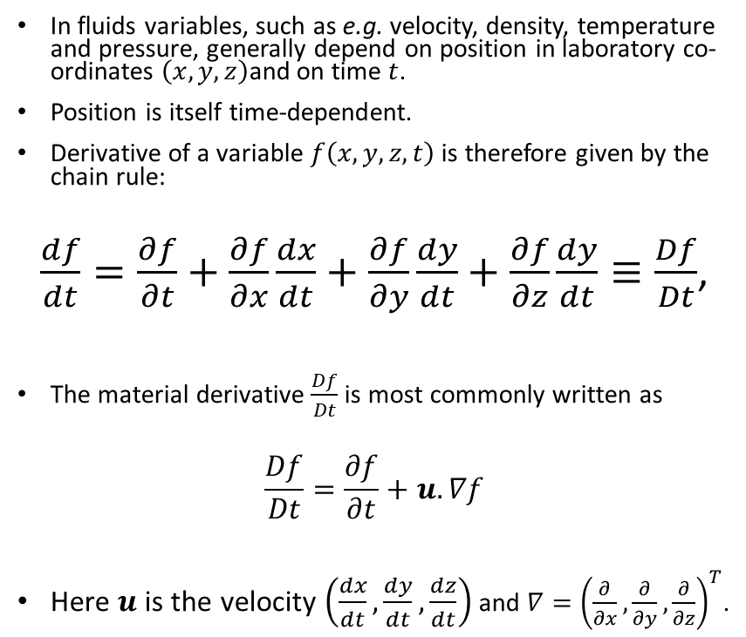


The Material Derivative
In fluids variables, such as e.g. velocity, density, temperature and pressure, generally depend on position in laboratory co-ordinates $\left(x, y, z\right)$and on time $t$.
Position is itself time-dependent.
Derivative of a variable $f\left(x, y, z, t\right)$ is therefore given by the chain rule:
$\frac{df}{dt}=\frac{∂f}{∂t}+\frac{∂f}{∂x}\frac{dx}{dt}+\frac{∂f}{∂y}\frac{dy}{dt}+\frac{∂f}{∂z}\frac{dy}{dt}≡\frac{Df}{Dt}$,
The material derivative $\frac{Df}{Dt}$ is most commonly written as
$$\frac{Df}{Dt}=\frac{∂f}{∂t}+u.∇f$$
Here $u$ is the velocity $\left(\frac{dx}{dt},\frac{dy}{dt},\frac{dz}{dt}\right)$ and $∇={\left(\frac{∂}{∂x},\frac{∂}{∂y},\frac{∂}{∂z}\right)}^{T}$.
$$\left(x_{1}, y_{1}, z_{1}, t_{1}\right)$$
Streamline
$$t_{2}>t_{1}$$
$$\left(x_{2}, y_{2}, z_{2}, t_{2}\right)$$

Slide 5
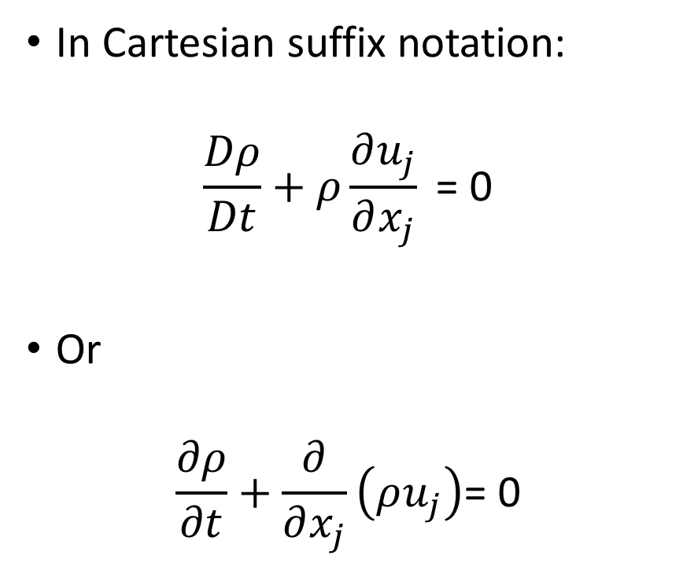
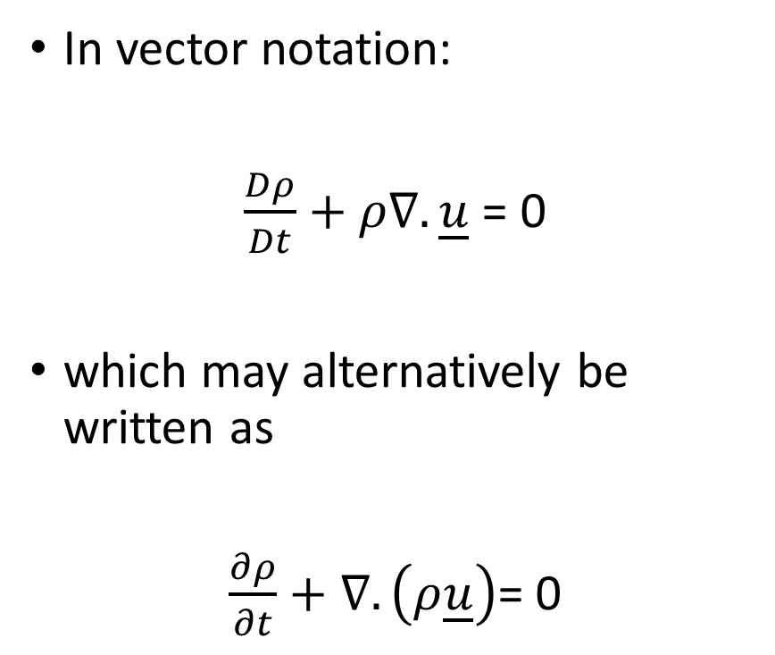
Mass Conservation
In vector notation:
$\frac{Dρ}{Dt}+ρ∇.\underline{u}$ = 0
which may alternatively be written as
$\frac{∂ρ}{∂t}+∇.\left(ρ\underline{u}\right)$= 0
In Cartesian suffix notation:
$$\frac{Dρ}{Dt}+ρ\frac{∂u_{j}}{∂x_{j}}\text{ = 0}$$
Or
$$\frac{∂ρ}{∂t}+\frac{∂}{∂x_{j}}\left(ρu_{j}\right)\text{= 0}$$

Slide 6
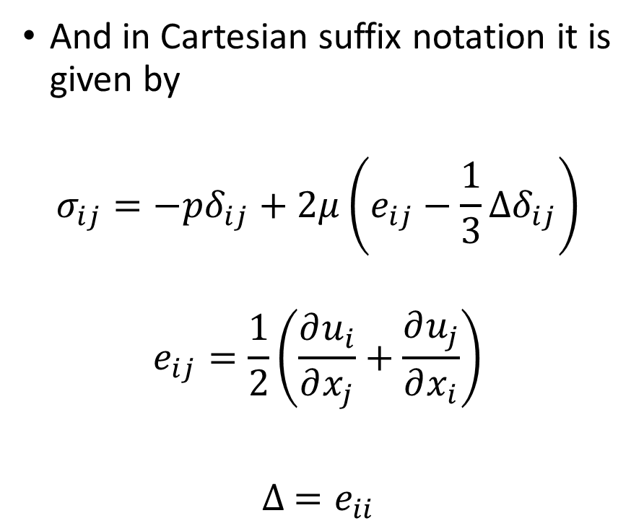
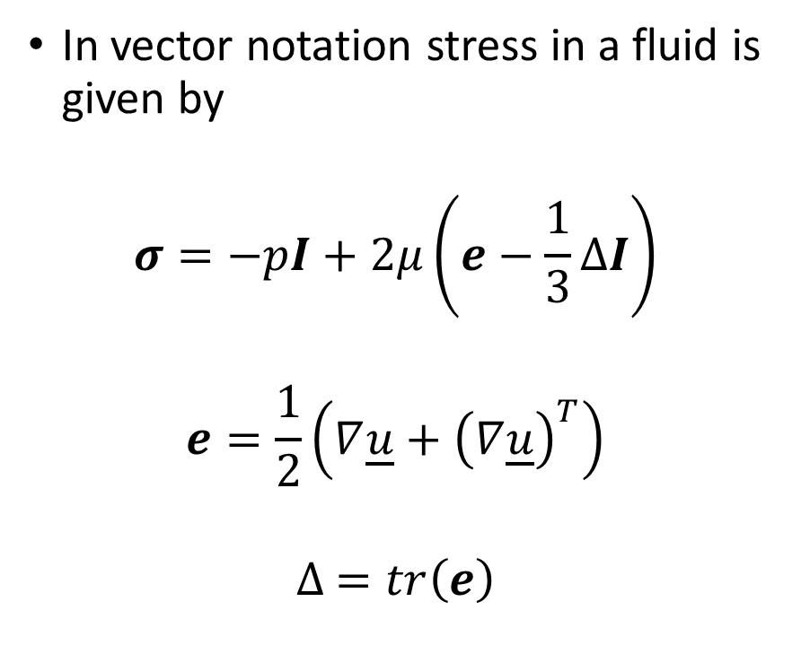
Stress and Strain Tensors
In vector notation stress in a fluid is given by
$$σ=−pI+2μ\left(e−\frac{1}{3}∆I\right)$$
$$e=\frac{1}{2}\left(∇\underline{u}+{\left(∇\underline{u}\right)}^{T}\right)$$
$$∆ =tr\left(e\right)$$
And in Cartesian suffix notation it is given by
$$σ_{ij}=−pδ_{ij}+2μ\left(e_{ij}−\frac{1}{3}∆δ_{ij}\right)$$
$$e_{ij}=\frac{1}{2}\left(\frac{∂u_{i}}{∂x_{j}}+\frac{∂u_{j}}{∂x_{i}}\right)$$
$∆ =e_{ii}$

Slide 7
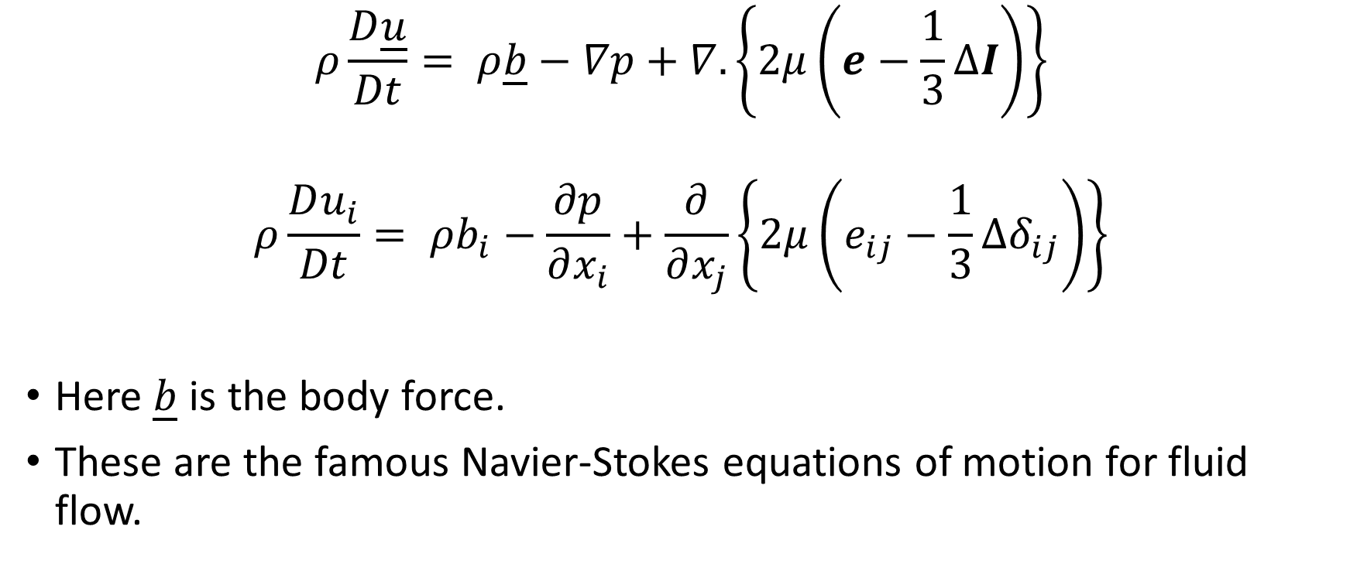
Momentum Conservation
$$ρ\frac{D\underline{u}}{Dt}= ρ\underline{b}−∇p+∇.\left\{2μ\left(e−\frac{1}{3}∆I\right)\right\}$$
$$ρ\frac{Du_{i}}{Dt}= ρb_{i}−\frac{∂p}{∂x_{i}}+\frac{∂}{∂x_{j}}\left\{2μ\left(e_{ij}−\frac{1}{3}∆δ_{ij}\right)\right\}$$
Here $\underline{b}$ is the body force.
These are the famous Navier-Stokes equations of motion for fluid flow.

Slide 8

Energy Conservation
$$ρ\frac{De}{Dt}=tr\left(σe\right)+k∇^{2}T$$
$$ρ\frac{De}{Dt}=σ_{ij} e_{ij}+k∇^{2}T$$
Here $k$ is the thermal conductivity and $T$ is the temperature.
Rate of gain of internal energy per unit volume
Rate of dissipation per unit volume
Heat per unit volume gained by conduction

Slide 9
Useful Analytical Solutions
Steady State Solutions
  Poiseuille flow
  Bernoulli’s Law
    Efflux from an orifice in a vessel
  Momentum integral method
    Force exerted by a jet on a wall.
Time-dependent Solutions
  Oscillatory flows
  Pinching of a cylinder between two frictionless plates

Slide 10
Steady State Solutions.
Poiseuille Flow -1
Poiseuille flow is relevant to many applications in industry where flow of viscous fluids in pipes is important.
Examples:
  Flow in oil pipe lines
  Heating and refrigeration systems
  In models of permeability – e.g. the powder ageing problem in Lecture 1 was validated by comparison with specific surface areas determined by permeammetry, which has models for permeability derived from Poiseuille Flow
  Medicine

Slide 11



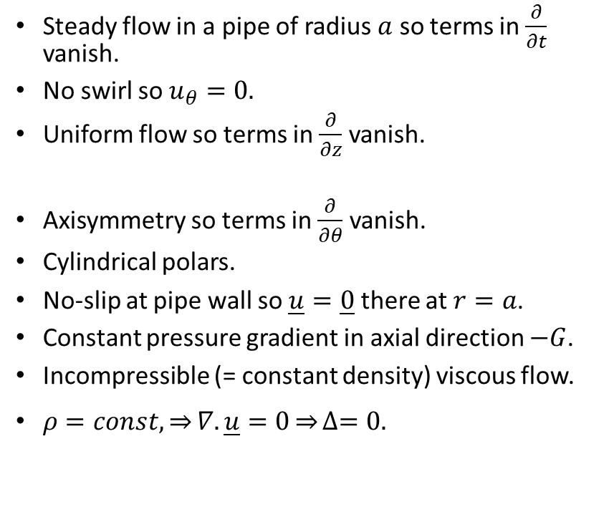



Poiseuille Flow – 2
Steady flow in a pipe of radius $a$ so terms in $\frac{∂}{∂t}$ vanish.
No swirl so $u_{θ}=0.$
Uniform flow so terms in $\frac{∂}{∂z}$ vanish.
Axisymmetry so terms in $\frac{∂}{∂θ}$vanish.
Cylindrical polars.
No-slip at pipe wall so $\underline{u}=\underline{0}$ there at $r=a$.
Constant pressure gradient in axial direction $−G$.
Incompressible (= constant density) viscous flow.
$ρ=const, \underset{⇒}{}∇.\underline{u}=0\underset{⇒}{}∆=0.$
$\underline{u}=\left(u_{r}, u_{θ}, u_{z}\right)$
$$r$$
$$u_{z}$$
$$r=a$$
$$θ$$
$$z$$

Slide 12
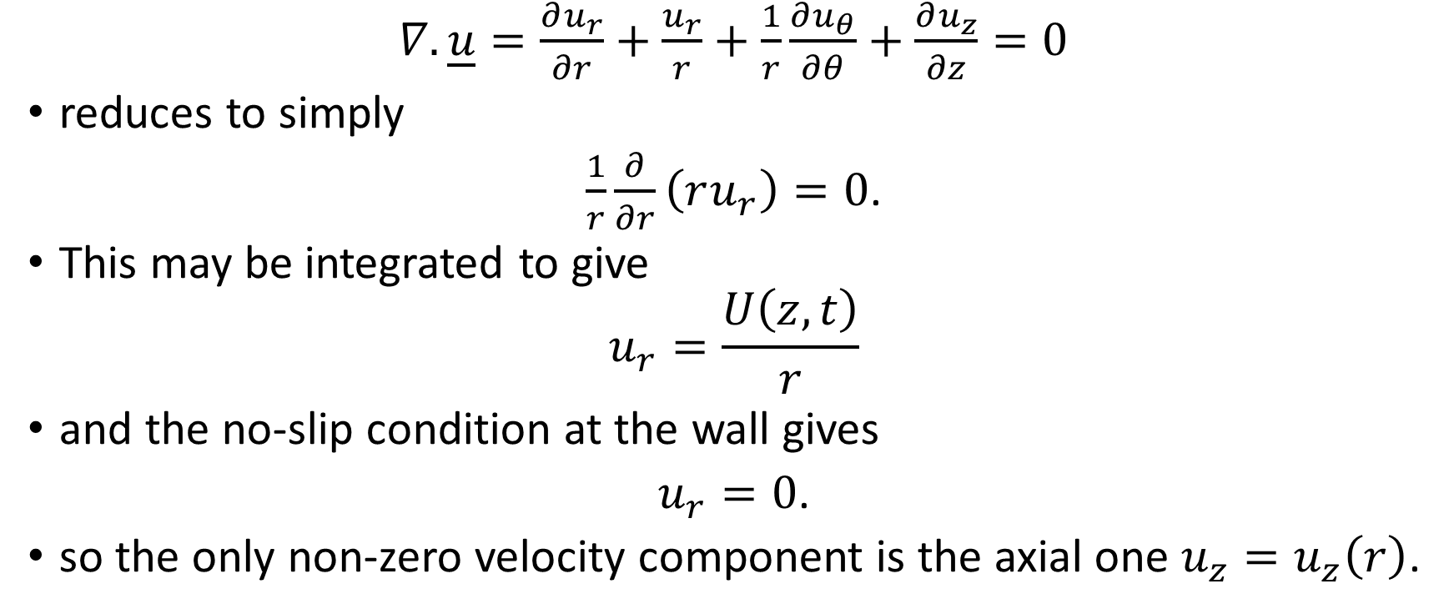
Poiseuille Flow - 3
$∇.\underline{u}=\frac{∂u_{r}}{∂r}+\frac{u_{r}}{r}+\frac{1}{r}\frac{∂u_{θ}}{∂θ}+\frac{∂u_{z}}{∂z}=0$
reduces to simply
$\frac{1}{r}\frac{∂}{∂r}\left(ru_{r}\right)=0$.
This may be integrated to give
$$u_{r}=\frac{U\left(z, t\right)}{r}$$
and the no-slip condition at the wall gives
$u_{r}=0$.
so the only non-zero velocity component is the axial one $u_{z}=u_{z}\left(r\right)$.

Slide 13
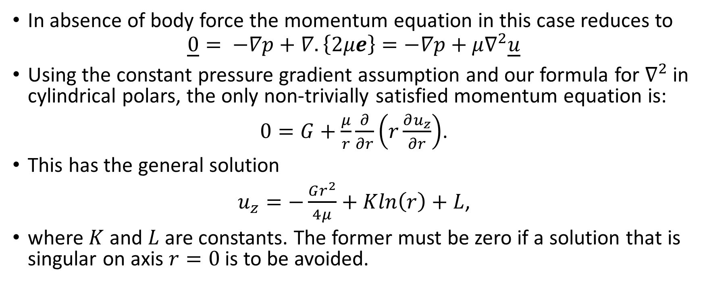
Poiseuille Flow - 4
In absence of body force the momentum equation in this case reduces to
$$\underline{0}= −∇p+∇.\left\{2μe\right\}=−∇p+μ∇^{2}\underline{u}$$
Using the constant pressure gradient assumption and our formula for $∇^{2}$ in cylindrical polars, the only non-trivially satisfied momentum equation is:
$0=G+\frac{μ}{r}\frac{∂}{∂r}\left(r\frac{∂u_{z}}{∂r}\right)$.
This has the general solution
$u_{z}=−\frac{Gr^{2}}{4μ}+Kln\left(r\right)+L$,
where $K$ and $L$ are constants. The former must be zero if a solution that is singular on axis $r=0$is to be avoided.

Slide 14
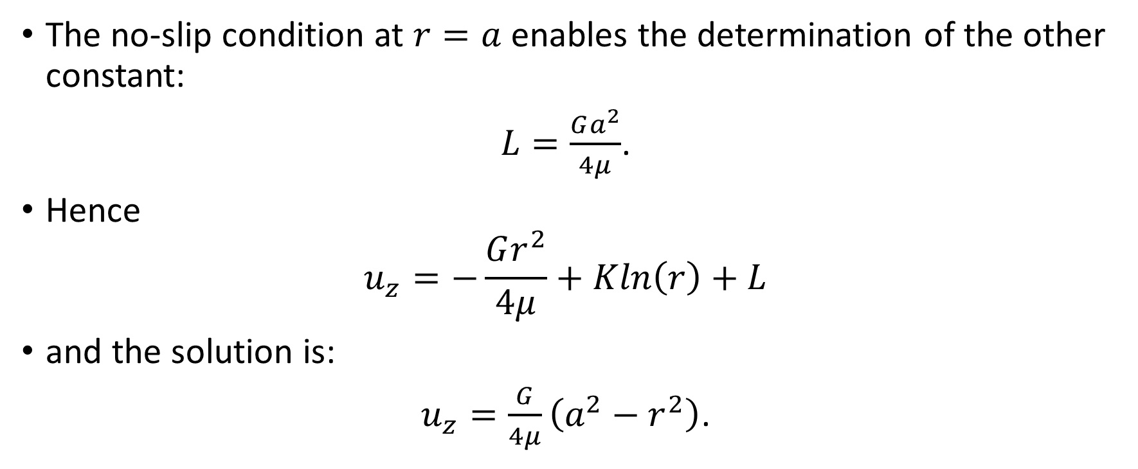
Poiseuille Flow - 5
The no-slip condition at $r=a$ enables the determination of the other constant:
$L=\frac{Ga^{2}}{4μ}$.
Hence
$$u_{z}=−\frac{Gr^{2}}{4μ}+Kln\left(r\right)+L$$
and the solution is:
$u_{z}=\frac{G}{4μ}\left(a^{2}−r^{2}\right)$.

Slide 15
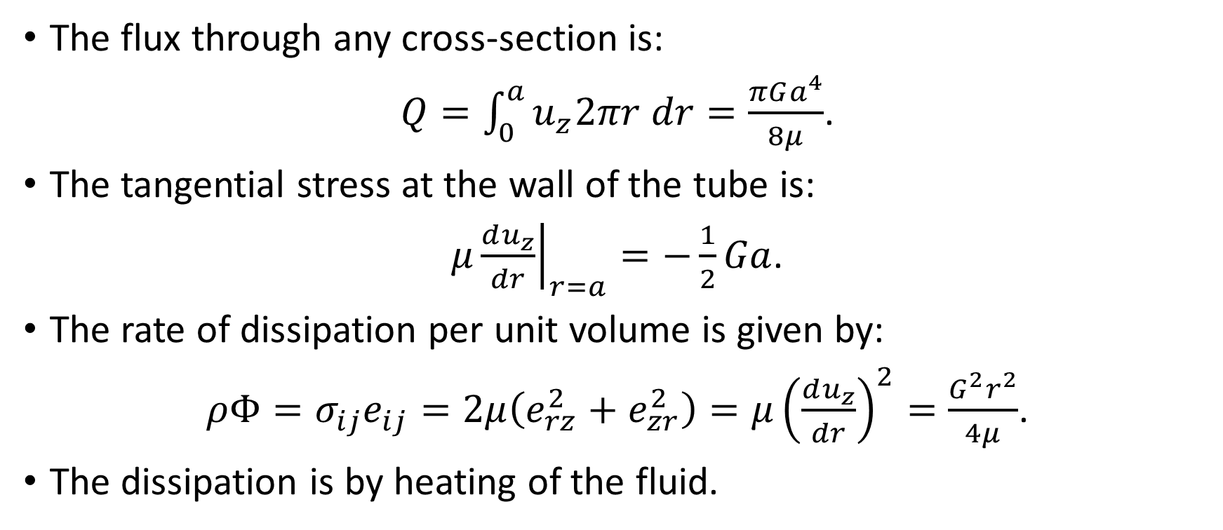
Poiseuille Flow -6
The flux through any cross-section is:
$Q=\int_{0}^{a}{u_{z}2πr dr=\frac{πGa^{4}}{8μ}}$.
The tangential stress at the wall of the tube is:
$μ{\left.\frac{du_{z}}{dr}\right|}_{r=a}=−\frac{1}{2}Ga$.
The rate of dissipation per unit volume is given by:
$ρΦ=σ_{ij}e_{ij}=2μ\left(e_{rz}^{2}+e_{zr}^{2}\right)=μ{\left(\frac{du_{z}}{dr}\right)}^{2}=\frac{G^{2}r^{2}}{4μ}$.
The dissipation is by heating of the fluid.

Slide 16
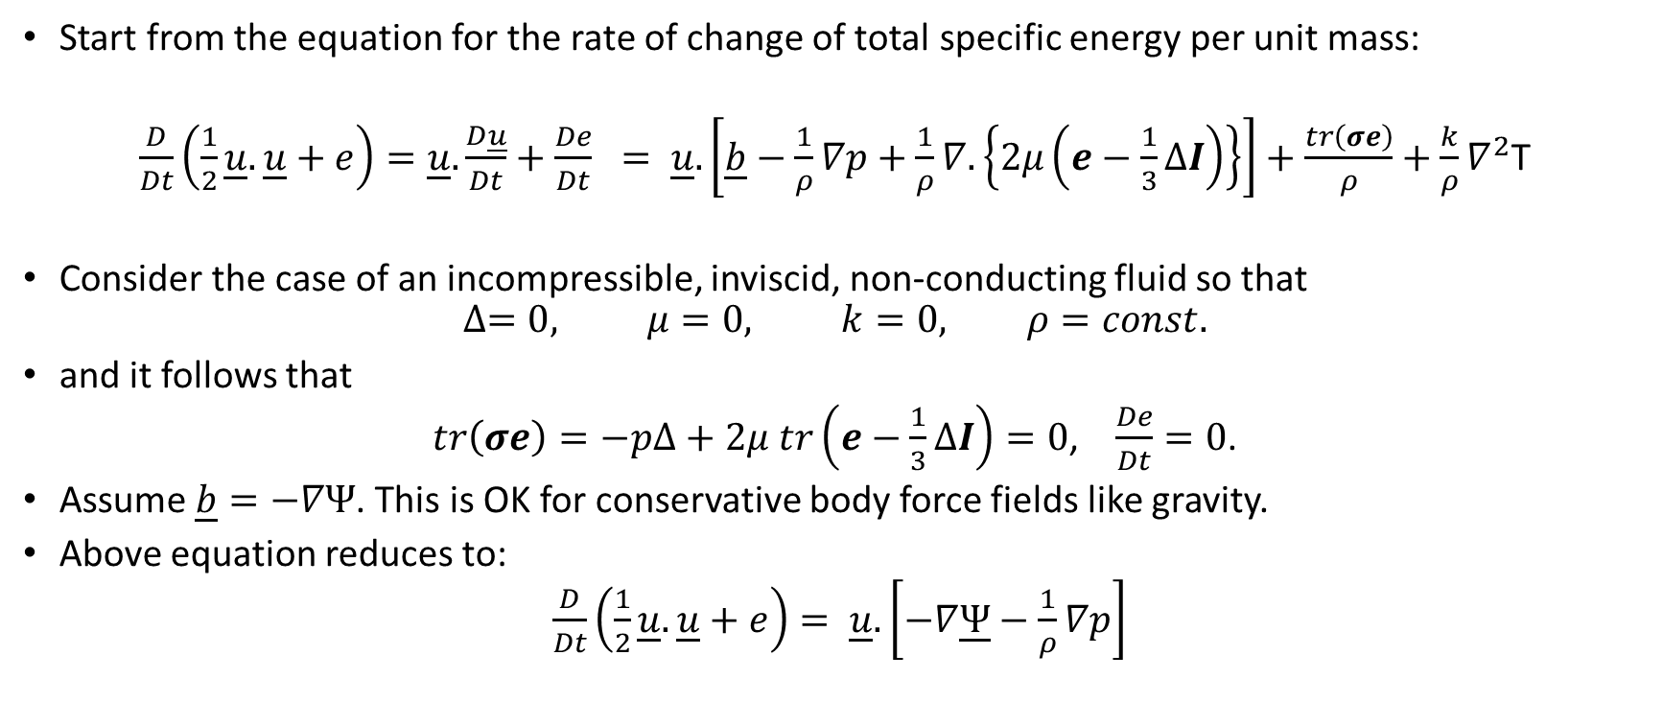
Bernoulli’s Law - 1
Start from the equation for the rate of change of total specific energy per unit mass:
$\frac{D}{Dt}\left(\frac{1}{2}\underline{u}.\underline{u}+e\right)=\underline{u}.\frac{D\underline{u}}{Dt}+\frac{De}{Dt} = \underline{u}.\left[\underline{b}−\frac{1}{ρ}∇p+\frac{1}{ρ}∇.\left\{2μ\left(e−\frac{1}{3}∆I\right)\right\}\right]+\frac{tr\left(σe\right)}{ρ}+\frac{k}{ρ}∇^{2}$T
Consider the case of an incompressible, inviscid, non-conducting fluid so that
$$∆=0, μ=0, k=0, ρ=const.$$
and it follows that
$tr\left(σe\right)=−p∆+2μ tr\left(e−\frac{1}{3}∆I\right)=0$, $\frac{De}{Dt}=0$.
Assume $\underline{b}=−∇Ψ$. This is OK for conservative body force fields like gravity.
Above equation reduces to:
$\frac{D}{Dt}\left(\frac{1}{2}\underline{u}.\underline{u}+e\right)= \underline{u}.\left[−∇\underline{Ψ}−\frac{1}{ρ}∇p\right]$

Slide 17
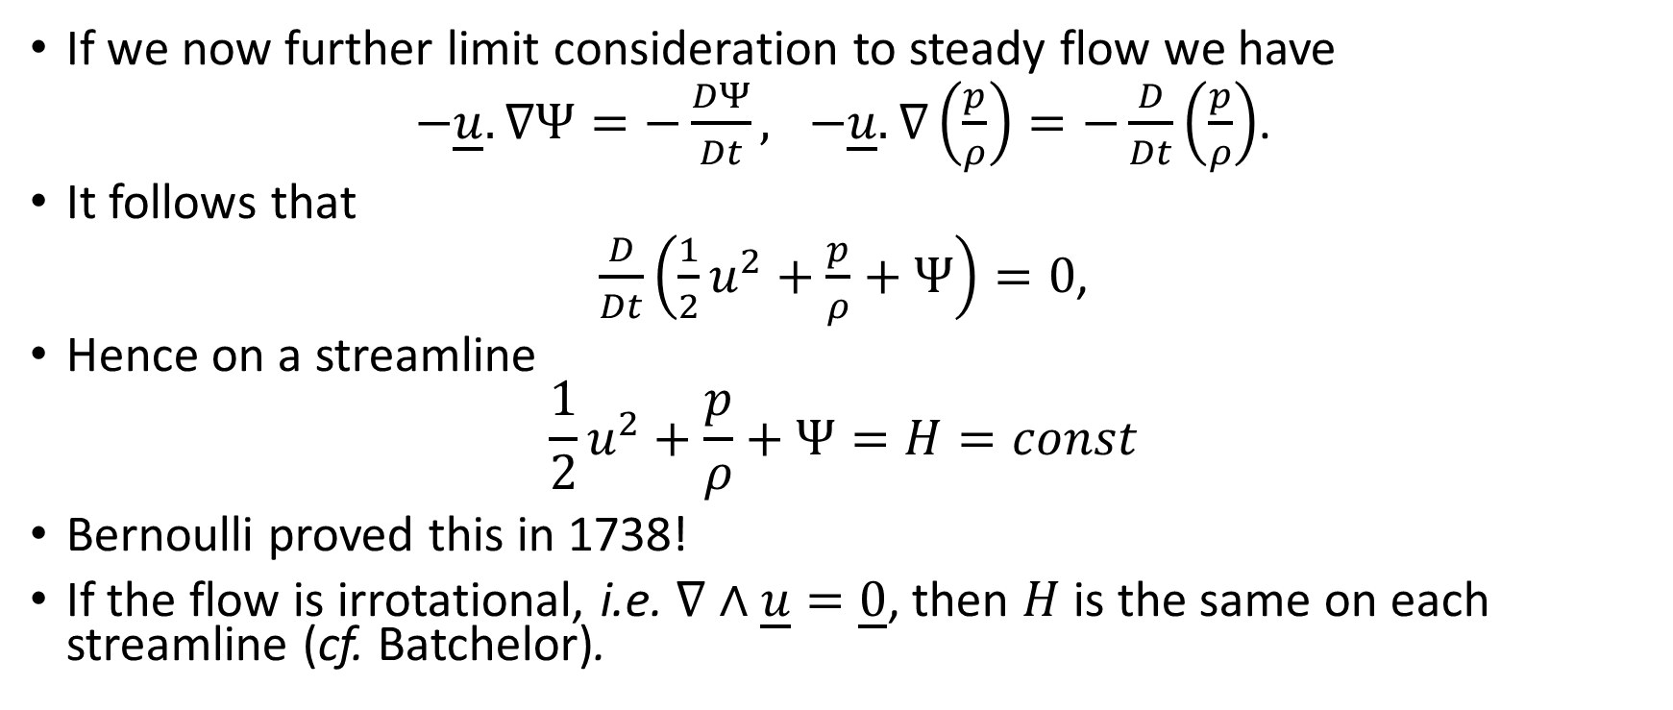
Bernoulli’s Law - 2
If we now further limit consideration to steady flow we have
$−\underline{u}. ∇Ψ=−\frac{DΨ}{Dt}, −\underline{u}.∇\left(\frac{p}{ρ}\right)=−\frac{D}{Dt}\left(\frac{p}{ρ}\right)$.
It follows that
$\frac{D}{Dt}\left(\frac{1}{2}u^{2}+\frac{p}{ρ}+Ψ\right)=0$,
Hence on a streamline
$$\frac{1}{2}u^{2}+\frac{p}{ρ}+Ψ=H=const$$
Bernoulli proved this in 1738!
If the flow is irrotational, i.e. $∇∧\underline{u}=\underline{0}$, then $H$ is the same on each streamline (cf. Batchelor).

Slide 18



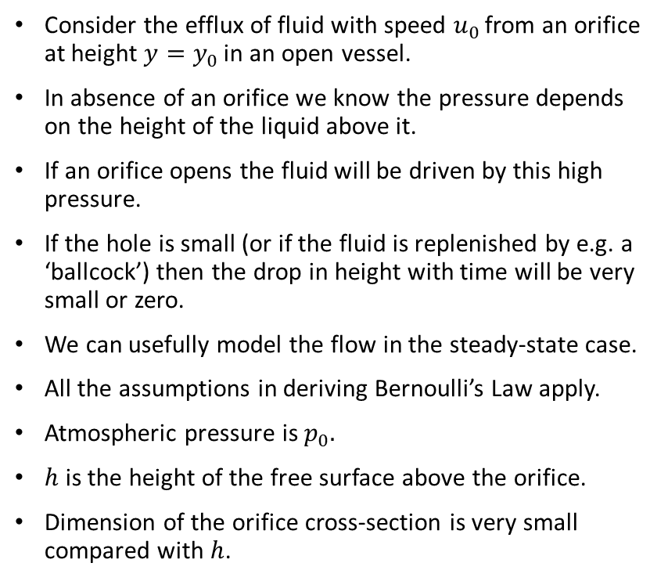




Bernoulli’s Law – 3: An Application
Consider the efflux of fluid with speed $u_{0 }$from an orifice at height $y=y_{0 }$in an open vessel.
In absence of an orifice we know the pressure depends on the height of the liquid above it.
If an orifice opens the fluid will be driven by this high pressure.
If the hole is small (or if the fluid is replenished by e.g. a ‘ballcock’) then the drop in height with time will be very small or zero.
We can usefully model the flow in the steady-state case.
All the assumptions in deriving Bernoulli’s Law apply.
Atmospheric pressure is $p_{0}.$
$h$ is the height of the free surface above the orifice.
Dimension of the orifice cross-section is very small compared with $h$.
$$y$$
$$p_{o}$$
$$h$$
$$p_{o}$$
$$u_{o}$$
$$y_{0}$$
$$x$$

Slide 19
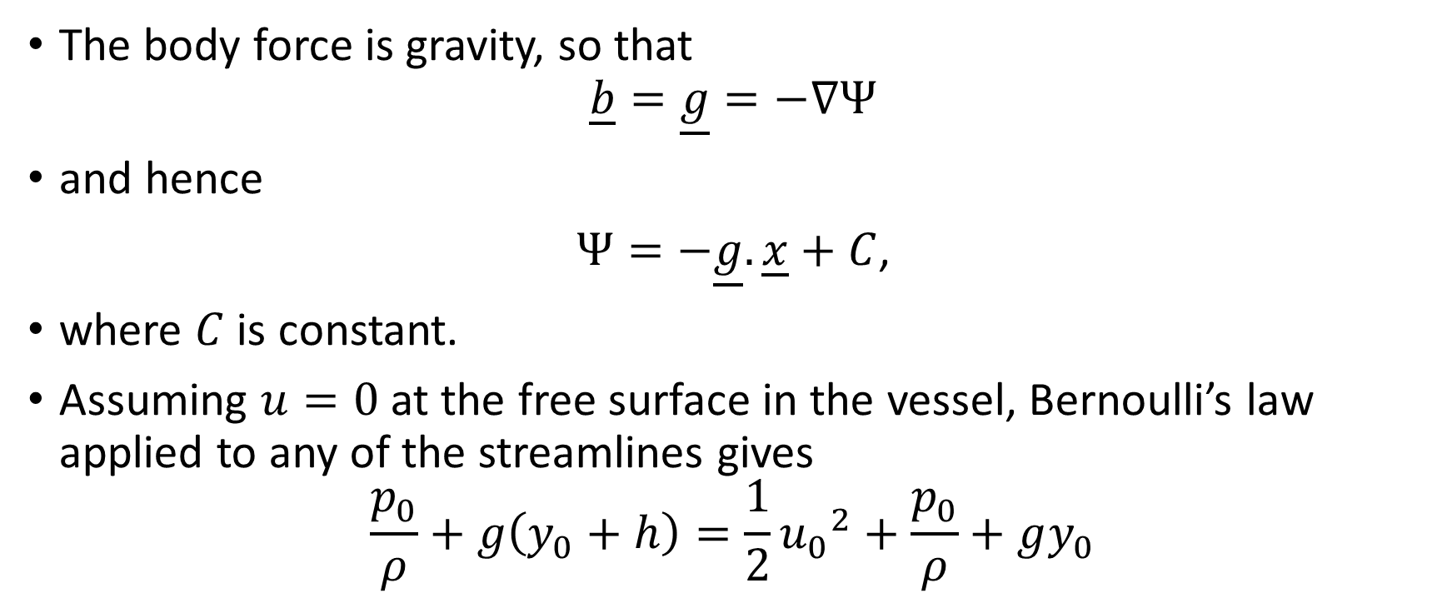
Bernoulli’s Law – 4
The body force is gravity, so that
$$\underline{b}=\underline{g}=−∇Ψ$$
and hence
$Ψ=−\underline{g}.\underline{x}+C$,
where $C$ is constant.
Assuming $u=0$ at the free surface in the vessel, Bernoulli’s law applied to any of the streamlines gives
$$\frac{p_{0}}{ρ}+g\left(y_{0}+h\right)=\frac{1}{2}{u_{0}}^{2}+\frac{p_{0}}{ρ}+gy_{0}$$

Slide 20
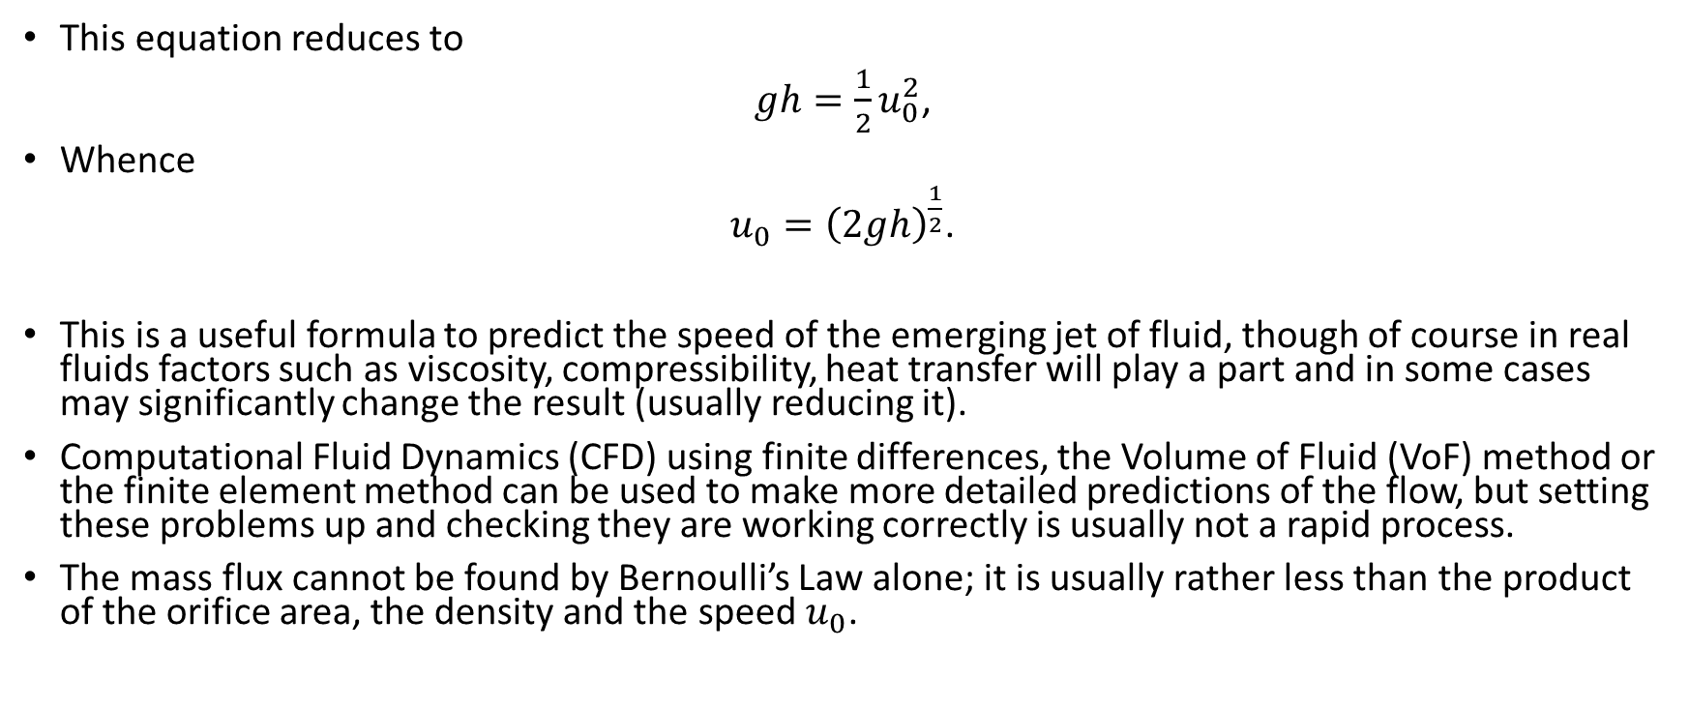
Bernoulli’s Law – 5
This equation reduces to
$gh=\frac{1}{2}u_{0}^{2}$,
Whence
$u_{0}={\left(2gh\right)}^{\frac{1}{2}}$.
This is a useful formula to predict the speed of the emerging jet of fluid, though of course in real fluids factors such as viscosity, compressibility, heat transfer will play a part and in some cases may significantly change the result (usually reducing it).
Computational Fluid Dynamics (CFD) using finite differences, the Volume of Fluid (VoF) method or the finite element method can be used to make more detailed predictions of the flow, but setting these problems up and checking they are working correctly is usually not a rapid process.
The mass flux cannot be found by Bernoulli’s Law alone; it is usually rather less than the product of the orifice area, the density and the speed${ u}_{0}$.

Slide 21
Bernoulli’s Law – 6
In industry many vessels are pressurised so the pressure terms differ on either side of the equation.
In fact the efflux may be controlled by adjusting this pressure or changing the size or shape of the orifice.
There are analytical results available for two-dimensional flows from orifices – Batchelor describes these in more detail.
An important application is that of quickly and crudely modelling accidents where there is a breach of the vessel and a jet of fluid escapes.

Slide 22
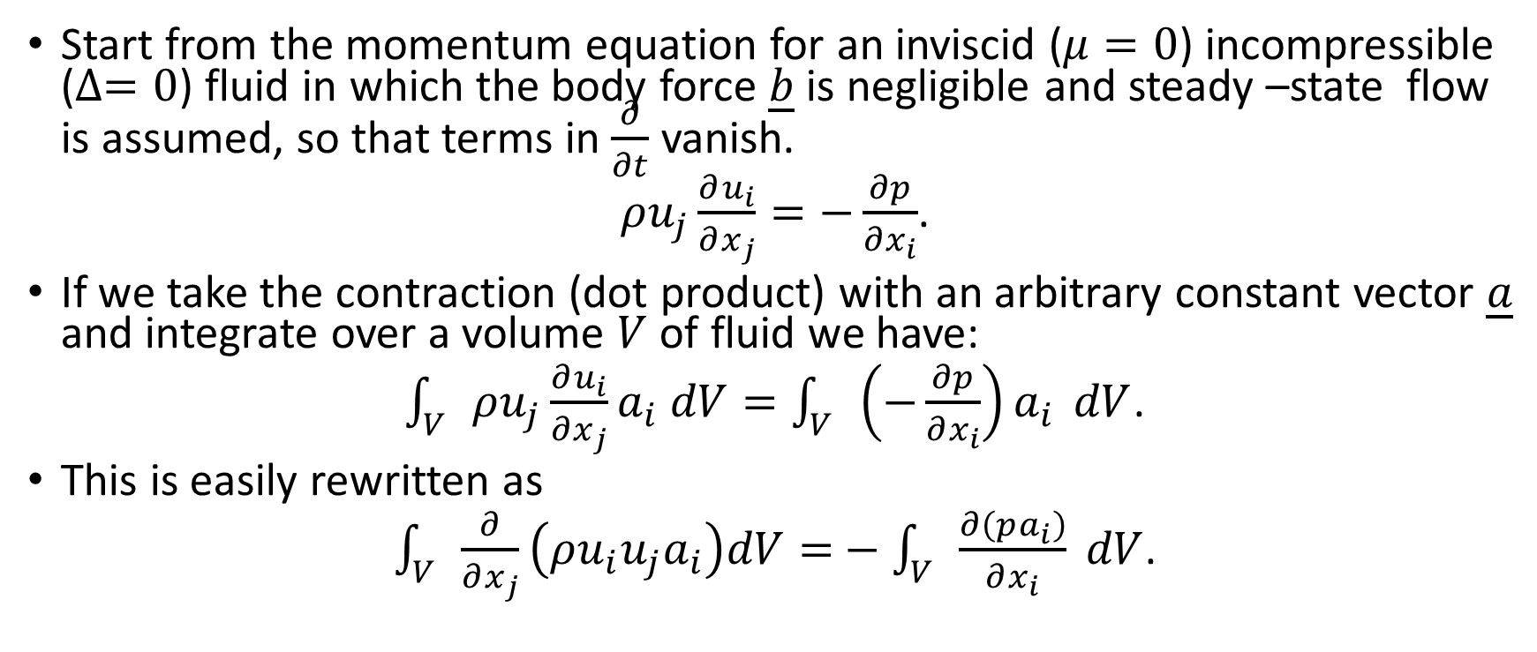
Momentum Integral Method - 1
Start from the momentum equation for an inviscid ($μ=0$) incompressible ($∆=0$) fluid in which the body force $\underline{b}$ is negligible and steady –state flow is assumed, so that terms in $\frac{∂}{∂t}$ vanish.
$ρu_{j}\frac{∂u_{i}}{∂x_{j}}=−\frac{∂p}{∂x_{i}}$.
If we take the contraction (dot product) with an arbitrary constant vector $\underline{a}$ and integrate over a volume $V$ of fluid we have:
$\int_{V}{ρu_{j}\frac{∂u_{i}}{∂x_{j}}}a_{i} dV=\int_{V}{\left(−\frac{∂p}{∂x_{i}}\right)a_{i}} dV$.
This is easily rewritten as
$\int_{V}{\frac{∂}{∂x_{j}}\left(ρu_{i}u_{j}a_{i}\right)dV=}−\int_{V}{\frac{∂\left(pa_{i}\right)}{∂x_{i}} dV}$.

Slide 23
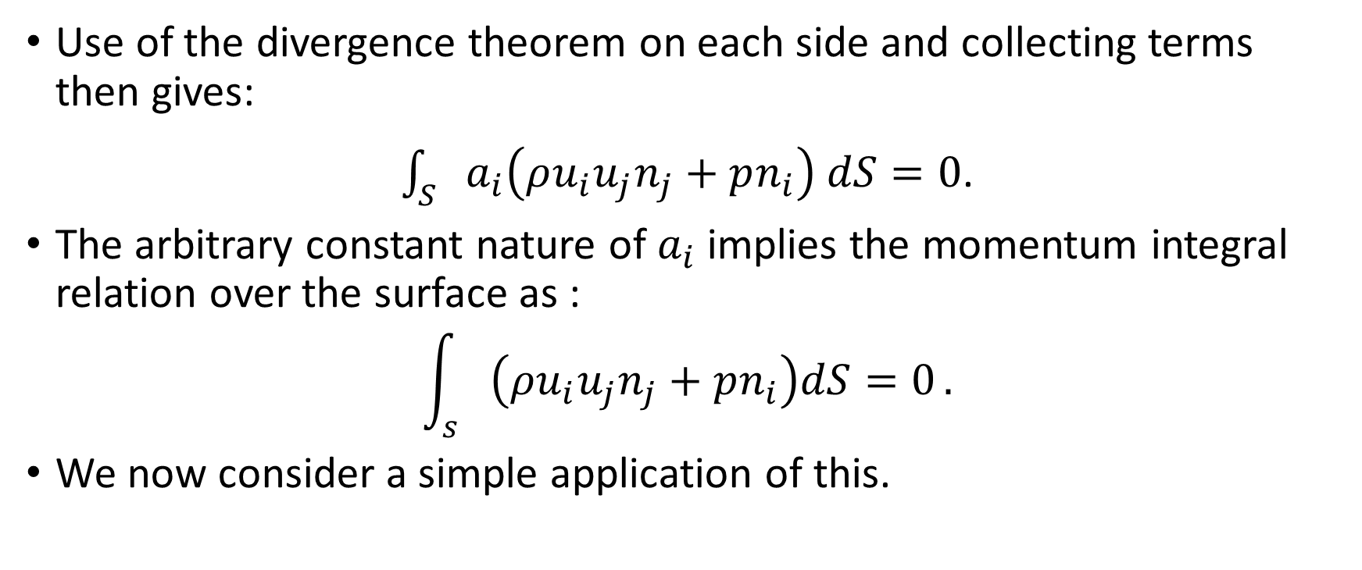
Momentum Integral Method - 2
Use of the divergence theorem on each side and collecting terms then gives:
$\int_{S}{a_{i}\left(ρu_{i}u_{j}n_{j}+pn_{i}\right) dS=0}$.
The arbitrary constant nature of $a_{i}$ implies the momentum integral relation over the surface as :
$$\int_{s}{\left(ρu_{i}u_{j}n_{j}+pn_{i}\right)dS=0}.$$
We now consider a simple application of this.

Slide 24





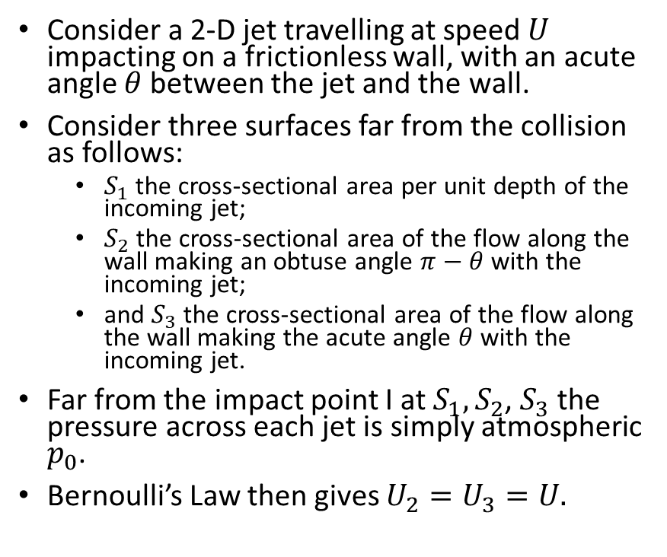






Momentum Integral Method – 3: An Application
Consider a 2-D jet travelling at speed $U$ impacting on a frictionless wall, with an acute angle $θ$between the jet and the wall.
Consider three surfaces far from the collision as follows:
  $S_{1}$ the cross-sectional area per unit depth of the incoming jet;
  $S_{2}$ the cross-sectional area of the flow along the wall making an obtuse angle $π−θ$with the incoming jet;
  and $S_{3}$ the cross-sectional area of the flow along the wall making the acute angle $θ$ with the incoming jet.
Far from the impact point I at $S_{1}{,S}_{2}$, $S_{3}$ the pressure across each jet is simply atmospheric $p_{0}$.
Bernoulli’s Law then gives $U_{2}=U_{3}=U.$
$$S_{1}$$
$$U$$
$$p_{0}$$
$$S_{4}$$
$$p_{0}$$
$$S_{5}$$
$$U_{2}$$
$$U_{3}$$
$$S_{2}$$
I
$$S_{W}$$
$$S_{3}$$

Slide 25
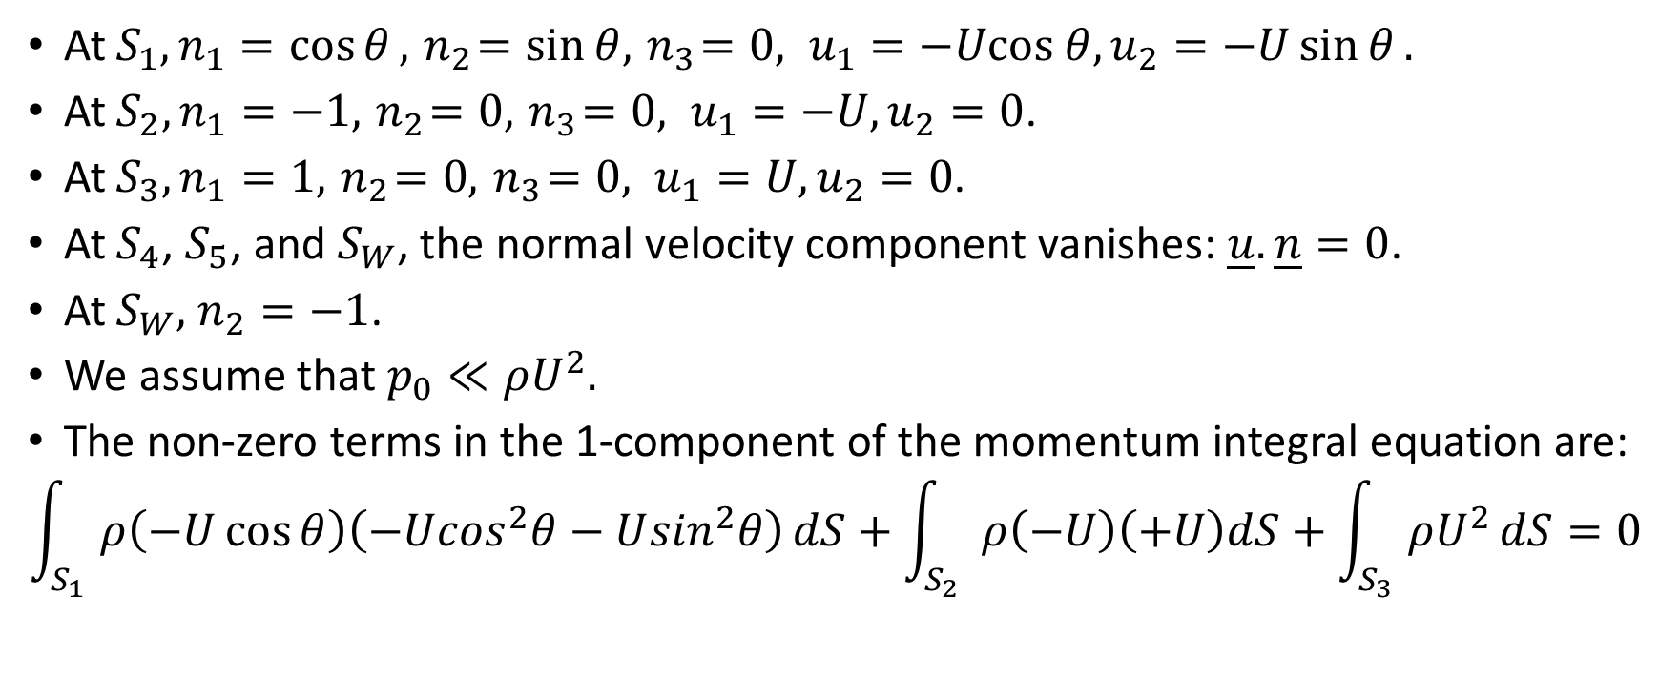
Momentum Integral Method – 4
At $S_{1}, n_{1}=\cos{θ}, { n}_{2}=\sin{θ, { n}_{3}=0, u_{1}=−Ucos θ, u_{2}=−U\sin{θ}.}$
At $S_{2}, n_{1}=−1, { n}_{2}=0{, { n}_{3}=0, u_{1}=−U, u_{2}=0}$.
At $S_{3}, n_{1}=1, { n}_{2}=0{, { n}_{3}=0, u_{1}=U, u_{2}=0}$.
At $S_{4}$, $S_{5}$, and $S_{W}$, the normal velocity component vanishes: $\underline{u}.\underline{n}=0$.
At $S_{W},$ $n_{2}=−1$.
We assume that $p_{0}≪ρU^{2}.$
The non-zero terms in the 1-component of the momentum integral equation are:
$$\int_{S_{1}}{ρ\left(−U\cos{θ}\right)\left(−U\cos^{2}θ−U\sin^{2}θ\right)}dS+\int_{S_{2}}{ρ\left(−U\right)\left(+U\right)dS+\int_{S_{3}}{ρU^{2}}dS=0}$$

Slide 26
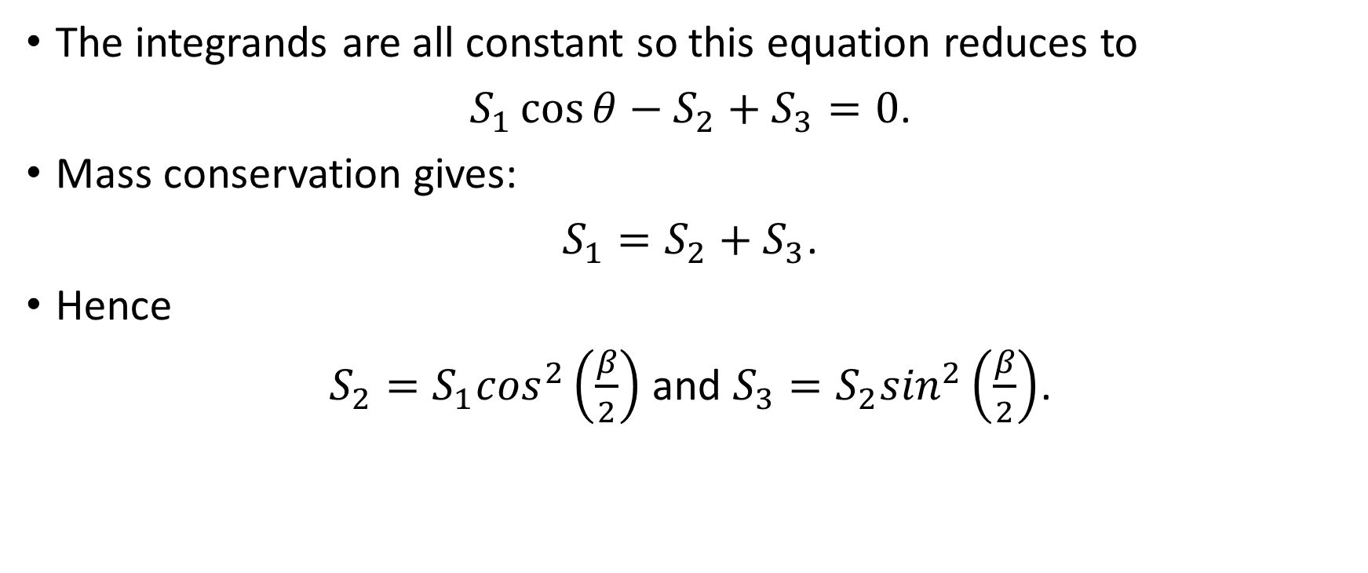
Momentum Integral Method – 5
The integrands are all constant so this equation reduces to
$S_{1}\cos{θ−S_{2}+S_{3}=0}$.
Mass conservation gives:
$S_{1}=S_{2}+S_{3}$.
Hence
$S_{2}={S_{1}cos}^{2}\left(\frac{β}{2}\right)$ and $S_{3}={S_{2}sin}^{2}\left(\frac{β}{2}\right)$.

Slide 27
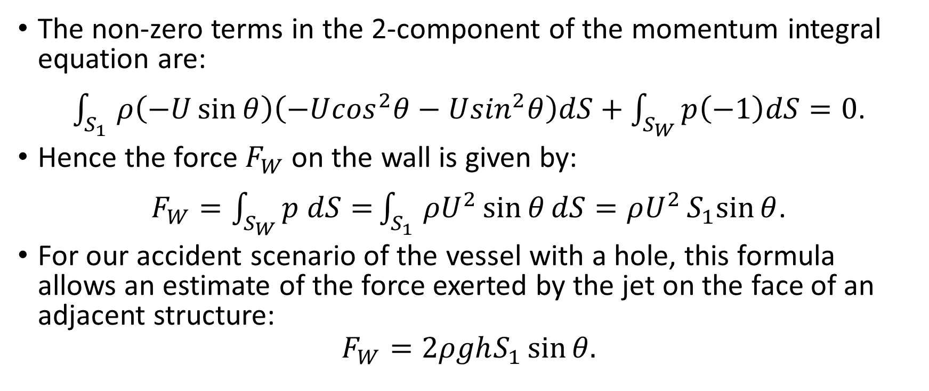
Momentum Integral Method – 6
The non-zero terms in the 2-component of the momentum integral equation are:
$\int_{S_{1}}{ρ\left(−U\sin{θ}\right)\left(−U\cos^{2}θ−U\sin^{2}θ\right)dS+\int_{S_{W}}{p\left(−1\right)dS=0}}$.
Hence the force $F_{W}$ on the wall is given by:
$F_{W}=\int_{S_{W}}{p dS=}\int_{S_{1}}{ρU^{2}\sin{θ}dS=ρU^{2}S_{1}sin{θ}}$.
For our accident scenario of the vessel with a hole, this formula allows an estimate of the force exerted by the jet on the face of an adjacent structure:
$$F_{W}=2ρghS_{1}\sin{θ.}$$

Slide 28
Time-Dependent Solutions
Oscillatory Flows - 1
Although steady-state solutions have useful applications as we have just seen – with some more to come as we consider jets - the vast majority of flows are in reality time-dependent.
It is obviously impossible to cover everything, but here are some that have come up or been of interest in my work in industry.
Through my work on spacecraft I encountered periodic flow in a tube associated with the nutation damper for the Ulysses spacecraft. I regret I cannot show you this work as it was proprietary work, uncleared for publication.
However, we can usefully discuss some examples of oscillatory flows which give you the ‘flavour’ of the work, which as I said is the aim of this course.

Slide 29

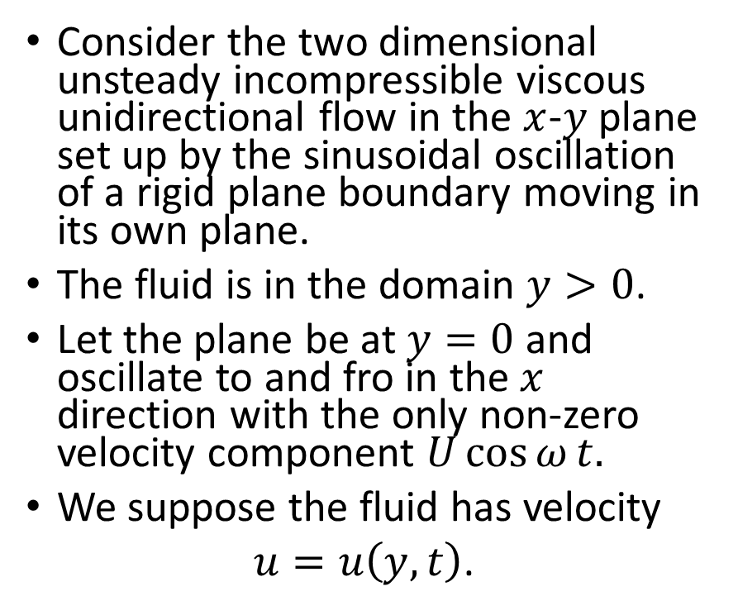

Oscillatory Flows - 2
$$y$$
Consider the two dimensional unsteady incompressible viscous unidirectional flow in the $x$-$y$plane set up by the sinusoidal oscillation of a rigid plane boundary moving in its own plane.
The fluid is in the domain $y>0$.
Let the plane be at $y=0$and oscillate to and fro in the $x$ direction with the only non-zero velocity component $U\cos{ω}t.$
We suppose the fluid has velocity
$u=u\left(y,t\right)$.
$$x$$

Slide 30
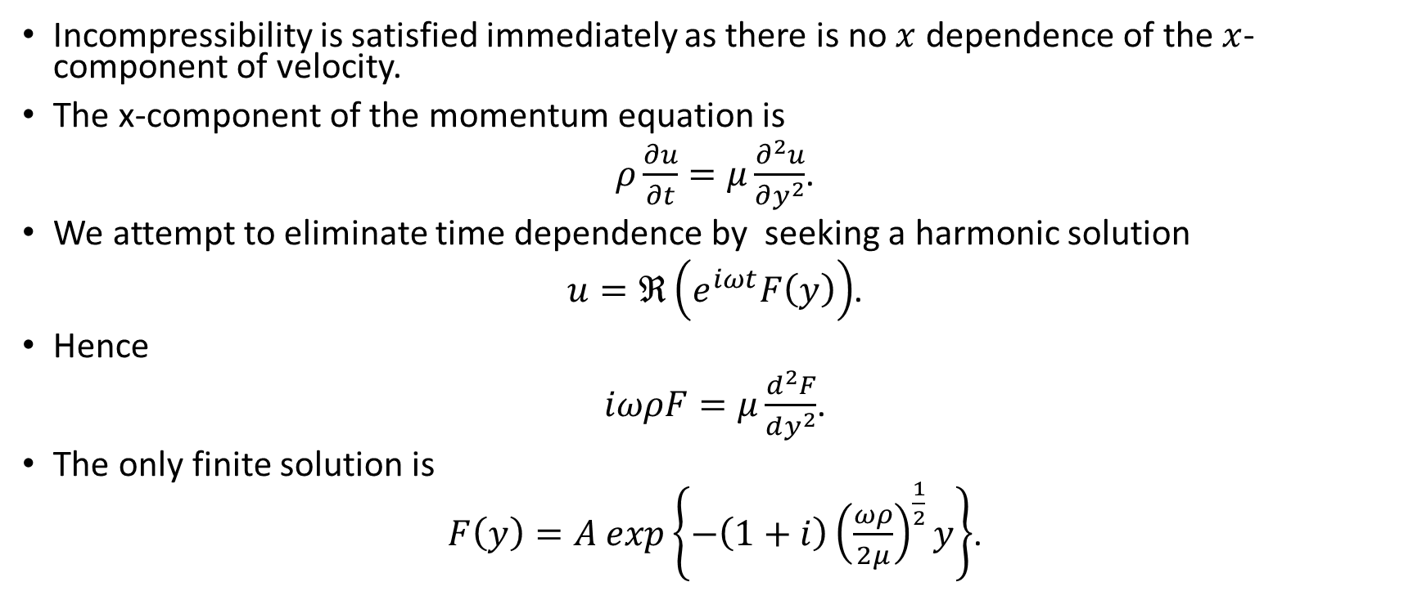
Oscillatory Flows - 3
Incompressibility is satisfied immediately as there is no $x$ dependence of the $x$-component of velocity.
The x-component of the momentum equation is
$ρ\frac{∂u}{∂t}=μ\frac{∂^{2}u}{∂y^{2}}$.
We attempt to eliminate time dependence by seeking a harmonic solution
$u=ℜ\left(e^{iωt}F\left(y\right)\right)$.
Hence
$iωρF=μ\frac{d^{2}F}{dy^{2}}$.
The only finite solution is
$F\left(y\right)=A exp\left\{−\left(1+i\right){\left(\frac{ωρ}{2μ}\right)}^{\frac{1}{2}}y\right\}$.

Slide 31
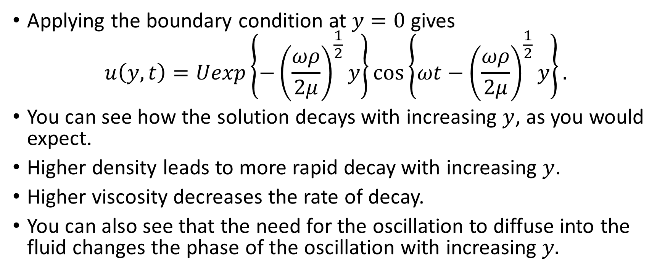
Oscillatory Flows - 4
Applying the boundary condition at $y=0$ gives
$$u\left(y,t\right)=Uexp\left\{−{\left(\frac{ωρ}{2μ}\right)}^{\frac{1}{2}}y\right\}\cos\left\{ωt−{\left(\frac{ωρ}{2μ}\right)}^{\frac{1}{2}}y\right\}.$$
You can see how the solution decays with increasing $y$, as you would expect.
Higher density leads to more rapid decay with increasing $y$.
Higher viscosity decreases the rate of decay.
You can also see that the need for the oscillation to diffuse into the fluid changes the phase of the oscillation with increasing $y.$

Slide 32

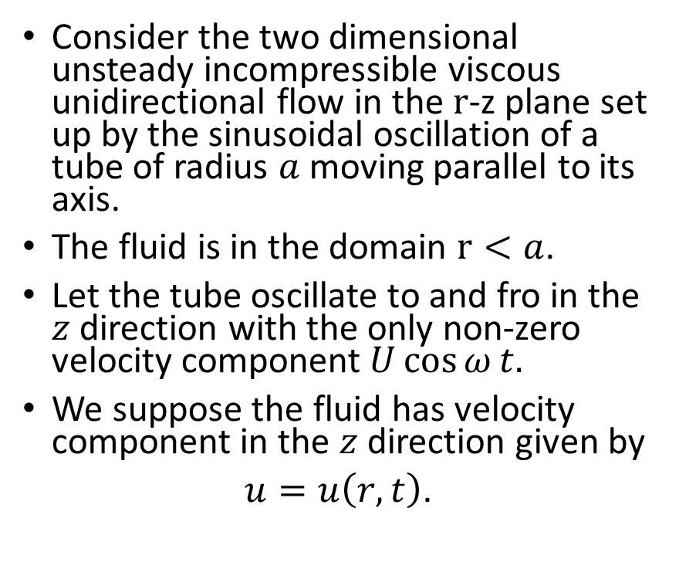


Oscillatory Flow - 5
Consider the two dimensional unsteady incompressible viscous unidirectional flow in the $r$-z plane set up by the sinusoidal oscillation of a tube of radius $a$moving parallel to its axis.
The fluid is in the domain $r<a$.
Let the tube oscillate to and fro in the $z$ direction with the only non-zero velocity component $U\cos{ω}t.$
We suppose the fluid has velocity component in the $z$ direction given by
$u=u\left(r,t\right)$.
$$r$$
$$r=a$$
$$z$$

Slide 33
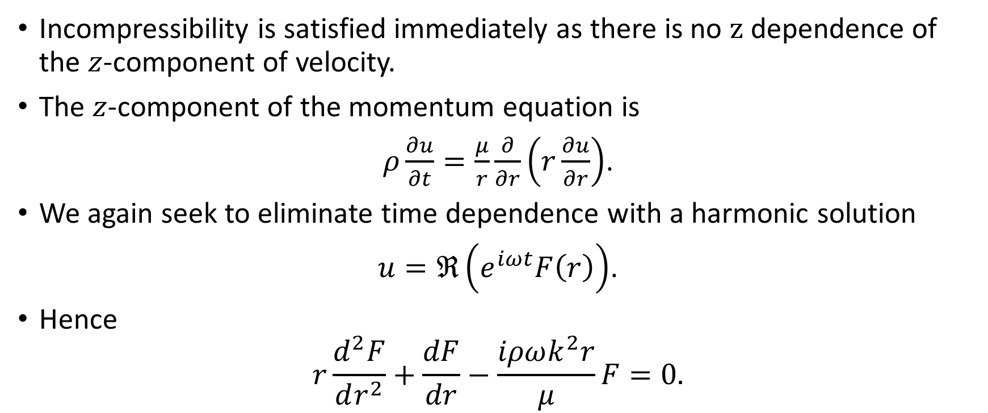
Oscillatory Flow - 6
Incompressibility is satisfied immediately as there is no $z$ dependence of the $z$-component of velocity.
The $z$-component of the momentum equation is
$ρ\frac{∂u}{∂t}=\frac{μ}{r}\frac{∂}{∂r}\left(r\frac{∂u}{∂r}\right)$.
We again seek to eliminate time dependence with a harmonic solution
$u=ℜ\left(e^{iωt}F\left(r\right)\right)$.
Hence
$$r\frac{d^{2}F}{dr^{2}}+\frac{dF}{dr}−\frac{iρωk^{2}r}{μ}F=0.$$

Slide 34
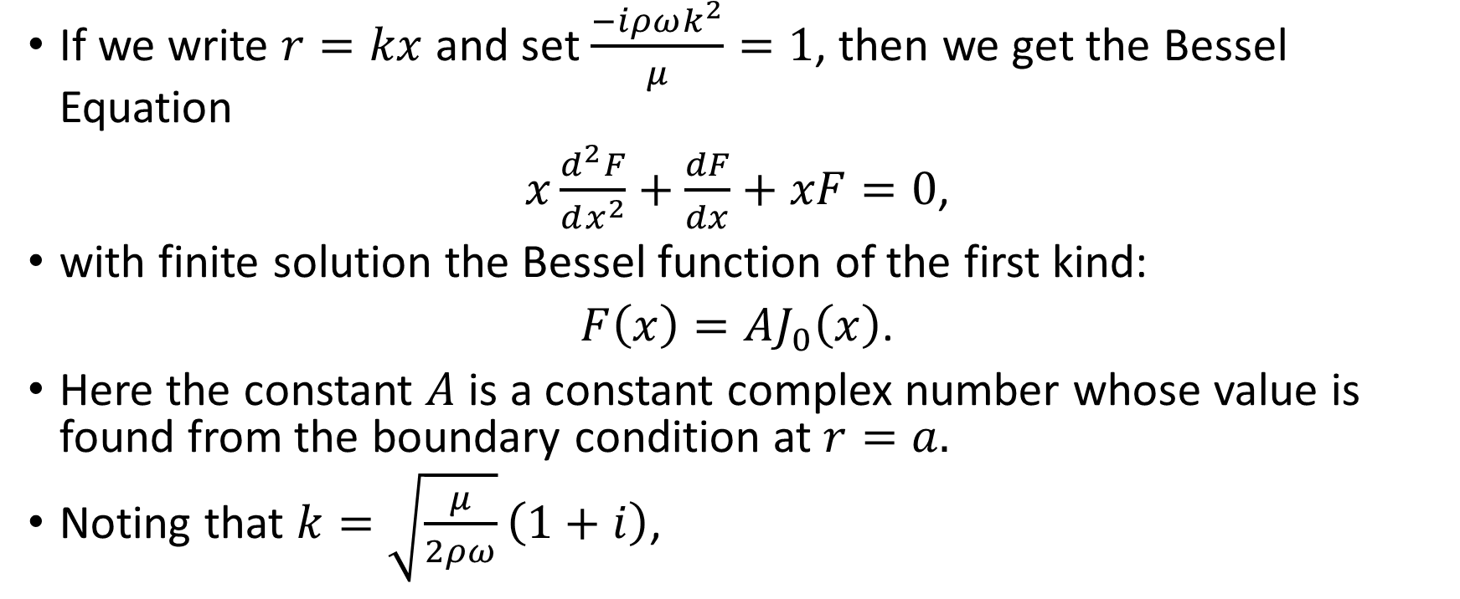
Oscillatory Flow - 7
If we write $r=kx$ and set $\frac{−iρωk^{2}}{μ}=1$, then we get the Bessel Equation
$x\frac{d^{2}F}{dx^{2}}+\frac{dF}{dx}+xF=0$,
with finite solution the Bessel function of the first kind:
$F\left(x\right)=AJ_{0}\left(x\right)$.
Here the constant $A$ is a constant complex number whose value is found from the boundary condition at $r=a.$
Noting that $k=\sqrt{\frac{μ}{2ρω}}\left(1+i\right)$,

Slide 35
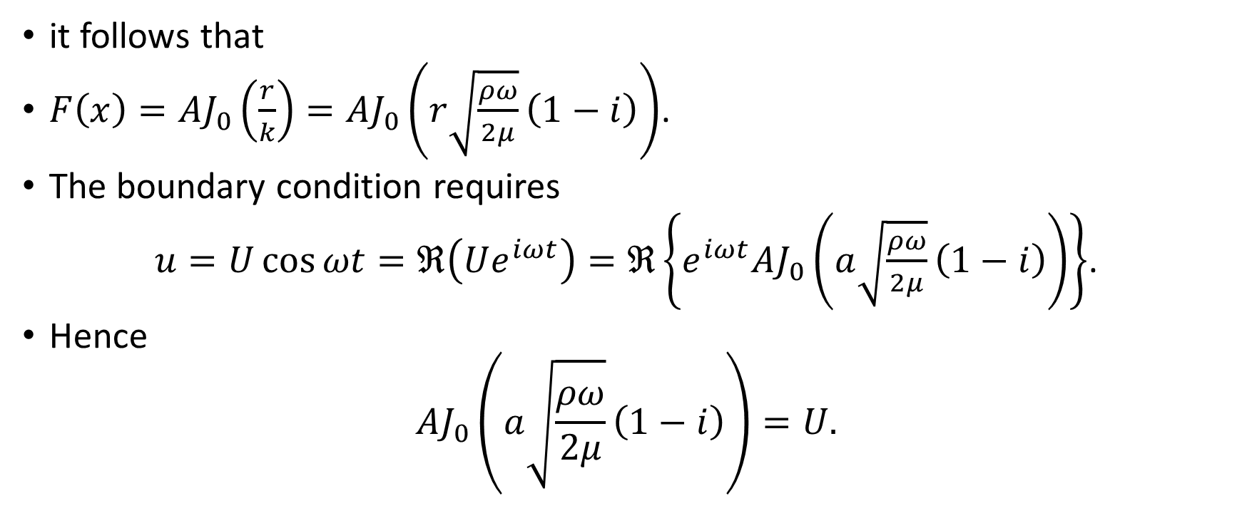
Oscillatory Flow - 8
it follows that
$F\left(x\right)=AJ_{0}\left(\frac{r}{k}\right)=AJ_{0}\left(r\sqrt{\frac{ρω}{2μ}}\left(1−i\right)\right)$.
The boundary condition requires
$u=U\cos{ωt}=ℜ\left(Ue^{iωt}\right)=ℜ\left\{e^{iωt}AJ_{0}\left(a\sqrt{\frac{ρω}{2μ}}\left(1−i\right)\right)\right\}$.
Hence
$$AJ_{0}\left(a\sqrt{\frac{ρω}{2μ}}\left(1−i\right)\right)=U.$$

Slide 36
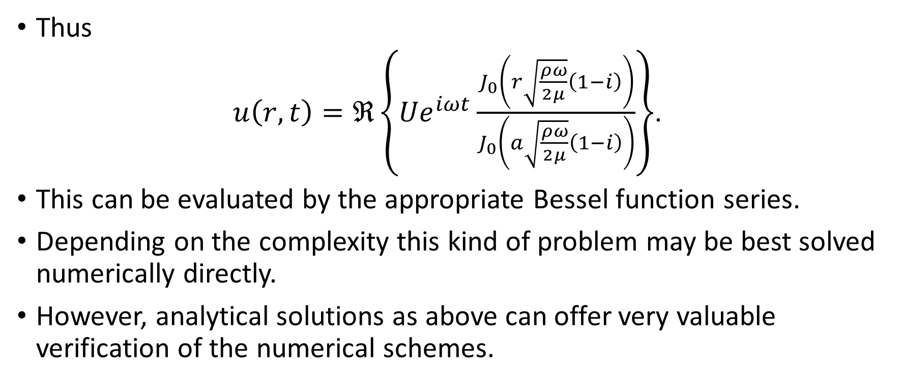
Oscillatory Flow - 9
Thus
$u\left(r,t\right)=ℜ\left\{{Ue}^{iωt}\frac{J_{0}\left(r\sqrt{\frac{ρω}{2μ}}\left(1−i\right)\right)}{J_{0}\left(a\sqrt{\frac{ρω}{2μ}}\left(1−i\right)\right)}\right\}$.
This can be evaluated by the appropriate Bessel function series.
Depending on the complexity this kind of problem may be best solved numerically directly.
However, analytical solutions as above can offer very valuable verification of the numerical schemes.

Slide 37
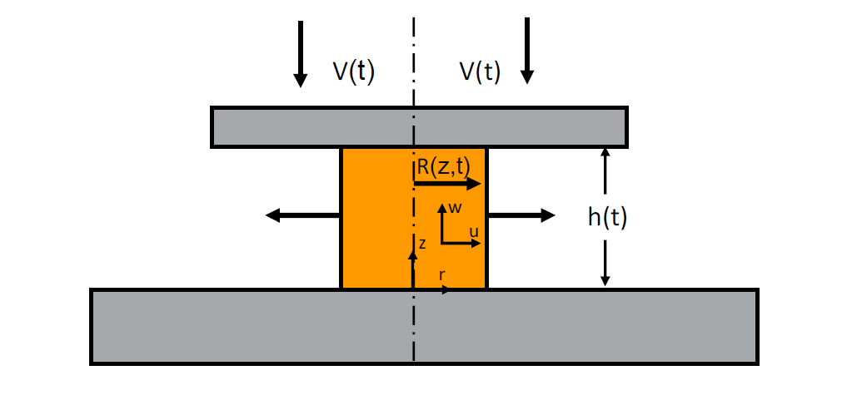
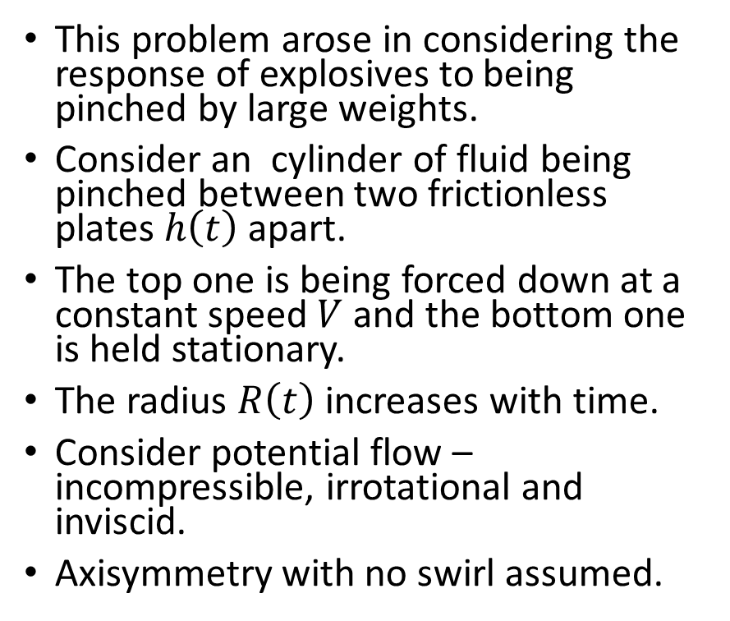
Pinching of a Cylinder - 1
This problem arose in considering the response of explosives to being pinched by large weights.
Consider an cylinder of fluid being pinched between two frictionless plates $h\left(t\right)$ apart.
The top one is being forced down at a constant speed $V$ and the bottom one is held stationary.
The radius $R\left(t\right)$ increases with time.
Consider potential flow – incompressible, irrotational and inviscid.
Axisymmetry with no swirl assumed.
R(t)

Slide 38
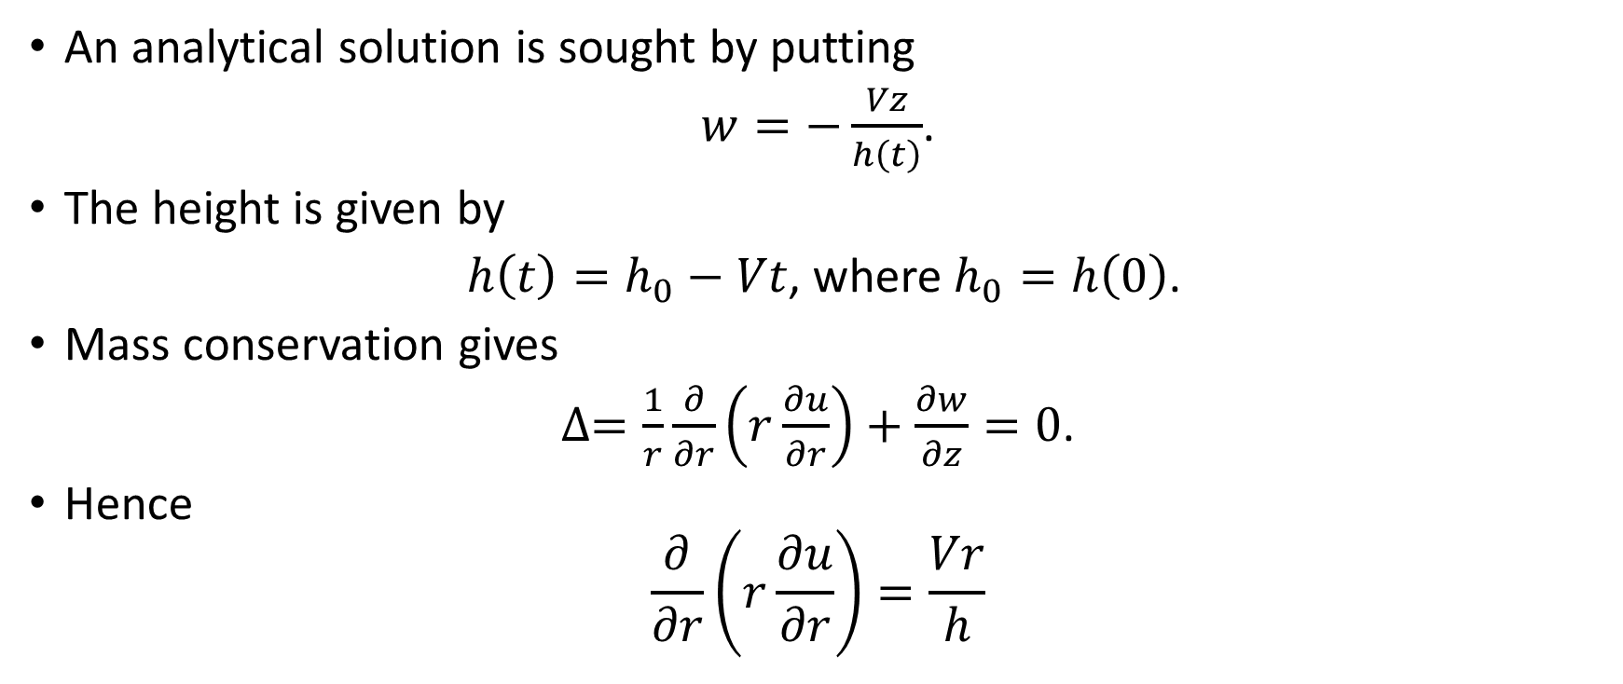
Pinching of a Cylinder - 2
An analytical solution is sought by putting
$w=−\frac{Vz}{h\left(t\right)}$.
The height is given by
$h\left(t\right)=h_{0}−Vt$, where $h_{0}=h\left(0\right)$.
Mass conservation gives
$∆=\frac{1}{r}\frac{∂}{∂r}\left(r\frac{∂u}{∂r}\right)+\frac{∂w}{∂z}=0$.
Hence
$$\frac{∂}{∂r}\left(r\frac{∂u}{∂r}\right)=\frac{Vr}{h}$$

Slide 39
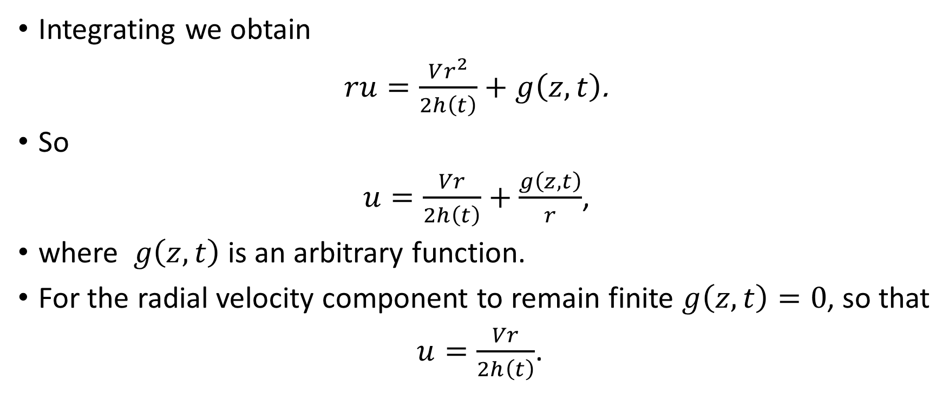
Pinching of a Cylinder - 3
Integrating we obtain
$ru=\frac{Vr^{2}}{2h\left(t\right)}+g\left(z,t\right)$.
So
$u=\frac{Vr}{2h\left(t\right)}+\frac{g\left(z,t\right)}{r}$,
where $g\left(z,t\right)$ is an arbitrary function.
For the radial velocity component to remain finite $g\left(z,t\right)=0$, so that
$u=\frac{Vr}{2h\left(t\right)}$.

Slide 40
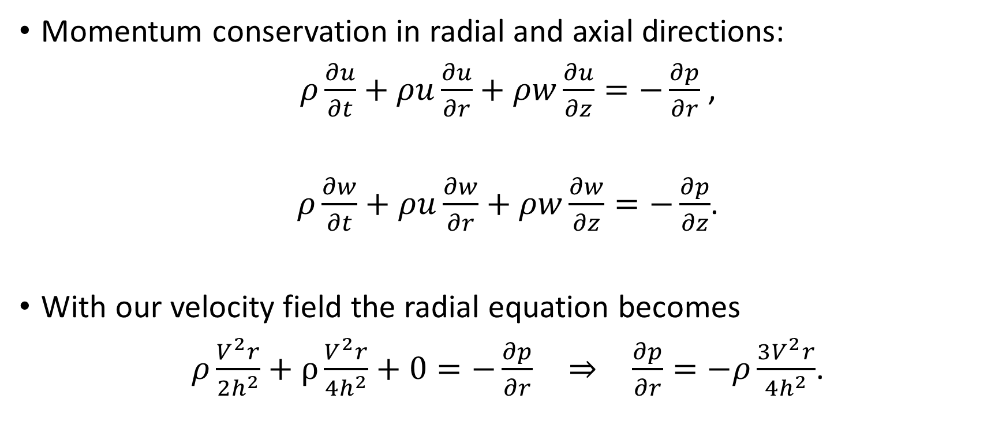
Pinching of a Cylinder - 4
Momentum conservation in radial and axial directions:
$ρ\frac{∂u}{∂t}+ρu\frac{∂u}{∂r}+ρw\frac{∂u}{∂z}=−\frac{∂p}{∂r}$ ,
$ρ\frac{∂w}{∂t}+ρu\frac{∂w}{∂r}+ρw\frac{∂w}{∂z}=−\frac{∂p}{∂z}$.
With our velocity field the radial equation becomes
$ρ\frac{V^{2}r}{2h^{2}}+ρ\frac{V^{2}r}{4h^{2}}+0=−\frac{∂p}{∂r} \overset{⇒}{} \frac{∂p}{∂r}=−ρ\frac{3V^{2}r}{4h^{2}}$.

Slide 41
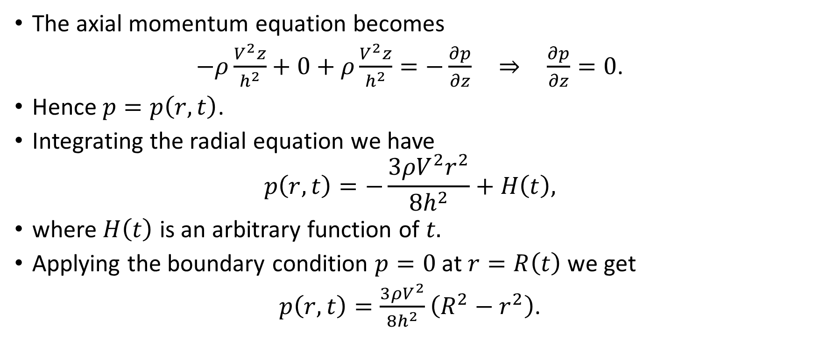
Pinching of a Cylinder - 5
The axial momentum equation becomes
$−ρ\frac{V^{2}z}{h^{2}}+0+ρ\frac{V^{2}z}{h^{2}}=−\frac{∂p}{∂z} \overset{⇒}{} \frac{∂p}{∂z}=0$.
Hence $p=p\left(r,t\right)$.
Integrating the radial equation we have
$$p\left(r,t\right)=−\frac{{3ρV}^{2}r^{2}}{8h^{2}}+H\left(t\right),$$
where $H\left(t\right)$ is an arbitrary function of $t.$
Applying the boundary condition $p=0$ at $r=R\left(t\right)$ we get
$p\left(r,t\right)=\frac{{3ρV}^{2}}{8h^{2}}\left(R^{2}−r^{2}\right)$.

Slide 42
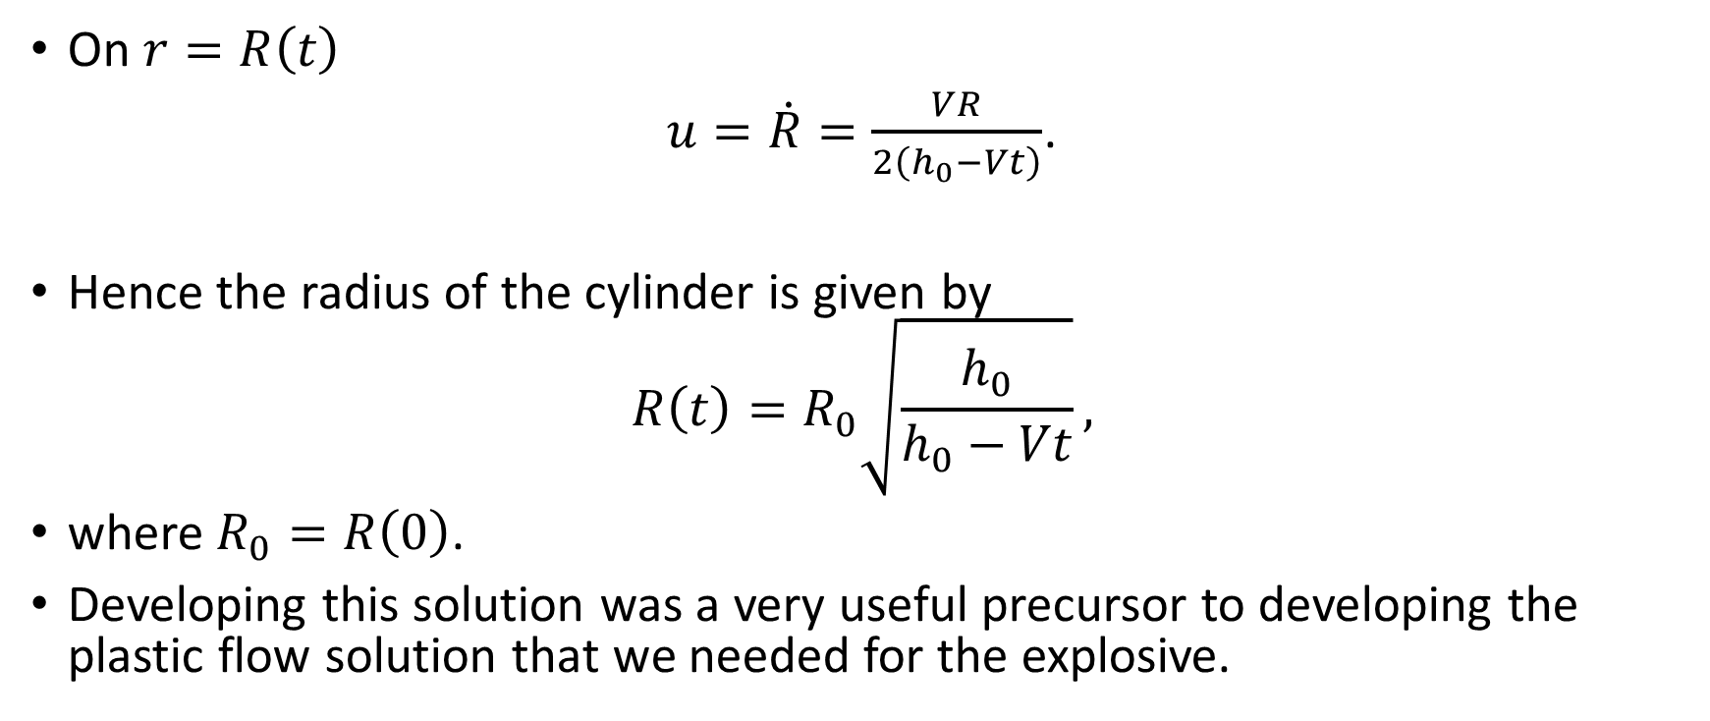
Pinching of a Cylinder - 6
On $r=R\left(t\right)$
$u=\dot{R}=\frac{VR}{2\left(h_{0}−Vt\right)}$.
Hence the radius of the cylinder is given by
$$R\left(t\right)=R_{0}\sqrt{\frac{h_{0}}{h_{0}−Vt}},$$
where $R_{0}=R\left(0\right)$.
Developing this solution was a very useful precursor to developing the plastic flow solution that we needed for the explosive.

Slide 43
Jets - 1
Jets are used in a variety of industrial applications.
Examples:
  Ink jet printers
  Oil well perforators
  Cleaning jets
  Drilling of geological materials in mining and oil recovery
  Cutting and slicing of materials including:
    Glass
    Steel
    Food

Slide 44
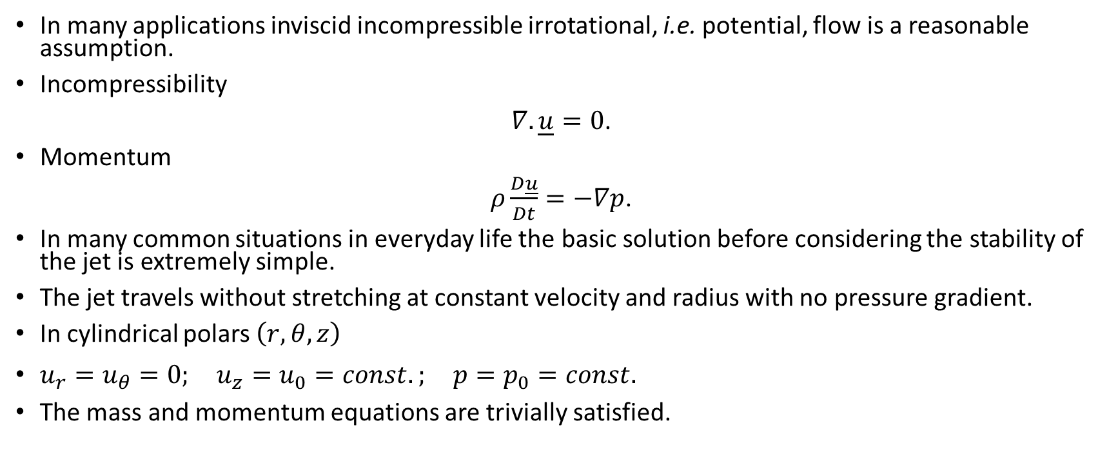
Jets - 2
In many applications inviscid incompressible irrotational, i.e. potential, flow is a reasonable assumption.
Incompressibility
$∇.\underline{u}=0$.
Momentum
$ρ\frac{D\underline{u}}{Dt}=−∇p$.
In many common situations in everyday life the basic solution before considering the stability of the jet is extremely simple.
The jet travels without stretching at constant velocity and radius with no pressure gradient.
In cylindrical polars $\left(r,θ,z\right)$
$u_{r}=u_{θ}=0; u_{z}=u_{0}=const.; p=p_{0}=const.$
The mass and momentum equations are trivially satisfied.

Slide 45
Jets - 3
In some situations it is desirable to have a stretching jet.
A prime example is that of the shaped charge jet as used in oil well perforators, ejector seats, tree-felling, demolition, and military applications.
Here the penetration depends on length (as we will show later) and the longest possible jet is wanted. For oil well perforators penetration length and the financial return from an oil well are highly correlated.
The mathematics is very similar indeed to that used for the pinching of the cylinder just presented and so it is a problem on the sheet.

Slide 46
Jets - 4
In some applications break-up of the jet into droplets is required.
Ink jet printers are the prime example of this.
Here the instability of the curved jet surface caused by surface tension is used to generate the droplets.
You see this process occurring every time you run a tap!

Slide 47
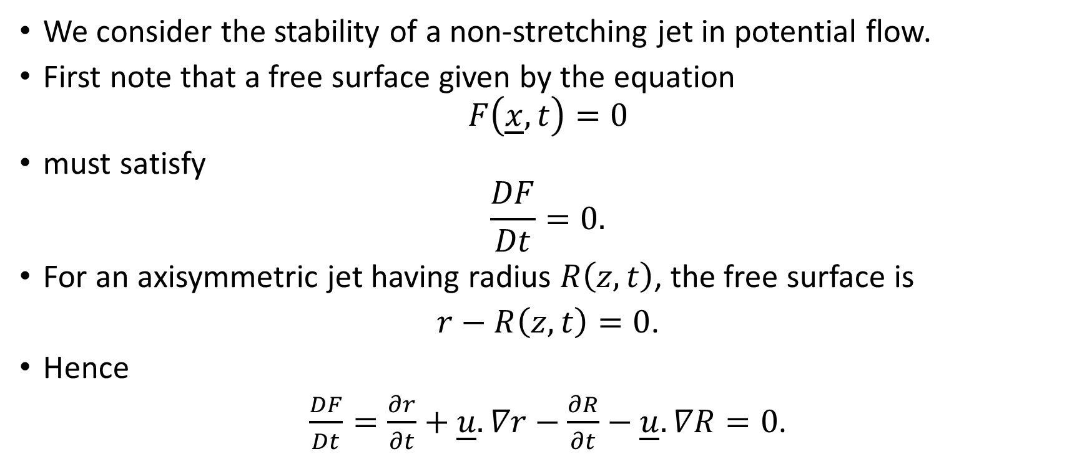
Jets – 5: Stability
We consider the stability of a non-stretching jet in potential flow.
First note that a free surface given by the equation
$$F\left(\underline{x},t\right)=0$$
must satisfy
$$\frac{DF}{Dt}=0.$$
For an axisymmetric jet having radius $R\left(z,t\right)$, the free surface is
$r−R\left(z,t\right)=0$.
Hence
$\frac{DF}{Dt}=\frac{∂r}{∂t}+\underline{u}.∇r−\frac{∂R}{∂t}−\underline{u}.∇R=0$.

Slide 48
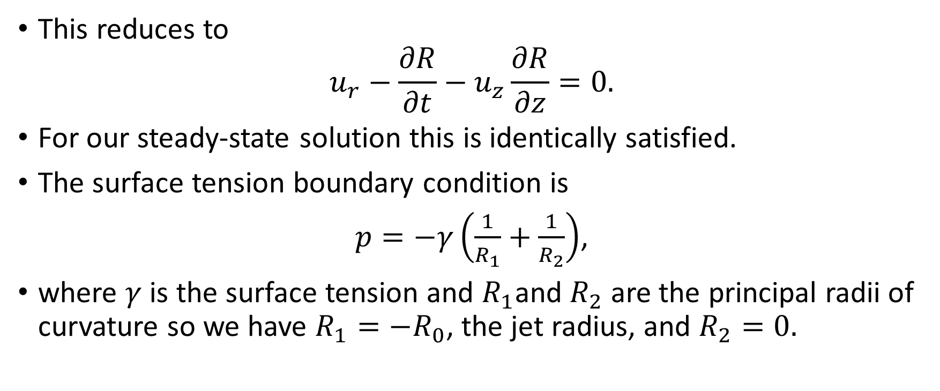
Jets - 6
This reduces to
$$u_{r}−\frac{∂R}{∂t}−u_{z}\frac{∂R}{∂z}=0.$$
For our steady-state solution this is identically satisfied.
The surface tension boundary condition is
$p=−γ\left(\frac{1}{R_{1}}+\frac{1}{R_{2}}\right)$,
where $γ$ is the surface tension and $R_{1}$and $R_{2}$ are the principal radii of curvature so we have $R_{1}={−R}_{0}$, the jet radius, and $R_{2}=0.$

Slide 49
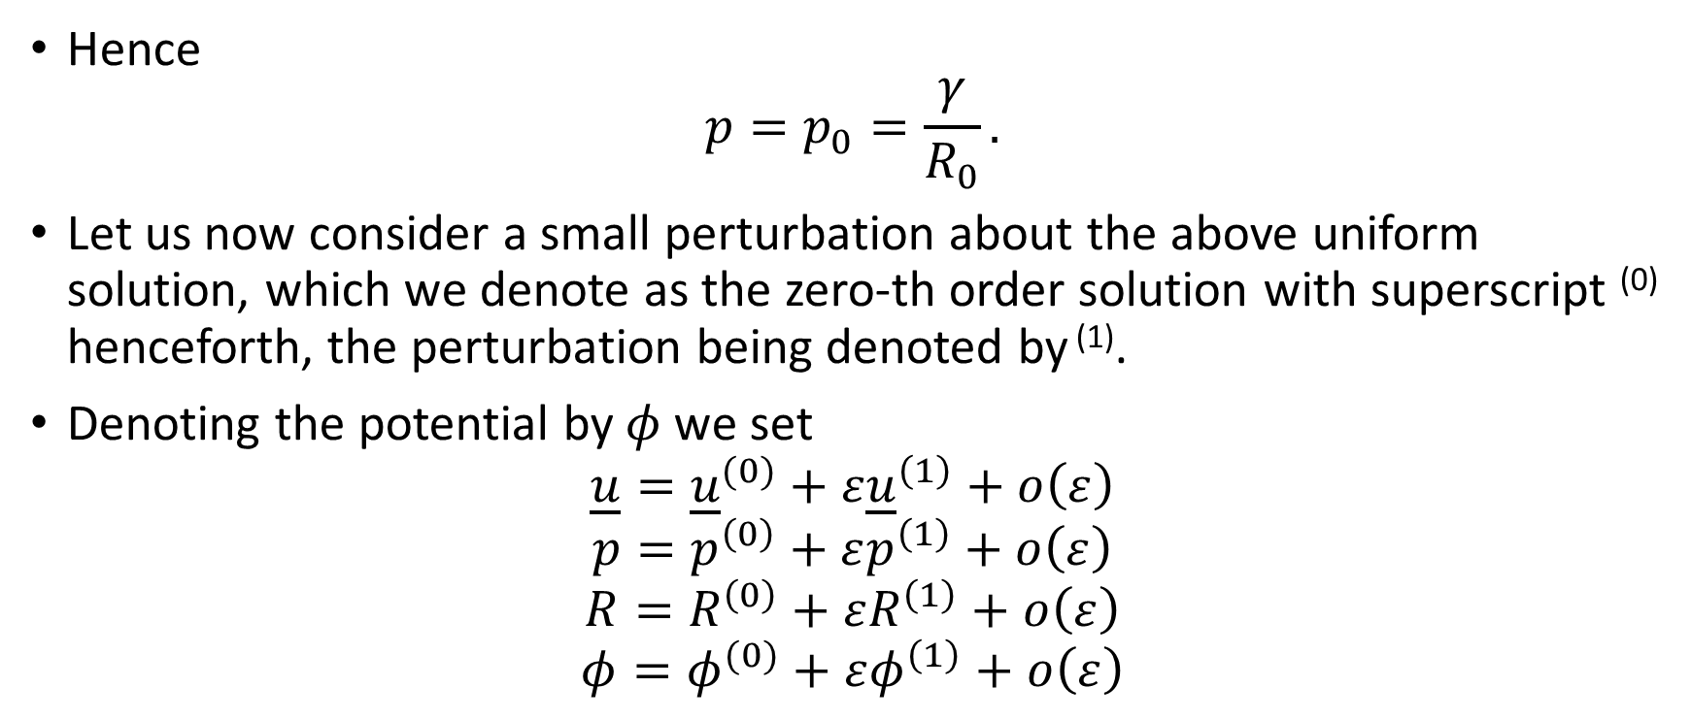
Jet - 7
Hence
$$p=p_{0}=\frac{γ}{R_{0}}.$$
Let us now consider a small perturbation about the above uniform solution, which we denote as the zero-th order solution with superscript ⁽⁰⁾ henceforth, the perturbation being denoted by ⁽¹⁾.
Denoting the potential by $φ$we set
$$\underline{u}={\underline{u}}^{(0)}+ε{\underline{u}}^{\left(1\right)}+o\left(ε\right)$$
$$p=p^{\left(0\right)}+εp^{\left(1\right)}+o\left(ε\right)$$
$$R=R^{\left(0\right)}+εR^{\left(1\right)}+o\left(ε\right)$$
$$φ=φ^{(0)}+εφ^{\left(1\right)}+o\left(ε\right)$$

Slide 50
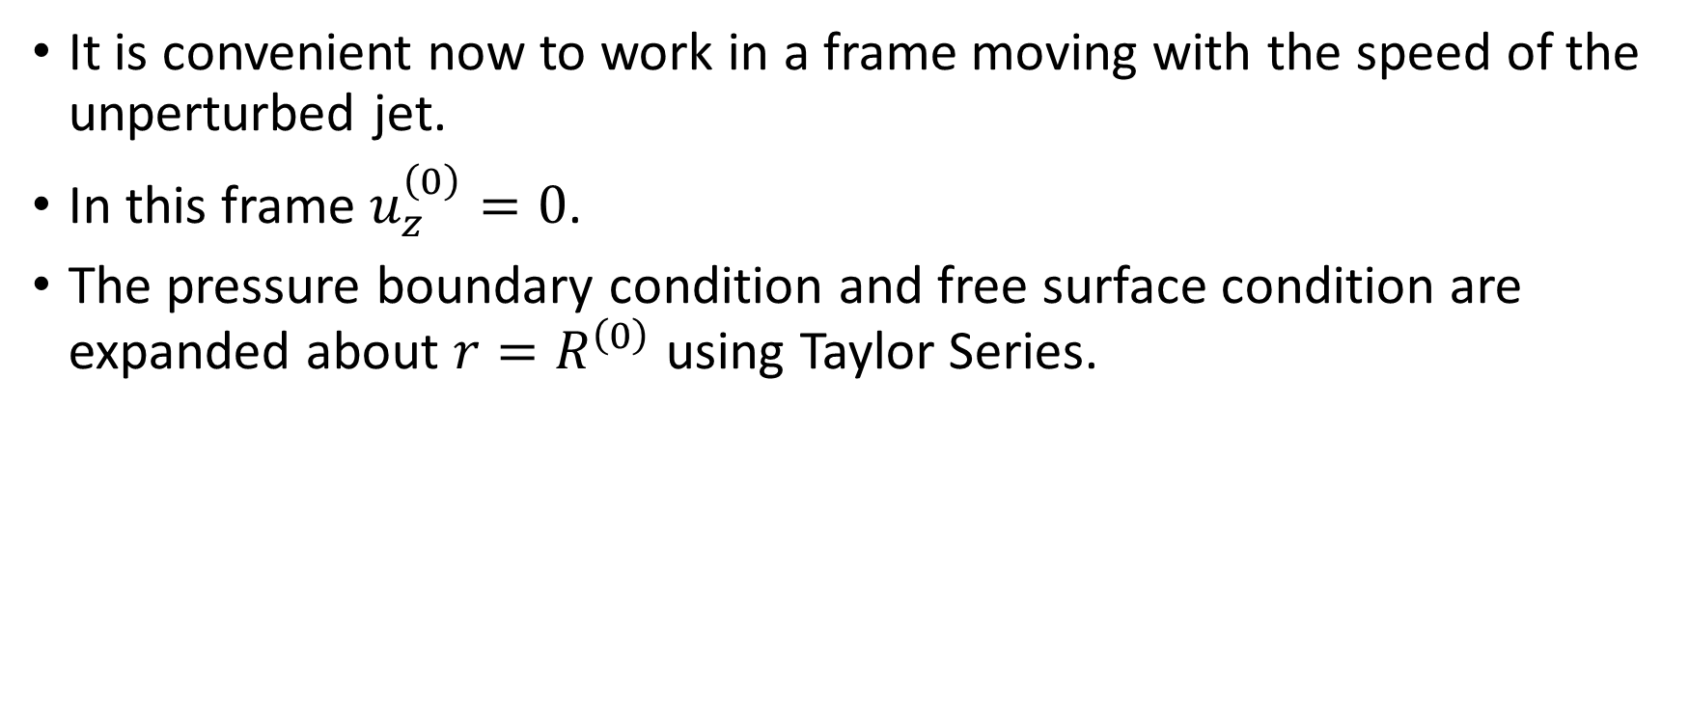
Jets - 8
It is convenient now to work in a frame moving with the speed of the unperturbed jet.
In this frame $u_{z}^{\left(0\right)}=0$.
The pressure boundary condition and free surface condition are expanded about $r=R^{\left(0\right)}$ using Taylor Series.

Slide 51
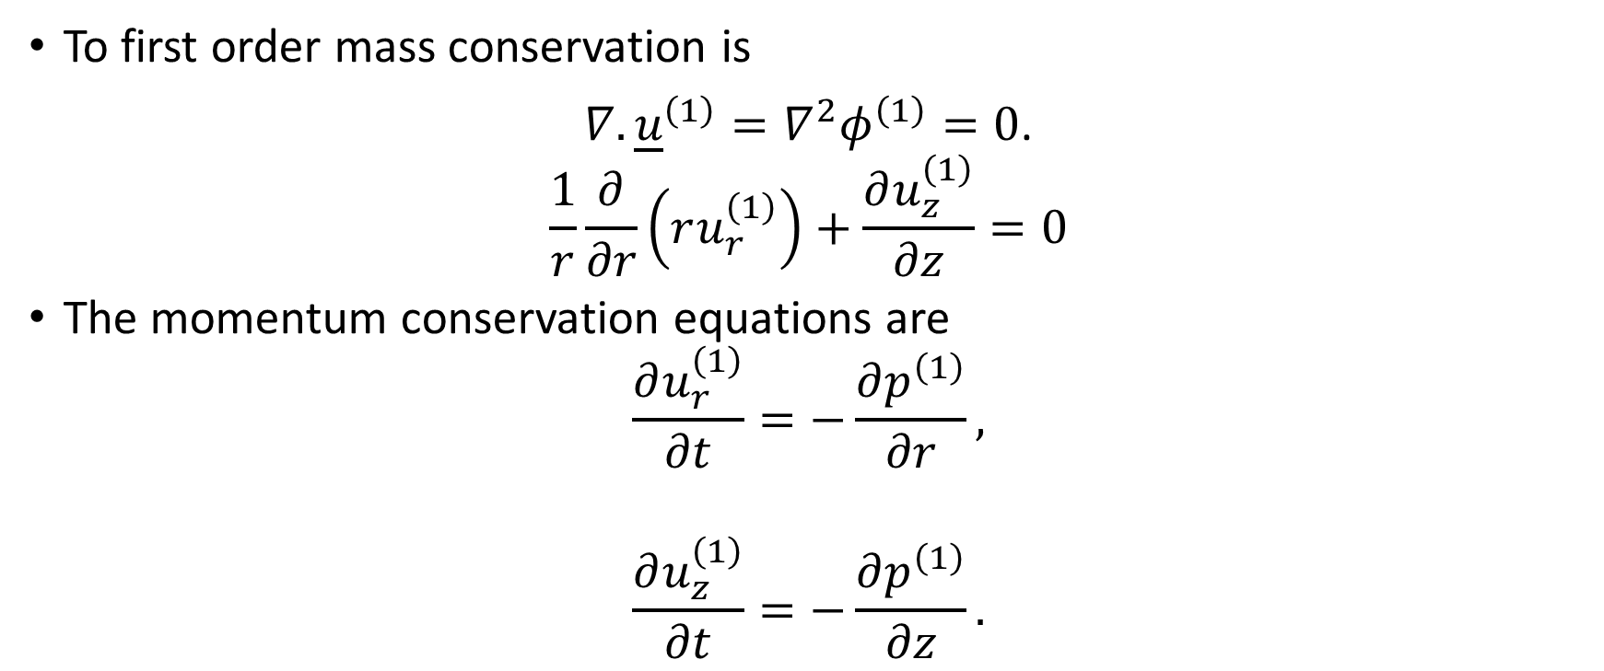
Jets – 9: Conservation of Mass and Momentum
To first order mass conservation is
$∇.{\underline{u}}^{\left(1\right)}=∇^{2}φ^{\left(1\right)}=0$.
$$\frac{1}{r}\frac{∂}{∂r}\left(ru_{r}^{\left(1\right)}\right)+\frac{∂u_{z}^{\left(1\right)}}{∂z}=0$$
The momentum conservation equations are
$$\frac{∂u_{r}^{\left(1\right)}}{∂t}=−\frac{∂p^{\left(1\right)}}{∂r},$$
$$\frac{∂u_{z}^{\left(1\right)}}{∂t}=−\frac{∂p^{\left(1\right)}}{∂z}.$$

Slide 52
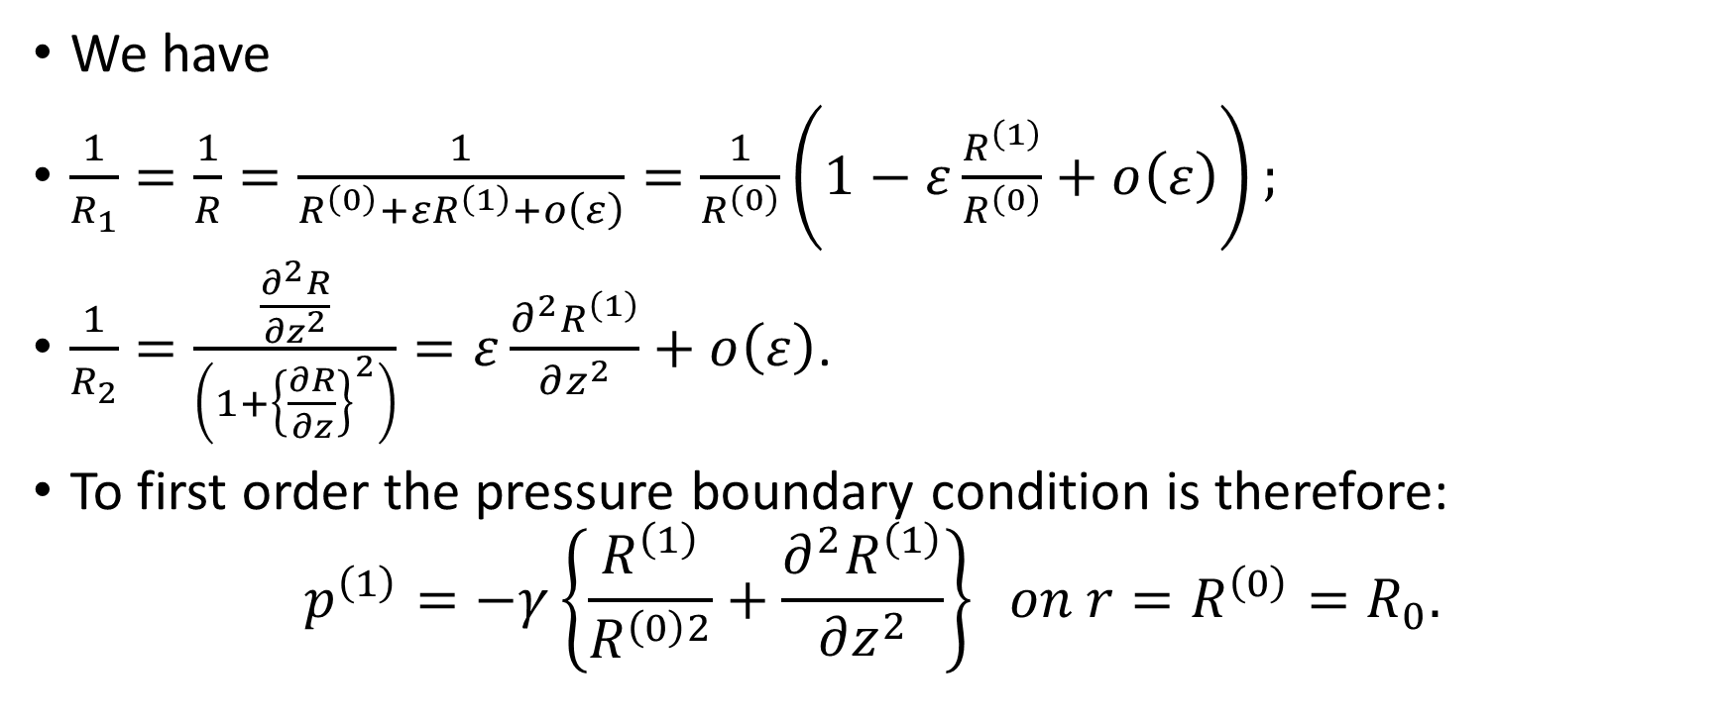
Jet – 10: Pressure Boundary Condition
We have
$\frac{1}{R_{1}}=\frac{1}{R}=\frac{1}{R^{\left(0\right)}+εR^{\left(1\right)}+o\left(ε\right)}=\frac{1}{R^{\left(0\right)}}\left(1−ε\frac{R^{\left(1\right)}}{R^{\left(0\right)}}+o\left(ε\right)\right);$
$\frac{1}{R_{2}}=\frac{\frac{∂^{2}R}{∂z^{2}}}{\left(1+{\left\{\frac{∂R}{∂z}\right\}}^{2}\right)}=ε\frac{∂^{2}R^{\left(1\right)}}{∂z^{2}}+o\left(ε\right)$.
To first order the pressure boundary condition is therefore:
$$p^{\left(1\right)}=−γ\left\{\frac{R^{\left(1\right)}}{R^{\left(0\right)2}}+\frac{∂^{2}R^{\left(1\right)}}{∂z^{2}}\right\} on r=R^{\left(0\right)}=R_{0}.$$

Slide 53
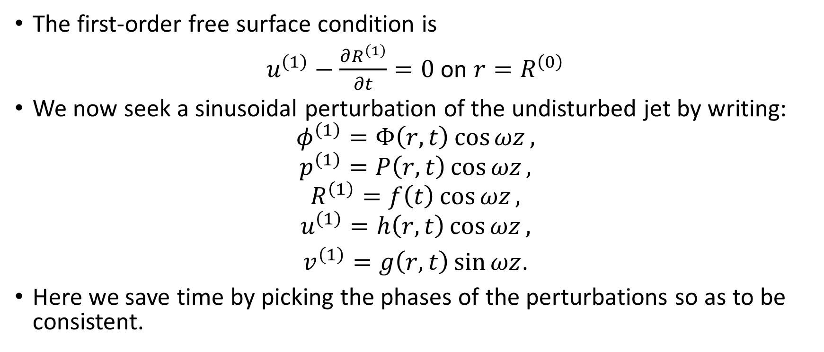
Jets - 11
The first-order free surface condition is
$u^{\left(1\right)}−\frac{∂R^{\left(1\right)}}{∂t}=0$ on $r=R^{\left(0\right)}$
We now seek a sinusoidal perturbation of the undisturbed jet by writing:
$$φ^{\left(1\right)}=Φ\left(r,t\right)\cos{ωz},$$
$$p^{\left(1\right)}=P\left(r,t\right)\cos{ωz},$$
$$R^{\left(1\right)}=f\left(t\right)\cos{ωz},$$
$$u^{\left(1\right)}=h\left(r,t\right)\cos{ωz},$$
$v^{\left(1\right)}=g\left(r,t\right)\sin{ωz}$.
Here we save time by picking the phases of the perturbations so as to be consistent.

Slide 54
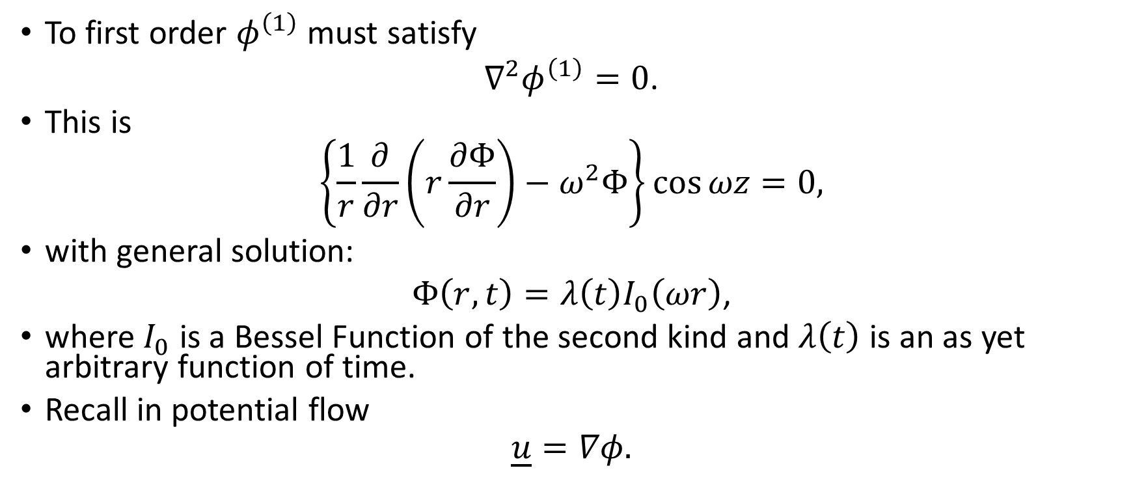
Jets - 12
To first order $φ^{\left(1\right)}$ must satisfy
$∇^{2}φ^{\left(1\right)}=0$.
This is
$$\left\{\frac{1}{r}\frac{∂}{∂r}\left(r\frac{∂Φ}{∂r}\right)−ω^{2}Φ\right\}\cos{ωz}=0,$$
with general solution:
$Φ\left(r,t\right)=λ\left(t\right)I_{0}\left(ωr\right)$,
where $I_{0}$ is a Bessel Function of the second kind and $λ\left(t\right)$ is an as yet arbitrary function of time.
Recall in potential flow
$$\underline{u}=∇φ.$$

Slide 55
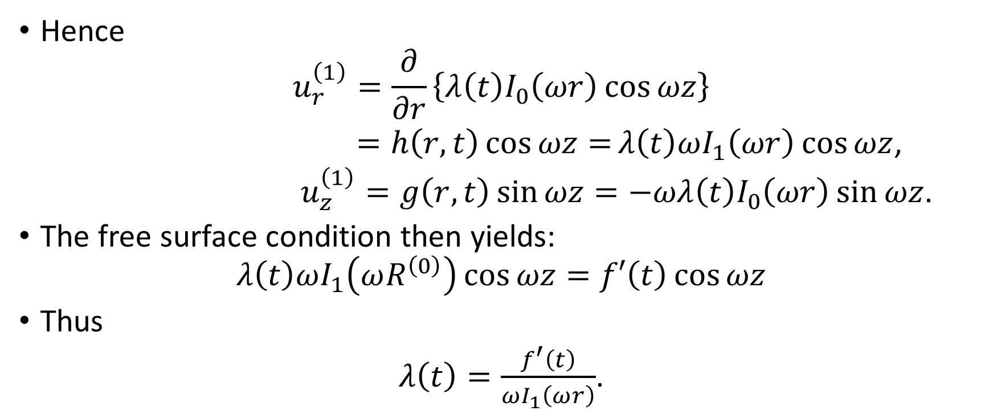
Jets – 13
Hence
$$u_{r}^{\left(1\right)}=\frac{∂}{∂r}\left\{λ\left(t\right)I_{0}\left(ωr\right)\cos{ωz}\right\}$$
$=h\left(r,t\right)\cos{ωz=}λ\left(t\right)ωI_{1}\left(ωr\right)\cos{ωz}$,
$u_{z}^{\left(1\right)}=g\left(r,t\right)\sin{ωz}=−ωλ\left(t\right)I_{0}\left(ωr\right)\sin{ωz}$.
The free surface condition then yields:
$$λ\left(t\right)ωI_{1}\left(ωR^{\left(0\right)}\right)\cos{ωz=f′\left(t\right)\cos{ωz}}$$
Thus
$λ\left(t\right)=\frac{f^{′}\left(t\right)}{ωI_{1}\left(ωr\right)}$.

Slide 56

Jets - 14
The pressure boundary condition at first order becomes
$P\left(R^{\left(0\right)},t\right)=−γ\left(\frac{f\left(t\right)}{R^{\left(0\right)2}}−ω^{2}f\left(t\right)\right)=−γf\left(t\right)\left(\frac{1}{R^{\left(0\right)2}}−ω^{2}\right)$.
The z-component of the momentum equations reduces to
$ρ\frac{∂g}{∂t}\sin{ωz}=ωP\sin{ωz}$.
And hence
$−ρω\frac{dλ}{dt}I_{0}\left(ωr\right)=ωP\left(r,t\right)$.
Using the boundary condition for $P$ above we have

Slide 57

Jets - 15
$ρ\frac{dλ}{dt}I_{0}\left(ωR^{\left(0\right)}\right)=γf\left(t\right)\left(\frac{1}{R^{\left(0\right)2}}−ω^{2}\right)$.
Eliminating $λ\left(t\right)$ in favour of $f\left(t\right)$ we obtain after manipulation the equation governing the growth of the sinusoidal disturbance originally derived by Lord Rayleigh:
$f^{′′}\left(t\right)=\frac{γωI_{1}\left(ωR^{0}\right)}{{ρR^{\left(0\right)2}I}_{0}\left(ωR^{0}\right)}\left(1−ω^{2}R^{\left(0\right)2}\right)f\left(t\right)$.
The fastest growing or dominant wavelength that eventually leads to droplet formation (as in printer ink jets) is found by maximising
$$\frac{γωI_{1}\left(ωR^{0}\right)}{{ρR^{\left(0\right)2}I}_{0}\left(ωR^{0}\right)}\left(1−ω^{2}R^{\left(0\right)2}\right)$$
with respect to $ω.$

Slide 58
Jets – 16: Jet Penetration
The penetration of jets is very important in numerous industrial applications.
In many cases it has been found possible to use the theory of incompressible inviscid flow, basically because for high speed jets viscosity is negligible and for many metals the effects of compressibility are negligible or nearly cancel.
We present the incompressible theory based on Bernoulli’s Law.
Note that there is a an analogous compressible theory based on the compressible version of this Law.

Slide 59



Jets – 17: Penetration Using Bernoulli’s Law
For high speed jets travelling at speed $V$ in the km/s regime the influence of gravity is negligible.
In the steady state Bernoulli’s Law is simply
$\frac{1}{2}{ρu}^{2}+p=const$.
To predict penetration speed $U$Hill Mott and Pack applied this Law in a frame moving with the axial point P at the interface between jet and target.
It turns out that the steady flow assumption works well even for jets with a gradient of velocity along them.
$$V$$
P
$$U$$

Slide 60

Jets – 18: Penetration Using Bernoulli’s Law
In the frame moving with P at velocity $U$ far from P the jet is travelling at $V−U$ and the target with velocity $−U$.
The pressure far from P is taken as atmospheric pressure $p_{0}.$
At P itself both are at rest in this frame: $u=0$ in both jet and target and the pressures are equal just to the left and right of P (lest there be infinite acceleration happening!).
Let $p_{s}$ be the pressure at P, the S standing for ‘stagnation’, as in this frame P is sometimes referred to as the ‘stagnation point’ even though it is actually travelling at several km/s!
Then, applying Bernoulli’s Law along the axis, we have in the jet of density $ρ_{J}$ :
$\frac{1}{2}ρ_{J}{\left(V−U\right)}^{2}+p_{0}=p_{S}$.

Slide 61

Jets – 19: Penetration Using Bernoulli’s Law
Similarly in the target of density $ρ_{T}$:
$p_{S}=\frac{1}{2}ρ_{T}U^{2}+p_{0}$.
Elimination of $p_{S}−p_{0}$ yields:
$\frac{1}{2}ρ_{J}{\left(V−U\right)}^{2}=\frac{1}{2}ρ_{T}U^{2}$.
This results in the quadratic for $U:$
$$U^{2}\left(1−\frac{ρ_{T}}{ρ_{J}}\right)−2VU+V^{2}=0,$$
with physically possible solution
$U=V/{\left(1+\sqrt{\frac{ρ_{T}}{ρ_{J}}}\right)}$.

Slide 62

Jets – 20: Penetration Using Bernoulli’s Law
Let a jet element of length $δl$ take a time $δt$ to penetrate a distance $δP.$
Then
$δt=\frac{δl}{\left(V−U\right)}=\frac{δP}{U}$.
It follows from the solution just found for $U$ that:
$δP=δl\sqrt{\frac{ρ_{J}}{ρ_{T}}}$.
This is the famous hydrodynamic penetration law of Hill, Mott and Pack.
For a jet of uniform speed and length L the total penetration $P$is simply
$P=L\sqrt{\frac{ρ_{J}}{ρ_{T}}}$.
We explore what happens for stretching jets in one of the sheet questions.

Slide 63
Shocks - 1
Shocks arise under conditions where there is impact or sudden release of energy such as when an explosive explodes.
Typical impact speeds causing shocks are in the range
500 – 10,000 m / s.
Pressures are in the GPa regime, usually dwarfing material strength, so that the material (even a metal) responds like a compressible fluid.
When shock waves hit the surface of a dense material they are reflected back at even higher pressure – the reason why e.g. the aircraft fuselage was ruptured in the Lockerbie disaster.

Slide 64

Shocks - 2
Shocked Pre-shock
$U$
Density ${ ρ}_{1}$ $ρ_{0}$
Particle Velocity ${ u}_{1}$ $u_{0}$
Pressure ${ p}_{1}$ $p_{0}$
Internal energy $e_{1}$ $U$ $e_{0}$
SHOCK

Slide 65

Shocks – 3: The Rankine-Hugoniot Equations
Derived by considering conservation of mass, momentum and energy in a frame moving with the shock travelling at speed $U$.
Courant and Friedrichs gives derivations and a wealth of information on shocks.
Mass:
$ρ_{1}\left(u_{1}−U\right)=ρ_{0}\left(u_{0}−U\right)$.
Momentum:
${p_{1}+ρ}_{1}{\left(u_{1}−U\right)}^{2}={p_{0}+ρ}_{0}{\left(u_{0}−U\right)}^{2}$.
Energy:
${\frac{p_{1}}{ρ_{1}}+e_{1}+\frac{1}{2}\left(u_{1}−U\right)}^{2}={\frac{p_{0}}{ρ_{0}}+e_{0}+\frac{1}{2}\left(u_{0}−U\right)}^{2}$.

Slide 66

Shocks - 4
These are 3 equations in 4 unknowns for the shocked variables.
An extra equation is required to close the system.
Often the empirical ‘Shock Velocity/Particle Velocity’ relationship is assumed:
$U=c_{0}+su_{1}$,
Here $c_{0}$ is the speed of sound in the pre-shocked state, and $s$ is the empirically determined constant.
More rigorously the system can be completed by using the ‘Equation of State’. This is usually a constitutive law for the pressure in the form:
$p=P\left(ρ,e\right)$ .

Slide 67

Some Very Significant Omissions with Industrial Application
Not presented as I have no or limited personal experience.
Boundary-layer theory – Aerodynamics, spacecraft re-entry, oceanography etc.
Turbulence – engine modelling, aerodynamics again, heating systems, the weather etc. I once (n.b. decades ago) did a review of the different models for a client, but have never applied them myself. Models to consider then included the $k−ε$Model, Algebraic Reynolds Stress Model (ARSM) , Large Eddy Simulation. Computing having come on immensely this one deserves a warning !
Porous flow of gases and liquids. Immense industrial importance especially in gas and petroleum recovery. Darcy’s Law.

