Slide 1
Methods of Industrial Mathematics – Session 4
Extended LTCC Advanced Course – Feb-Mar 2018
John Curtis, UCL Mathematics Department
© British Crown Owned Copyright 2018/AWE.

Slide 2
Session 4
A brief survey of optimisation methods.
Optimisation of functions
  Single variable
  Some dangers
  Multiple variables
  Constraints – Lagrange Multipliers
Some applications
  Optimisation of kinetic energy of an explosively projected plate.
  Minimisation of heat loss
  Maintaining orthogonality of axes
  Minimising variance
A brief review of methods where analysis is less simple and intelligent search is needed:
  Nelder-Mead
  Genetic algorithms
  Simulated annealing
  Tabu Search

Slide 3
Industrial Mathematics Encountered by JC
ELECTROMAGNETIC THEORY
MECHANICS
HEAT TRANSFER
APPLIED PHYSICS
CONTROL THEORY
INDUSTRIAL MATHEMATICS USED BY JC
SIGNAL PROCESSING
SIMULATION
ENGINEERING
STATISTICS
NUMERICAL ANALYSIS
CHEMISTRY
PROBABILITY
OPTIMISATION
Arrows join most of the above subjects
N.B. No attempt at definitive list of Industrial Mathematics , e.g. Image Processing, Big Data, Formal Methods, Financial Mathematics are missing.

Slide 4
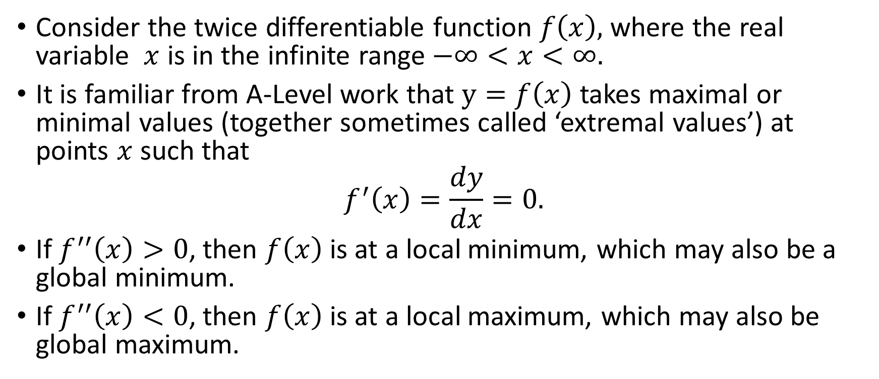
Functions of One Variable
Consider the twice differentiable function $f\left(x\right),$ where the real variable $x$ is in the infinite range $−∞<x<∞.$
It is familiar from A-Level work that $y=f\left(x\right)$ takes maximal or minimal values (together sometimes called ‘extremal values’) at points $x$ such that
$$f^{′}\left(x\right)=\frac{dy}{dx}=0.$$
If $f^{′′}\left(x\right)>0$, then $f\left(x\right)$ is at a local minimum, which may also be a global minimum.
If $f^{′′}\left(x\right)<0$, then $f\left(x\right)$ is at a local maximum, which may also be global maximum.

Slide 5
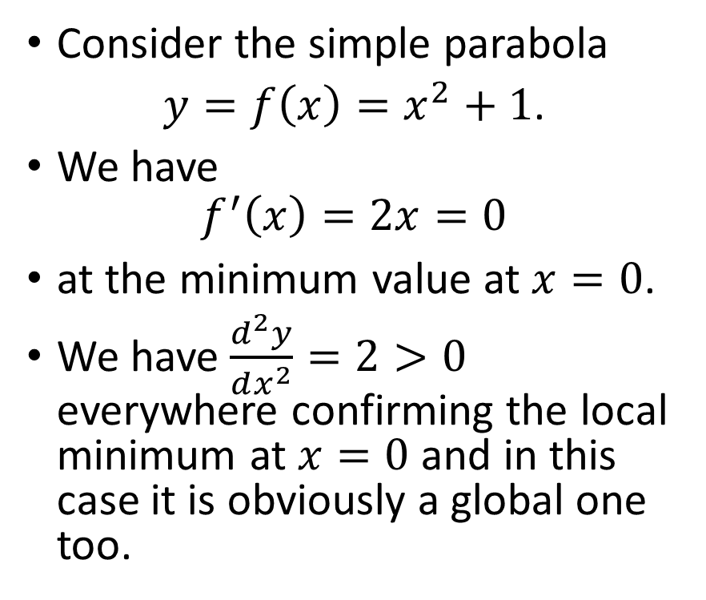
Local and Global Extrema -1
Consider the simple parabola
$y=f\left(x\right)=x^{2}+1$.
We have
$$f^{′}\left(x\right)=2x=0$$
at the minimum value at $x=0$.
We have $\frac{d^{2}y}{dx^{2}}=2>0$ everywhere confirming the local minimum at $x=0$and in this case it is obviously a global one too.
y
(0,1)
x

Slide 6
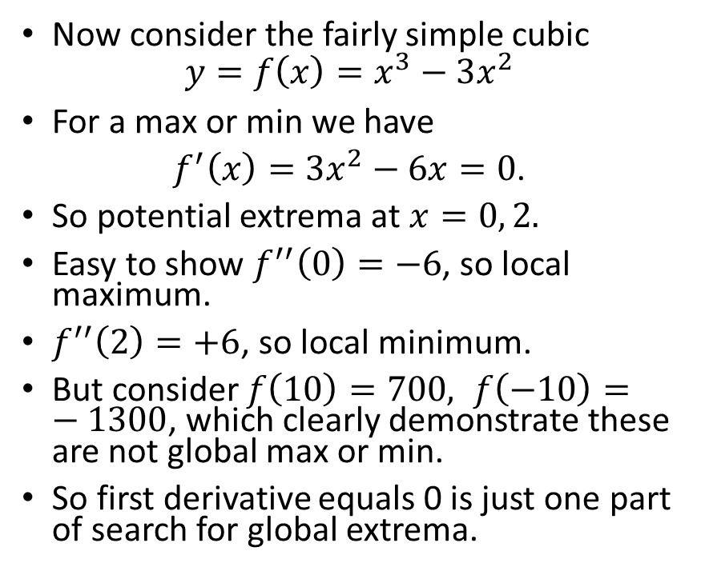
Local and Global Extrema -2
Now consider the fairly simple cubic
$$y=f\left(x\right)=x^{3}−3x^{2}$$
For a max or min we have
$f^{′}\left(x\right)=3x^{2}−6x=0$.
So potential extrema at $x=0, 2.$
Easy to show $f^{′′}\left(0\right)=−6$, so local maximum.
$f^{′′}\left(2\right)=+6$, so local minimum.
But consider $f\left(10\right)=700, f\left(−10\right)=−1300$, which clearly demonstrate these are not global max or min.
So first derivative equals 0 is just one part of search for global extrema.
y
x

Slide 7
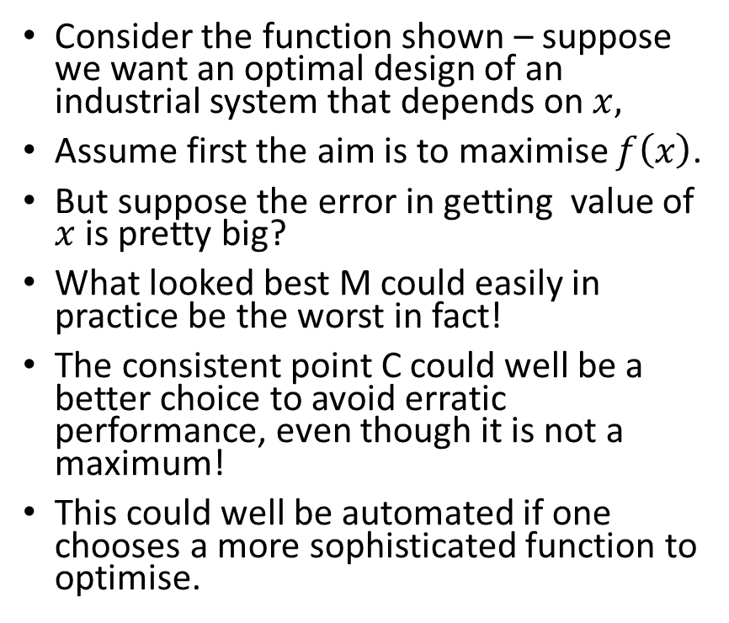
What is Optimal? A Danger of Blind Optimisation.
M
Consider the function shown – suppose we want an optimal design of an industrial system that depends on $x,$
Assume first the aim is to maximise $f\left(x\right)$.
But suppose the error in getting value of $x$ is pretty big?
What looked best M could easily in practice be the worst in fact!
The consistent point C could well be a better choice to avoid erratic performance, even though it is not a maximum!
This could well be automated if one chooses a more sophisticated function to optimise.
y
C
x

Slide 8
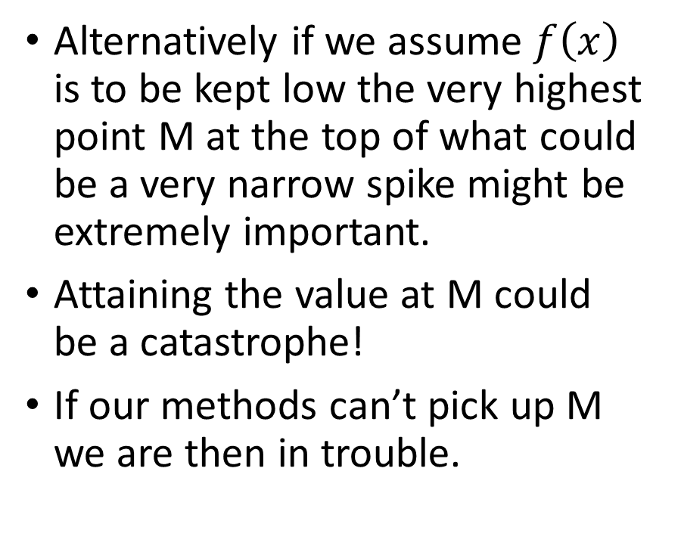
Failure to Find a Maximum
M
Alternatively if we assume $f\left(x\right)$ is to be kept low the very highest point M at the top of what could be a very narrow spike might be extremely important.
Attaining the value at M could be a catastrophe!
If our methods can’t pick up M we are then in trouble.
y
DANGER!
x

Slide 9

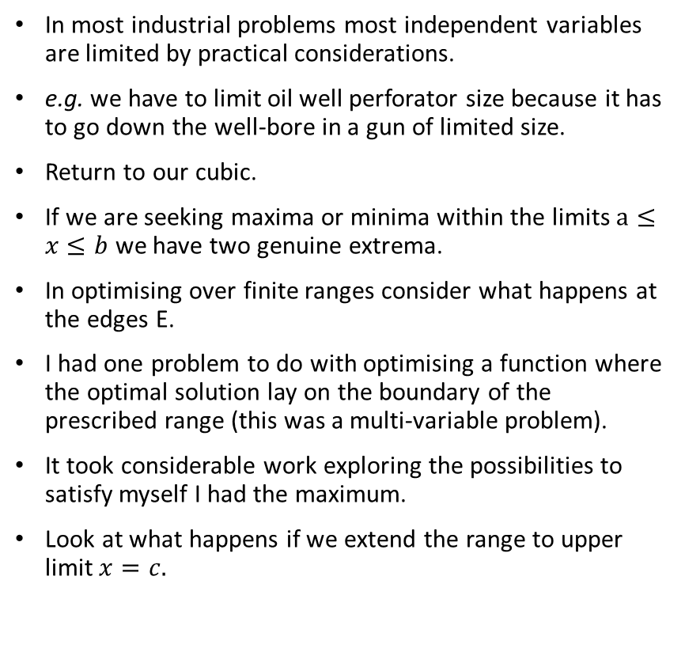


Optimisation over a Finite Range
In most industrial problems most independent variables are limited by practical considerations.
e.g. we have to limit oil well perforator size because it has to go down the well-bore in a gun of limited size.
Return to our cubic.
If we are seeking maxima or minima within the limits $a≤x≤b$ we have two genuine extrema.
In optimising over finite ranges consider what happens at the edges E.
I had one problem to do with optimising a function where the optimal solution lay on the boundary of the prescribed range (this was a multi-variable problem).
It took considerable work exploring the possibilities to satisfy myself I had the maximum.
Look at what happens if we extend the range to upper limit $x=c.$
$$x=a$$
y
$$x=b$$
$$x=c$$
E
x
E
E

Slide 10
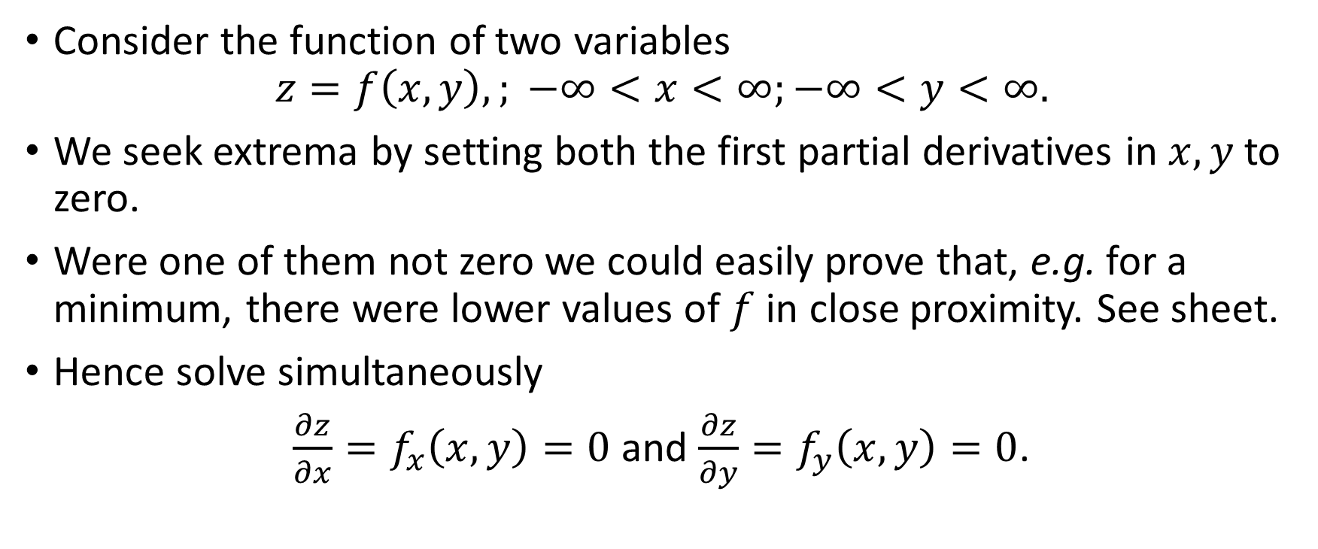
Functions of More than One Variable
Consider the function of two variables
$$z=f\left(x,y\right),; −∞<x<∞;−∞<y<∞.$$
We seek extrema by setting both the first partial derivatives in $x, y$ to zero.
Were one of them not zero we could easily prove that, e.g. for a minimum, there were lower values of $f$ in close proximity. See sheet.
Hence solve simultaneously
$\frac{∂z}{∂x}=f_{x}\left(x,y\right)=0$ and $\frac{∂z}{∂y}=f_{y}\left(x,y\right)=0$.

Slide 11
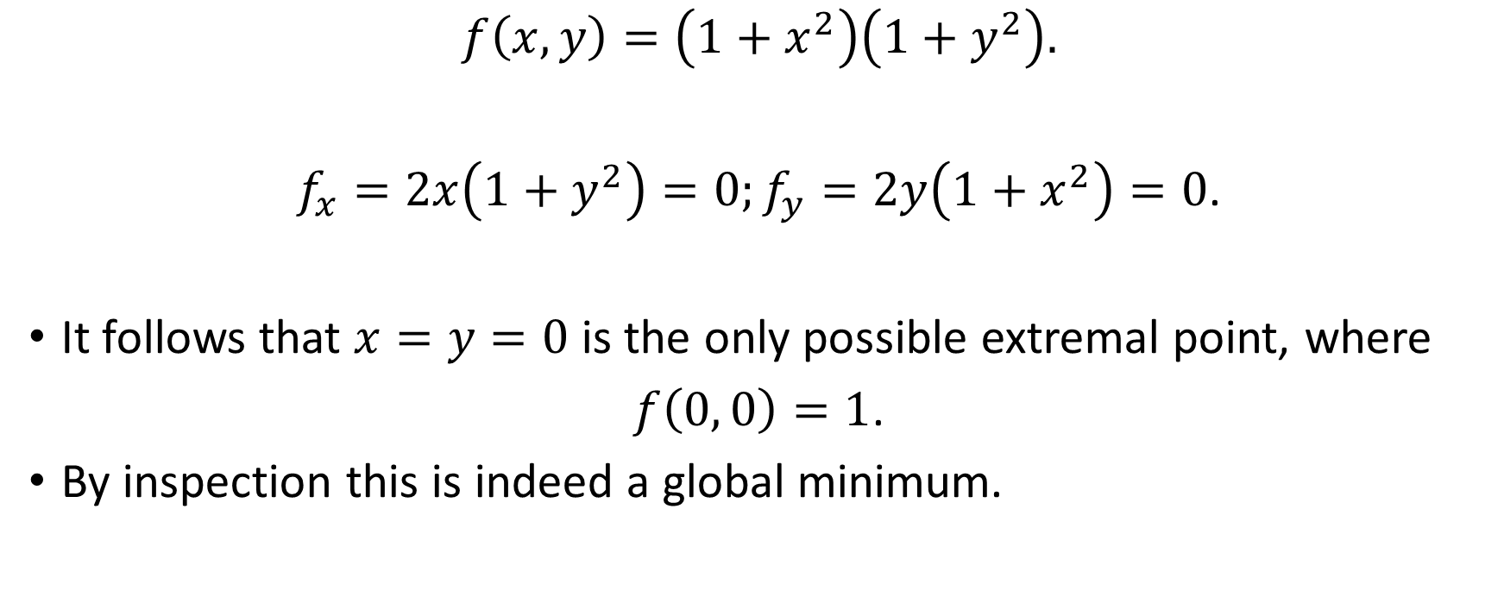
Simple Examples - 1
$$f\left(x,y\right)=\left(1+x^{2}\right)\left(1+y^{2}\right).$$
$f_{x}=2x\left(1+y^{2}\right)=0;f_{y}=2y\left(1+x^{2}\right)=0$.
It follows that $x=y=0$ is the only possible extremal point, where
$f\left(0, 0\right)=1$.
By inspection this is indeed a global minimum.

Slide 12
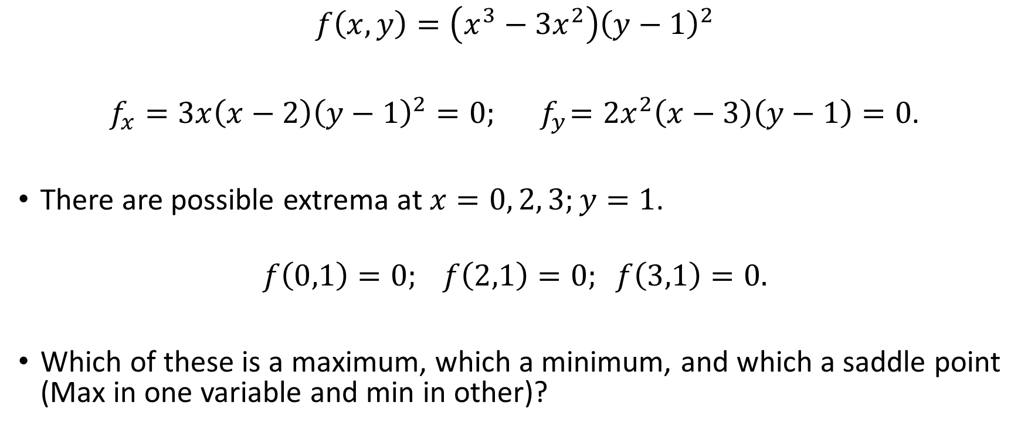
Simple Examples - 2
$$f\left(x,y\right)=\left(x^{3}−3x^{2}\right){\left(y−1\right)}^{2}$$
$f_{x}=3x\left(x−2\right){\left(y−1\right)}^{2}=0;{ f}_{y}={2x}^{2}\left(x−3\right)\left(y−1\right)=0$.
There are possible extrema at $x=0, 2, 3;y=1$.
$$f\left(0,1\right)=0; f\left(2,1\right)=0; f\left(3,1\right)=0.$$
Which of these is a maximum, which a minimum, and which a saddle point (Max in one variable and min in other)?

Slide 14


Sufficient Conditions for Maximum and Minimum (See sheet for proof).
Maximum
Minimum
$$f_{xx}<0$$
And
$$\left|\begin{matrix}f_{xx} & f_{xy} \\ f_{xy} & f_{yy}\end{matrix}\right|>0$$
$$f_{xx}>0$$
And
$$\left|\begin{matrix}f_{xx} & f_{xy} \\ f_{xy} & f_{yy}\end{matrix}\right|>0$$

Slide 15
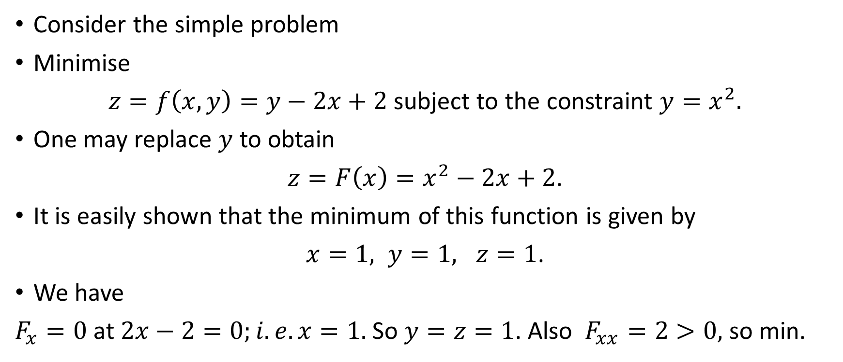
Constraints – Lagrange Multipliers - 1
Consider the simple problem
Minimise
$z=f\left(x,y\right)=y−2x+2$ subject to the constraint $y=x^{2}.$
One may replace $y$ to obtain
$z={F\left(x\right)=x}^{2}−2x+2$.
It is easily shown that the minimum of this function is given by
$x=1, y=1, z=1$.
We have
$F_{x}=0$ at $2x−2=0;i.e. x=1.$ So $y=z=1$. Also $F_{xx}=2>0,$ so min.

Slide 16
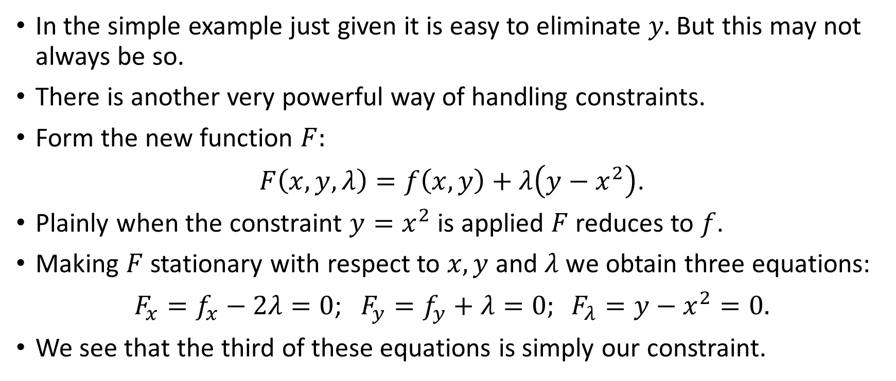
Constraints – Lagrange Multipliers - 2
In the simple example just given it is easy to eliminate $y.$But this may not always be so.
There is another very powerful way of handling constraints.
Form the new function $F:$
$F\left(x, y, λ\right)=f\left(x,y\right)+λ\left(y−x^{2}\right)$.
Plainly when the constraint $y=x^{2}$ is applied $F$ reduces to $f$.
Making $F$ stationary with respect to $x, y$ and $λ$ we obtain three equations:
${F_{x}=f}_{x}−2λ=0$; $F_{y}=f_{y}+λ=0; F_{λ}=y−x^{2}=0.$
We see that the third of these equations is simply our constraint.

Slide 17
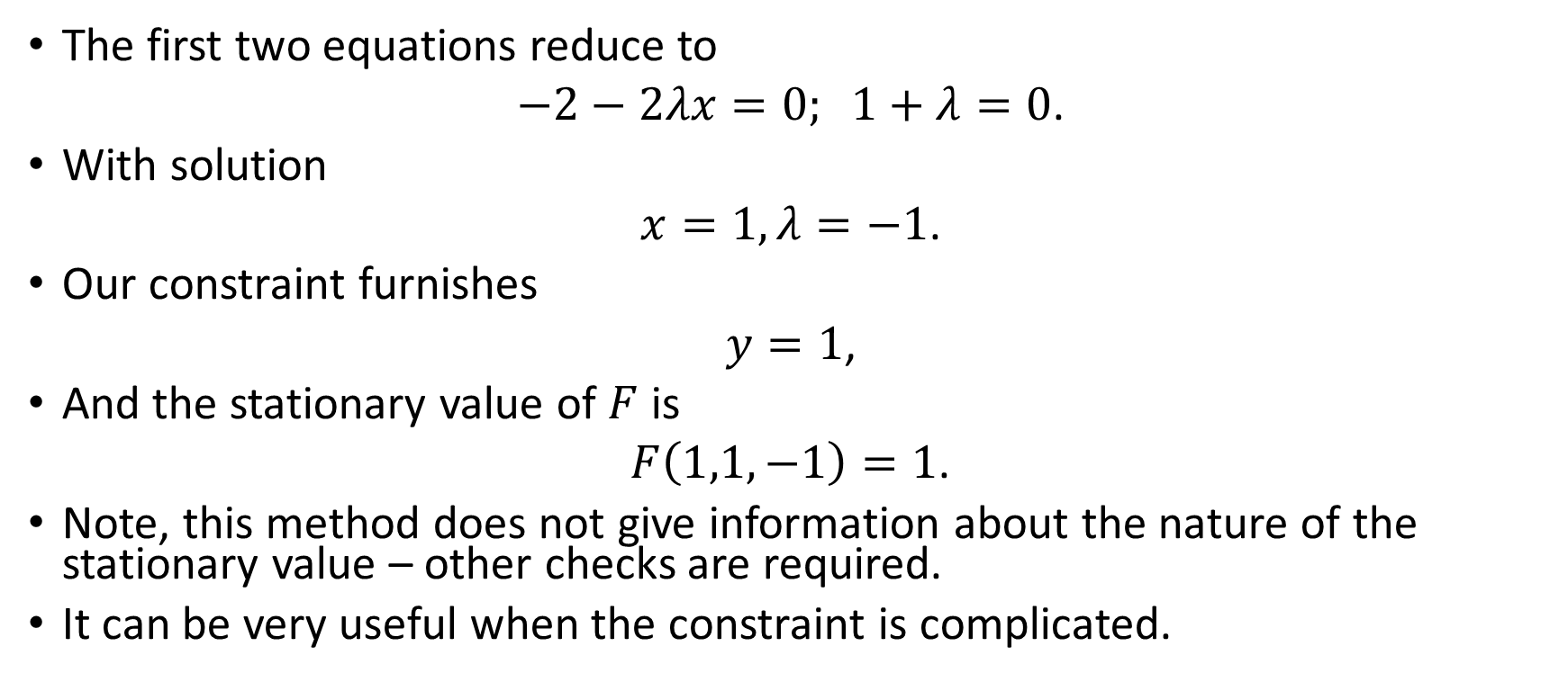
Constraints – Lagrange Multipliers - 3
The first two equations reduce to
$−2−2λx=0; 1+λ=0$.
With solution
$x=1, λ=−1$.
Our constraint furnishes
$y=1$,
And the stationary value of $F$ is
$F\left(1,1,−1\right)=1$.
Note, this method does not give information about the nature of the stationary value – other checks are required.
It can be very useful when the constraint is complicated.

Slide 18
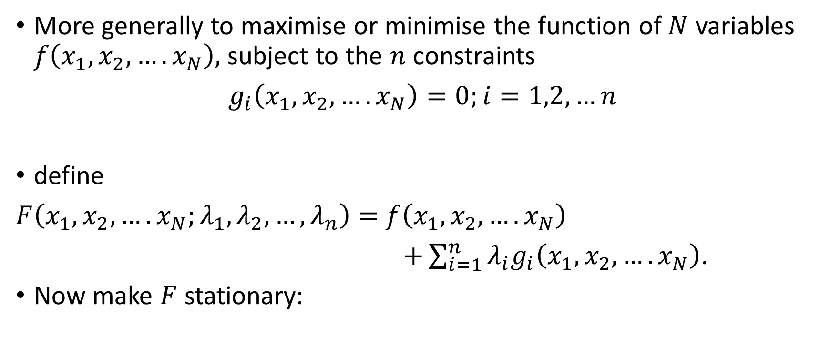
Constraints – Lagrange Multipliers - 4
More generally to maximise or minimise the function of $N$ variables $f\left(x_{1}, x_{2},….x_{N}\right),$ subject to the $n$ constraints
$g_{i}\left(x_{1}, x_{2},….x_{N}\right)=0;i=1,2,…n$
define
$F\left(x_{1}, x_{2},….x_{N};λ_{1}, λ_{2}, …,λ_{n}\right)=$ $f\left(x_{1}, x_{2},….x_{N}\right)$
$+\sum_{i=1}^{n}{{λ_{i}g}_{i}\left(x_{1}, x_{2},….x_{N}\right)}$.
Now make $F$ stationary:

Slide 19
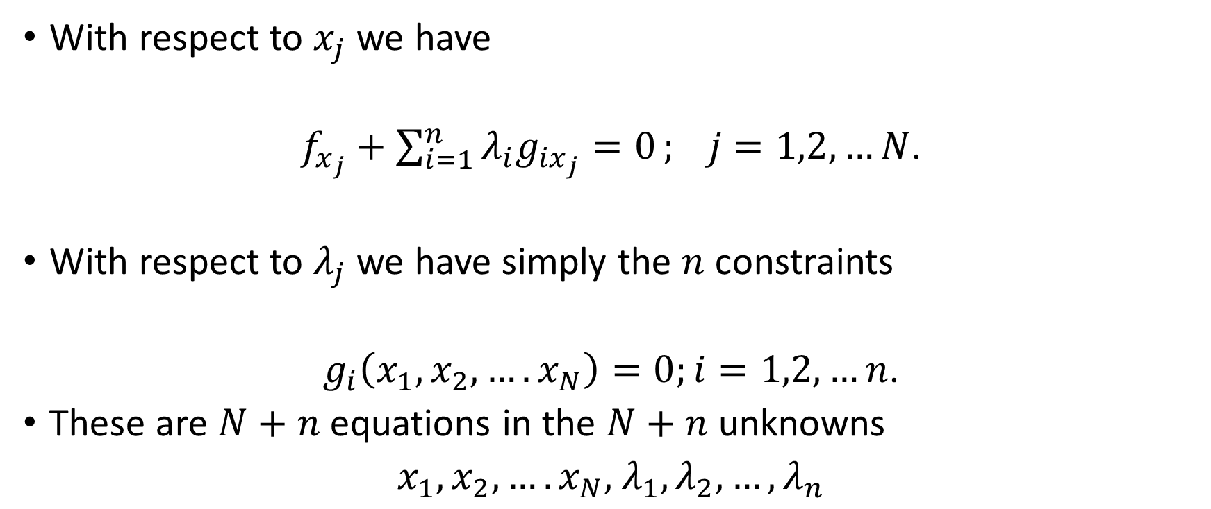
Constraints – Lagrange Multipliers - 5
With respect to $x_{j}$ we have
$f_{x_{j}}+\sum_{i=1}^{n}{λ_{i}g_{{ix}_{j}}=0}; j=1,2,…N$.
With respect to $λ_{j}$ we have simply the $n$ constraints
$g_{i}\left(x_{1}, x_{2},….x_{N}\right)=0;i=1,2,…n$.
These are $N+n$ equations in the $N+n$ unknowns
$x_{1}, x_{2},….x_{N},$ $λ_{1}, λ_{2}, …,λ_{n}$

Slide 20
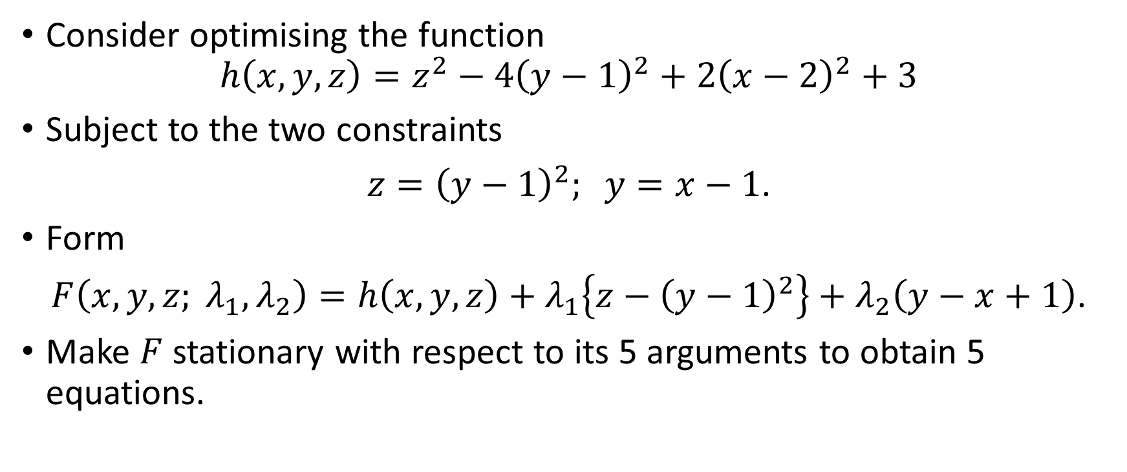
Constraints – Lagrange Multipliers – 6 – An Example
Consider optimising the function
$$h\left(x, y, z\right)=z^{2}−4{\left(y−1\right)}^{2}+2{\left(x−2\right)}^{2}+3$$
Subject to the two constraints
$z={\left(y−1\right)}^{2}; y=x−1$.
Form
$F\left(x, y, z; λ_{1}, λ_{2}\right)=h\left(x, y, z\right)+λ_{1}\left\{z−{\left(y−1\right)}^{2}\right\}+λ_{2}\left(y−x+1\right)$.
Make $F$ stationary with respect to its 5 arguments to obtain 5 equations.

Slide 21

Constraints – Lagrange Multipliers – 7 – An Example
$$h_{x}−λ_{2}=0,$$
$h_{y}−2λ_{1}\left(y−1\right)=0$,
$h_{z}+λ_{1}=0$,
$$z−{\left(y−1\right)}^{2}=0,$$
$y−x+1=0$.
The first equation becomes
$$4\left(x−2\right)−λ_{2}=0.$$
The second equation is
$−8\left(y−1\right)−2λ_{1}\left(y−1\right)+λ_{2}=0$.
The third equation is
$2z+λ_{1}=0$.

Slide 22
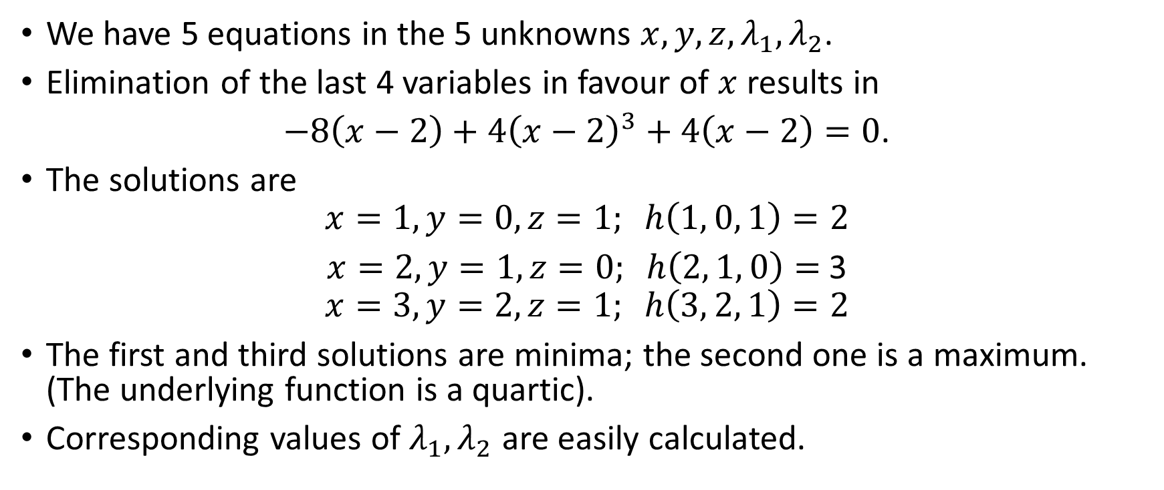
Constraints – Lagrange Multipliers – 8 – An Example
We have 5 equations in the 5 unknowns $x, y, z, λ_{1},λ_{2}$.
Elimination of the last 4 variables in favour of $x$ results in
$−8\left(x−2\right)+4{\left(x−2\right)}^{3}+4\left(x−2\right)=0$.
The solutions are
$$x=1, y=0, z=1; h\left(1, 0, 1\right)=2$$
$x=2, y=1, z=0; h\left(2, 1, 0\right)=$ 3
$$x=3, y=2, z=1; h\left(3, 2, 1\right)=2$$
The first and third solutions are minima; the second one is a maximum. (The underlying function is a quartic).
Corresponding values of $λ_{1},λ_{2}$ are easily calculated.

Slide 23
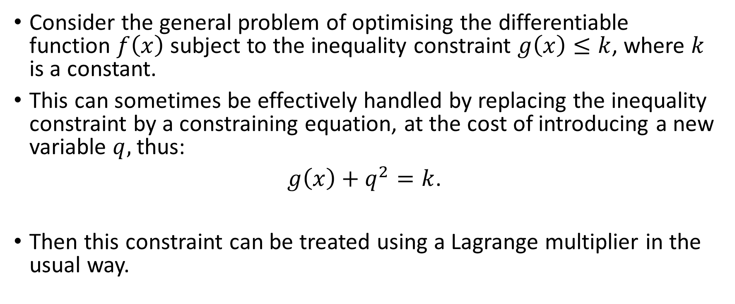
Inequality Constraints - 1
Consider the general problem of optimising the differentiable function $f\left(x\right)$ subject to the inequality constraint $g\left(x\right)≤k$, where $k$ is a constant.
This can sometimes be effectively handled by replacing the inequality constraint by a constraining equation, at the cost of introducing a new variable $q,$ thus:
$g\left(x\right)+q^{2}=k$.
Then this constraint can be treated using a Lagrange multiplier in the usual way.

Slide 24
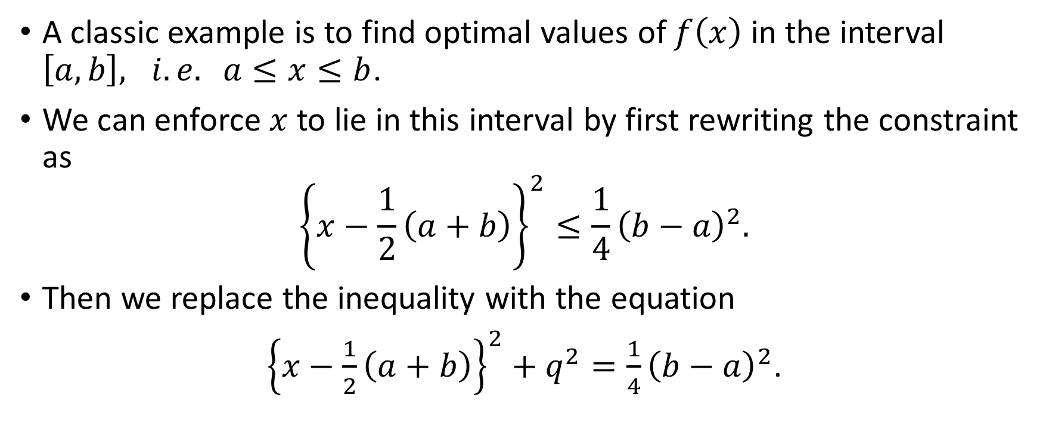
Inequality Constraints - 2
A classic example is to find optimal values of $f\left(x\right)$ in the interval $\left[a,b\right], i.e. a≤x≤b$.
We can enforce $x$ to lie in this interval by first rewriting the constraint as
$${\left\{x−\frac{1}{2}\left(a+b\right)\right\}}^{2}≤\frac{1}{4}{\left(b−a\right)}^{2}.$$
Then we replace the inequality with the equation
${\left\{x−\frac{1}{2}\left(a+b\right)\right\}}^{2}+q^{2}=\frac{1}{4}{\left(b−a\right)}^{2}$.

Slide 25
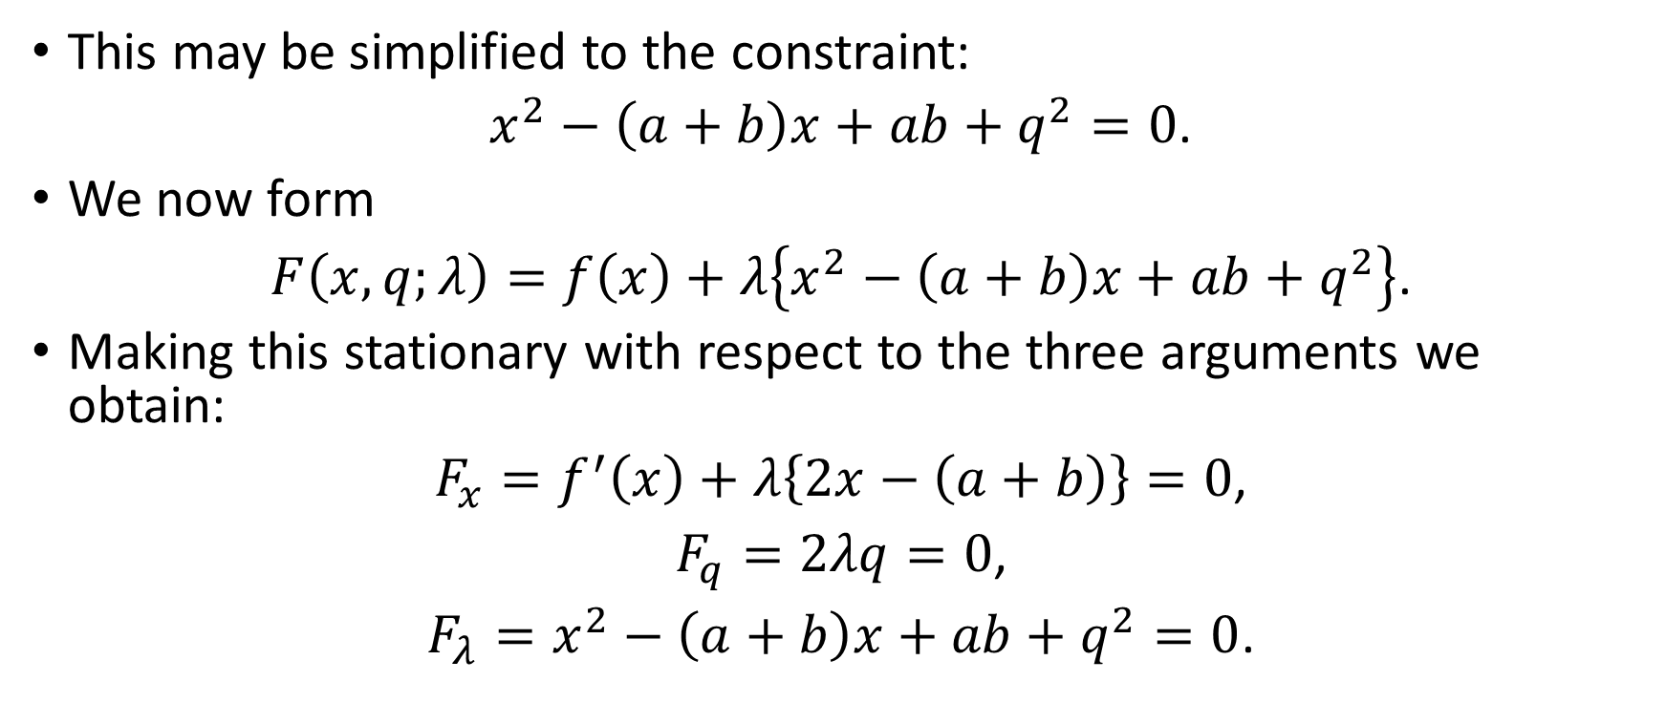
Inequality Constraints - 3
This may be simplified to the constraint:
$x^{2}−\left(a+b\right)x+ab+q^{2}=0$.
We now form
$F\left(x, q;λ\right)=f\left(x\right)+λ\left\{x^{2}−\left(a+b\right)x+ab+q^{2}\right\}$.
Making this stationary with respect to the three arguments we obtain:
$F_{x}=f^{′}\left(x\right)+λ\left\{2x−\left(a+b\right)\right\}=0$,
$F_{q}=2λq=0$,
$F_{λ}=x^{2}−\left(a+b\right)x+ab+q^{2}=0$.

Slide 26
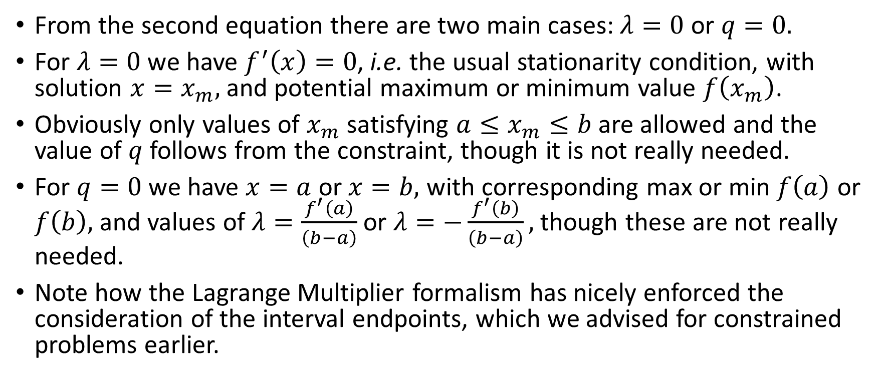
Inequality Constraints - 4
From the second equation there are two main cases: $λ=0$ or $q=0.$
For $λ=0$ we have $f^{′}\left(x\right)=0$, i.e. the usual stationarity condition, with solution $x=x_{m},$ and potential maximum or minimum value $f\left(x_{m}\right)$.
Obviously only values of $x_{m}$ satisfying $a≤x_{m}≤b$ are allowed and the value of $q$ follows from the constraint, though it is not really needed.
For $q=0$ we have $x=a$ or $x=b,$ with corresponding max or min $f\left(a\right)$ or $f\left(b\right),$and values of $λ=\frac{f^{′}\left(a\right)}{\left(b−a\right)}$ or $λ=−\frac{f^{′}\left(b\right)}{\left(b−a\right)},$ though these are not really needed.
Note how the Lagrange Multiplier formalism has nicely enforced the consideration of the interval endpoints, which we advised for constrained problems earlier.

Slide 27
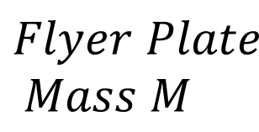

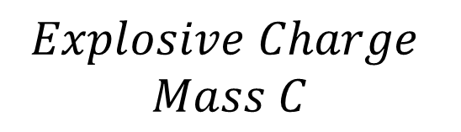
Applications – Explosively Projected Plate - 1
$$Flyer Plate$$
$$Mass M$$
Open-faced sandwich explosive assemblies such as that shown right are used to launch a flyer plate in explosive welding and other applications.
The speed with which the plate is launched normally to itself by the explosion is given to a good approximation by a formula due to Gurney.
$$V$$
$$Explosive Charge$$
$$Mass C$$

Slide 28
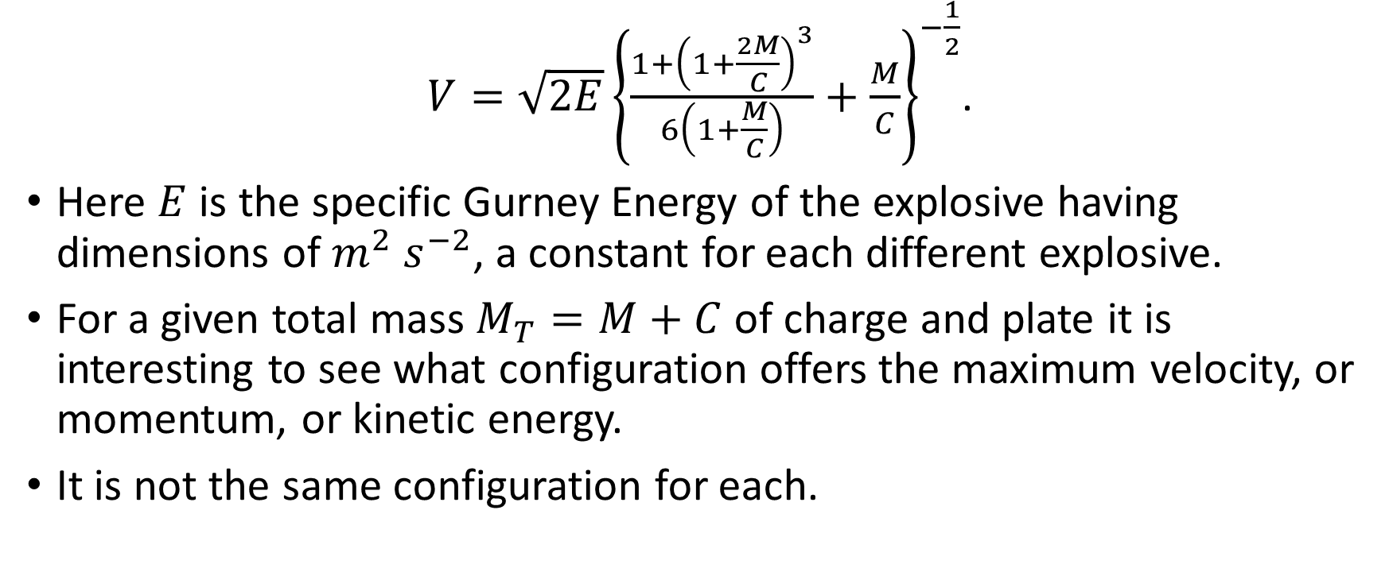
Applications – Explosively Projected Plate - 2
$V={\sqrt{2E}\left\{\frac{1+{\left(1+\frac{2M}{C}\right)}^{3}}{6\left(1+\frac{M}{C}\right)}+\frac{M}{C}\right\}}^{−\frac{1}{2}}$.
Here $E$ is the specific Gurney Energy of the explosive having dimensions of $m^{2} s^{−2}$, a constant for each different explosive.
For a given total mass $M_{T}=M+C$of charge and plate it is interesting to see what configuration offers the maximum velocity, or momentum, or kinetic energy.
It is not the same configuration for each.

Slide 29
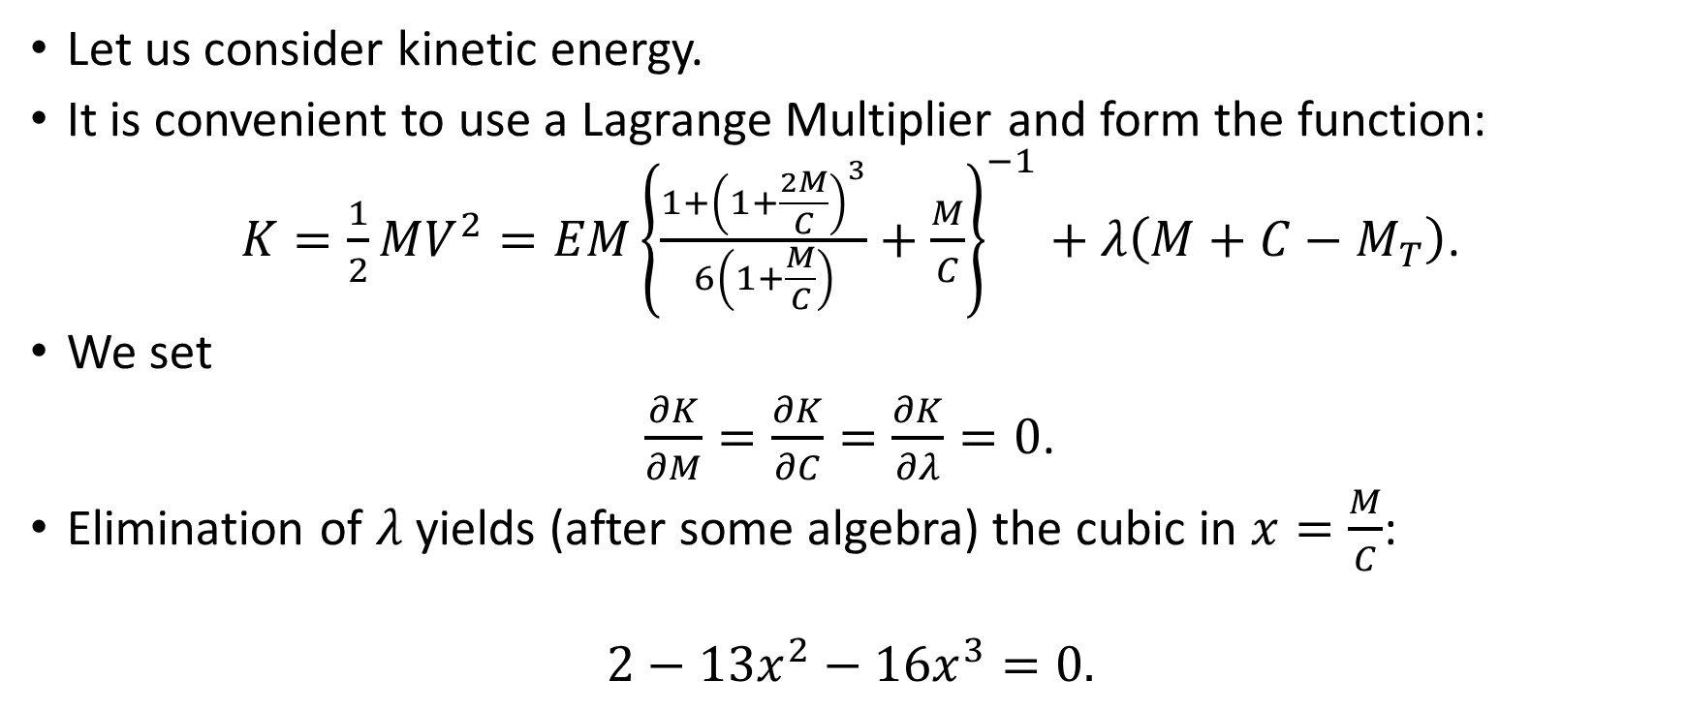
Applications – Explosively Projected Plate - 3
Let us consider kinetic energy.
It is convenient to use a Lagrange Multiplier and form the function:
$K=\frac{1}{2}MV^{2}={EM\left\{\frac{1+{\left(1+\frac{2M}{C}\right)}^{3}}{6\left(1+\frac{M}{C}\right)}+\frac{M}{C}\right\}}^{−1}+λ\left(M+C−M_{T}\right)$.
We set
$\frac{∂K}{∂M}=\frac{∂K}{∂C}=\frac{∂K}{∂λ}=0$.
Elimination of $λ$ yields (after some algebra) the cubic in $x=\frac{M}{C}$:
$$2−13x^{2}−16x^{3}=0.$$

Slide 30
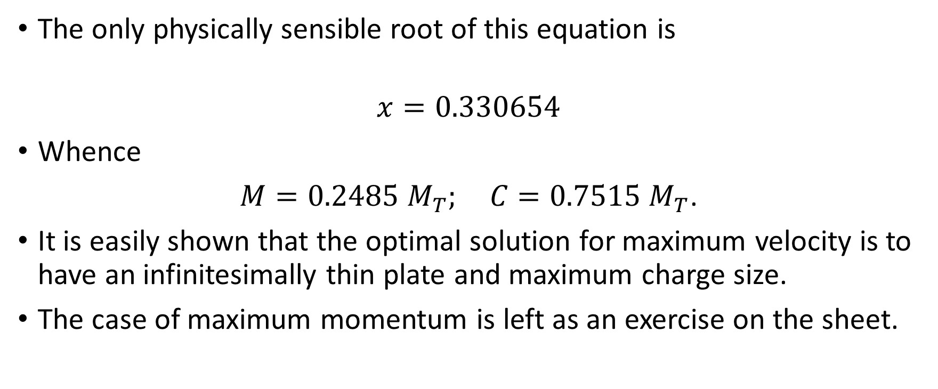
Applications – Explosively Projected Plate - 4
The only physically sensible root of this equation is
$$x=0.330654$$
Whence
$M=0.2485 M_{T}; C=0.7515 M_{T}$.
It is easily shown that the optimal solution for maximum velocity is to have an infinitesimally thin plate and maximum charge size.
The case of maximum momentum is left as an exercise on the sheet.

Slide 31
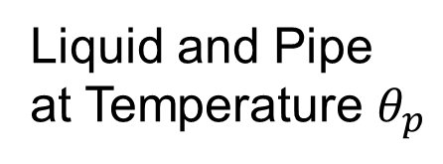
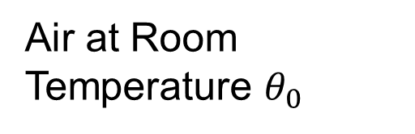

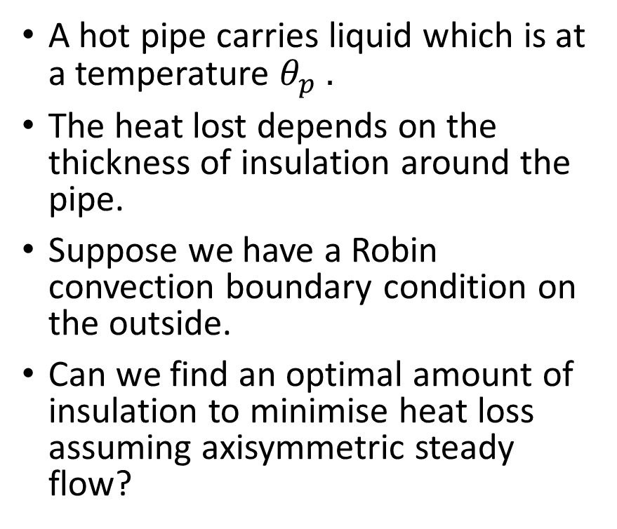


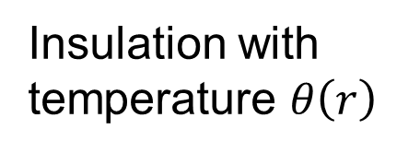
Minimisation of Heat Loss - 1
Air at Room Temperature $θ_{0}$
A hot pipe carries liquid which is at a temperature $θ_{p} .$
The heat lost depends on the thickness of insulation around the pipe.
Suppose we have a Robin convection boundary condition on the outside.
Can we find an optimal amount of insulation to minimise heat loss assuming axisymmetric steady flow?
Insulation with temperature $θ\left(r\right)$
$$r$$
$$r_{2}$$
$$r_{1}$$
Liquid and Pipe at Temperature $θ_{p}$

Slide 32
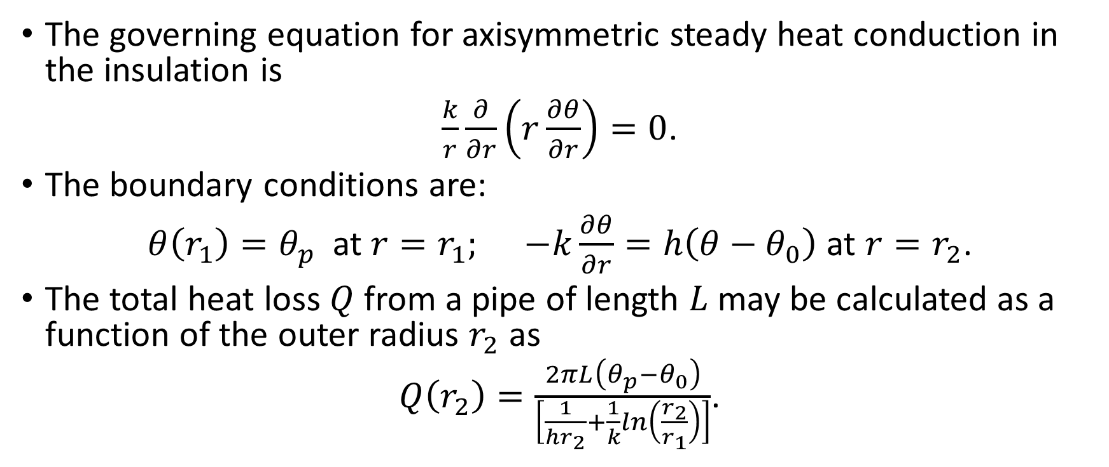
Minimisation of Heat Loss - 2
The governing equation for axisymmetric steady heat conduction in the insulation is
$\frac{k}{r}\frac{∂}{∂r}\left(r\frac{∂θ}{∂r}\right)=0$.
The boundary conditions are:
$θ\left(r_{1}\right)=θ_{p}$at $r=r_{1}; −k\frac{∂θ}{∂r}=h\left({θ−θ}_{0}\right)$ at $r=r_{2}$.
The total heat loss $Q$from a pipe of length $L$ may be calculated as a function of the outer radius $r_{2}$ as
$Q\left(r_{2}\right)=\frac{2πL\left(θ_{p}−θ_{0}\right)}{\left[\frac{1}{hr_{2}}+\frac{1}{k}ln\left(\frac{r_{2}}{r_{1}}\right)\right]}$.

Slide 33
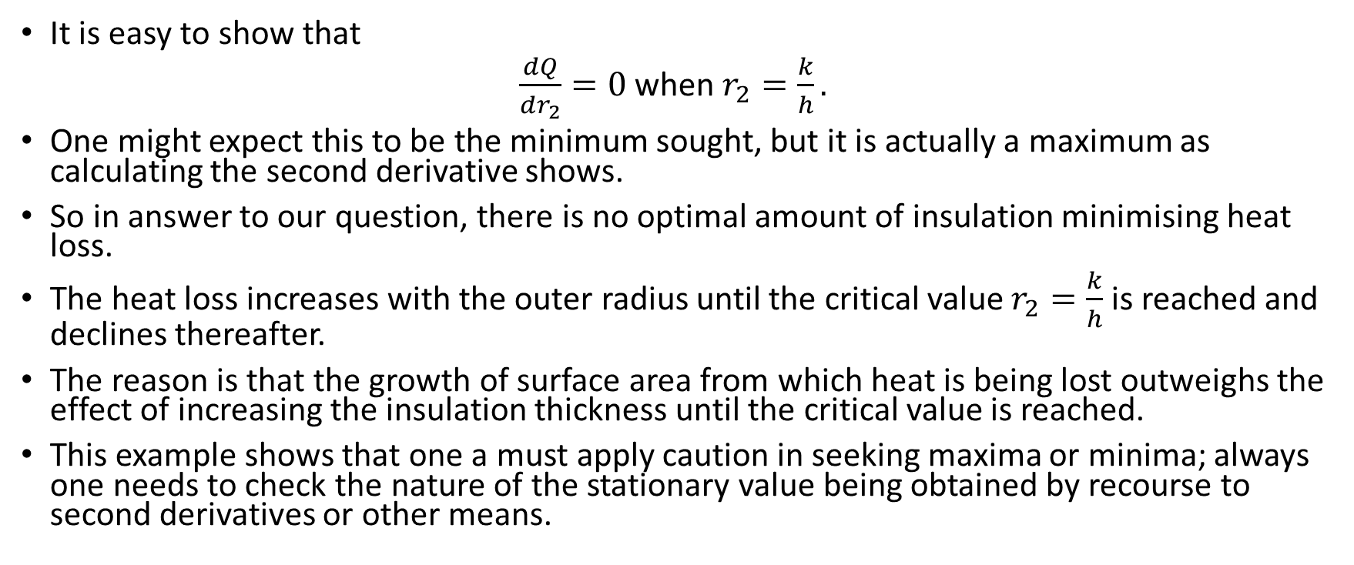
Minimisation of Heat Loss - 3
It is easy to show that
$\frac{dQ}{dr_{2}}=0$ when $r_{2}=\frac{k}{h}.$
One might expect this to be the minimum sought, but it is actually a maximum as calculating the second derivative shows.
So in answer to our question, there is no optimal amount of insulation minimising heat loss.
The heat loss increases with the outer radius until the critical value $r_{2}=\frac{k}{h}$ is reached and declines thereafter.
The reason is that the growth of surface area from which heat is being lost outweighs the effect of increasing the insulation thickness until the critical value is reached.
This example shows that one a must apply caution in seeking maxima or minima; always one needs to check the nature of the stationary value being obtained by recourse to second derivatives or other means.

Slide 34
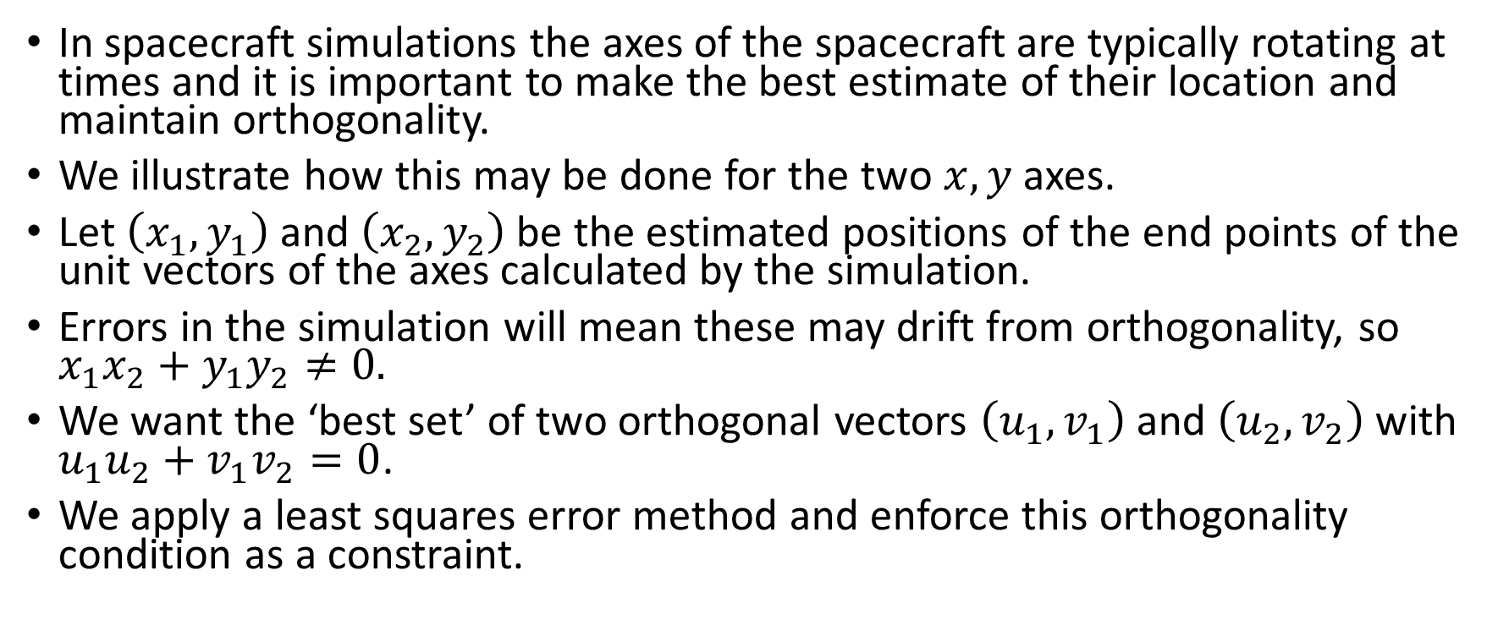
Maintaining Orthogonality of Axes - 1
In spacecraft simulations the axes of the spacecraft are typically rotating at times and it is important to make the best estimate of their location and maintain orthogonality.
We illustrate how this may be done for the two $x, y$axes.
Let $\left(x_{1}, y_{1}\right)$ and $\left(x_{2},y_{2}\right)$ be the estimated positions of the end points of the unit vectors of the axes calculated by the simulation.
Errors in the simulation will mean these may drift from orthogonality, so $x_{1}x_{2}+y_{1}y_{2}≠0.$
We want the ‘best set’ of two orthogonal vectors $\left(u_{1}, v_{1}\right)$ and $\left(u_{2},v_{2}\right)$ with $u_{1}u_{2}+v_{1}v_{2}=0$.
We apply a least squares error method and enforce this orthogonality condition as a constraint.

Slide 35
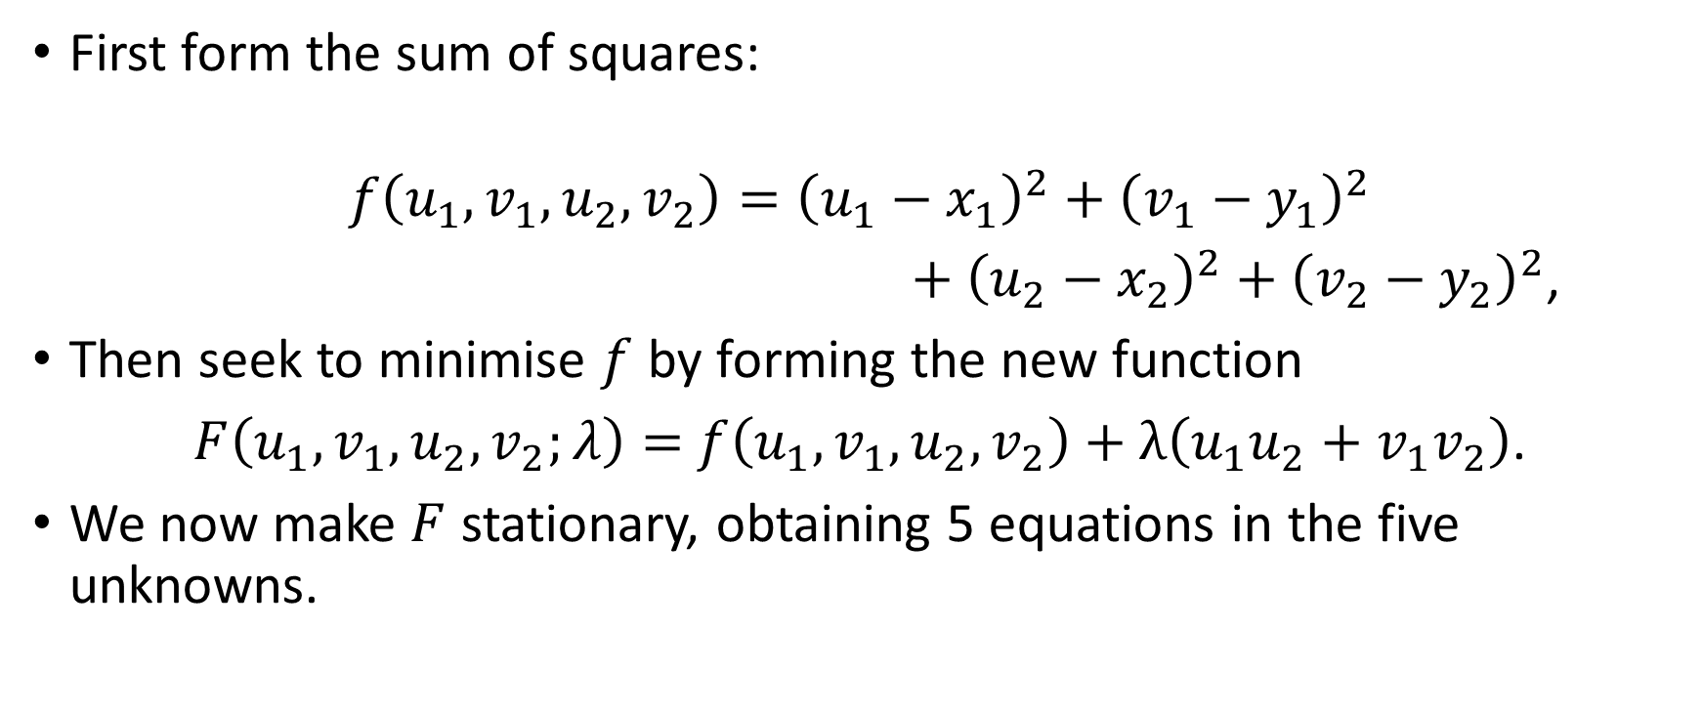
Maintaining Orthogonality of Axes - 2
First form the sum of squares:
$$f\left(u_{1},v_{1},u_{2},v_{2}\right)={\left(u_{1}−x_{1}\right)}^{2}+{\left(v_{1}−y_{1}\right)}^{2}$$
$+$ ${\left(u_{2}−x_{2}\right)}^{2}+{\left(v_{2}−y_{2}\right)}^{2}$,
Then seek to minimise $f$ by forming the new function
$F\left(u_{1},v_{1},u_{2},v_{2};λ\right)=$ $f\left(u_{1},v_{1},u_{2},v_{2}\right)+λ\left(u_{1}u_{2}+v_{1}v_{2}\right)$.
We now make $F$ stationary, obtaining 5 equations in the five unknowns.

Slide 36
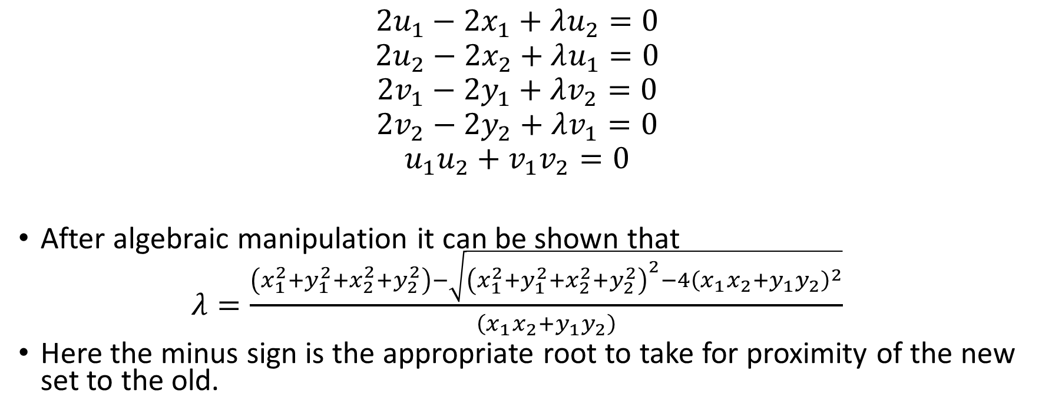
Maintaining Orthogonality of Axes - 3
$$2u_{1}−2x_{1}+λu_{2}=0$$
$$2u_{2}−2x_{2}+λu_{1}=0$$
$$2v_{1}−2y_{1}+λv_{2}=0$$
$$2v_{2}−2y_{2}+λv_{1}=0$$
$$u_{1}u_{2}+v_{1}v_{2}=0$$
After algebraic manipulation it can be shown that
$λ=\frac{\left(x_{1}^{2}+y_{1}^{2}+x_{2}^{2}+y_{2}^{2}\right)−\sqrt{{\left(x_{1}^{2}+y_{1}^{2}+x_{2}^{2}+y_{2}^{2}\right)}^{2}−4{\left(x_{1}x_{2}+y_{1}y_{2}\right)}^{2}}}{\left(x_{1}x_{2}+y_{1}y_{2}\right)}$
Here the minus sign is the appropriate root to take for proximity of the new set to the old.

Slide 37

Maintaining Orthogonality of Axes - 4
The required orthogonal values of $u_{1}, v_{1}, u_{2}, v_{2}$ are:
$$u_{1}=\frac{4x_{1}−2λx_{2}}{\left(4−λ^{2}\right)}$$
$$u_{2}=\frac{4x_{2}−2λx_{1}}{\left(4−λ^{2}\right)}$$
$$v_{1}=\frac{4y_{1}−2λy_{2}}{\left(4−λ^{2}\right)}$$
$$v_{2}=\frac{4y_{2}−2λy_{1}}{\left(4−λ^{2}\right)}$$
Orthogonality follows immediately from the quadratic for $λ$, which is small.

Slide 38
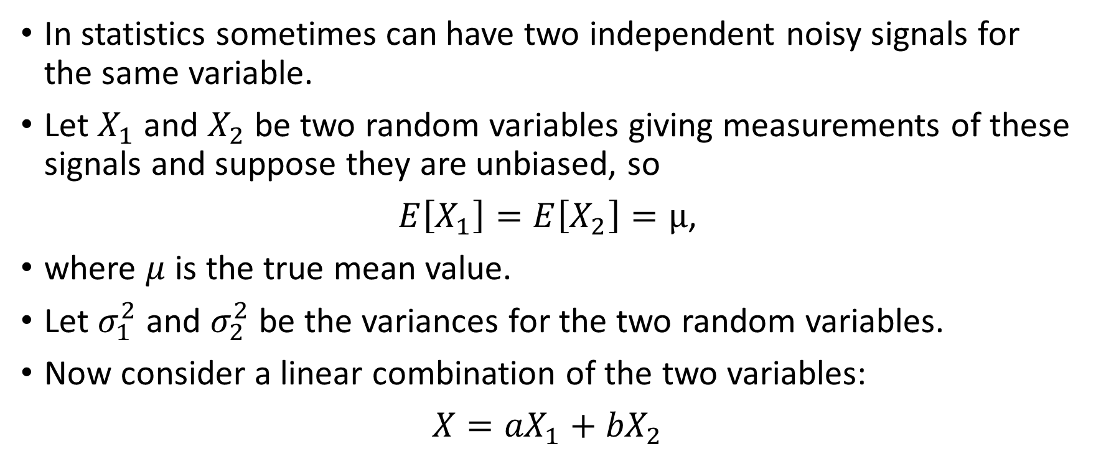
Minimising Variance – 1 N.B. !!
In statistics sometimes can have two independent noisy signals for the same variable.
Let $X_{1}$ and $X_{2}$ be two random variables giving measurements of these signals and suppose they are unbiased, so
$E\left[X_{1}\right]=E\left[X_{2}\right]=μ$,
where $μ$ is the true mean value.
Let $σ_{1}^{2}$ and $σ_{2}^{2}$ be the variances for the two random variables.
Now consider a linear combination of the two variables:
$X={aX}_{1}+{bX}_{2}$

Slide 39
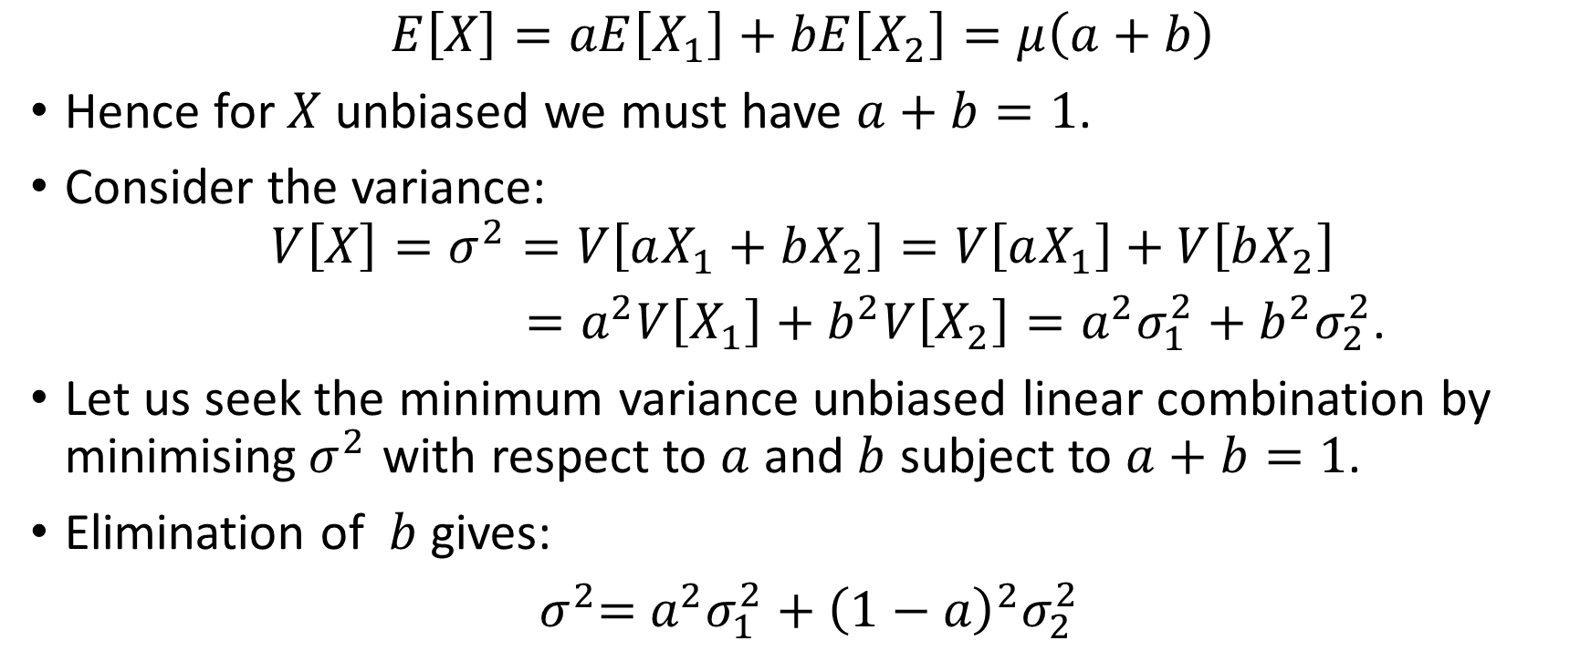
Minimising Variance – 2
$$E\left[X\right]=aE\left[X_{1}\right]+bE\left[X_{2}\right]=μ\left(a+b\right)$$
Hence for $X$ unbiased we must have $a+b=1$.
Consider the variance:
$$V\left[X\right]=σ^{2}=V\left[aX_{1}+bX_{2}\right]=V\left[aX_{1}\right]+V\left[bX_{2}\right]$$
$=a^{2}V\left[X_{1}\right]+b^{2}V\left[X_{2}\right]=a^{2}σ_{1}^{2}+b^{2}σ_{2}^{2}$.
Let us seek the minimum variance unbiased linear combination by minimising${ σ}^{2}$ with respect to $a$ and $b$ subject to $a+b=1$.
Elimination of $b$gives:
${ σ}^{2}=$ $a^{2}σ_{1}^{2}+{\left(1−a\right)}^{2}σ_{2}^{2}$

Slide 40
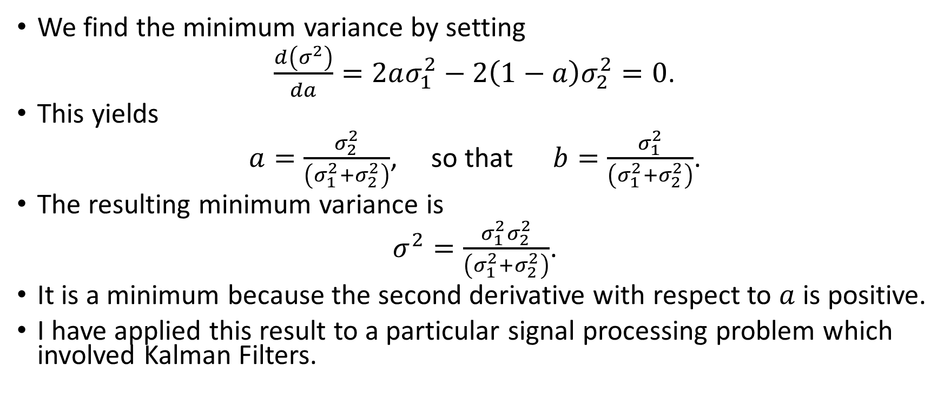
Minimising Variance – 3
We find the minimum variance by setting
$\frac{d\left(σ^{2}\right)}{da}=2aσ_{1}^{2}−2\left(1−a\right)σ_{2}^{2}=0$.
This yields
$a=\frac{σ_{2}^{2}}{\left(σ_{1}^{2}+σ_{2}^{2}\right)}$, so that $b=\frac{σ_{1}^{2}}{\left(σ_{1}^{2}+σ_{2}^{2}\right)}$.
The resulting minimum variance is
$σ^{2}=\frac{σ_{1}^{2}σ_{2}^{2}}{\left(σ_{1}^{2}+σ_{2}^{2}\right)}$.
It is a minimum because the second derivative with respect to $a$ is positive.
I have applied this result to a particular signal processing problem which involved Kalman Filters.

Slide 41
Search Methods
Sometimes one wishes to optimise a function where evaluations of the function are expensive in resources and where there are no analytical expressions available for the derivatives.
Very typical examples arise where the performance of a system is determined by running a software model that depends on many parameters (e.g. the penetration by an oil well perforator.)
Here it is prohibitively expensive to try to calculate derivatives.
There have been various methods developed to address this problem.
We cannot review them all; this is a vast research area in its own right.
But I describe a few I have had direct contact with, again with the aim of giving you the flavour of this kind of problem, likely to be increasingly prevalent.

Slide 42
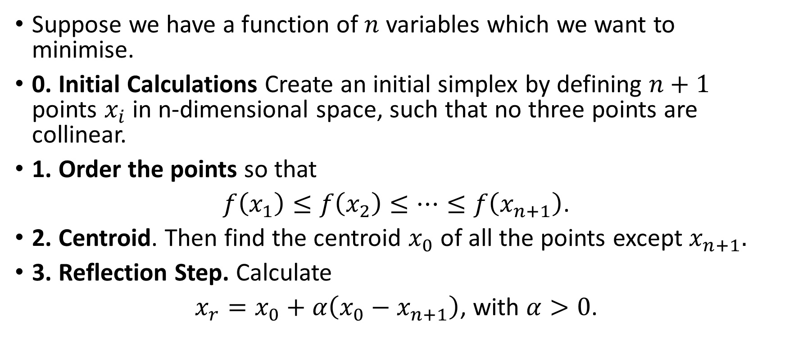
Simplex Methods – Nelder-Mead Method - 1
Suppose we have a function of $n$ variables which we want to minimise.
0. Initial Calculations Create an initial simplex by defining $n+1$ points $x_{i}$ in n-dimensional space, such that no three points are collinear.
1. Order the points so that
$f\left(x_{1}\right)≤f\left(x_{2}\right)≤…≤f\left(x_{n+1}\right)$.
2. Centroid. Then find the centroid $x_{0}$ of all the points except $x_{n+1}.$
3. Reflection Step. Calculate
$x_{r}=x_{0}+α\left(x_{0}−x_{n+1}\right)$, with $α>0$.

Slide 43
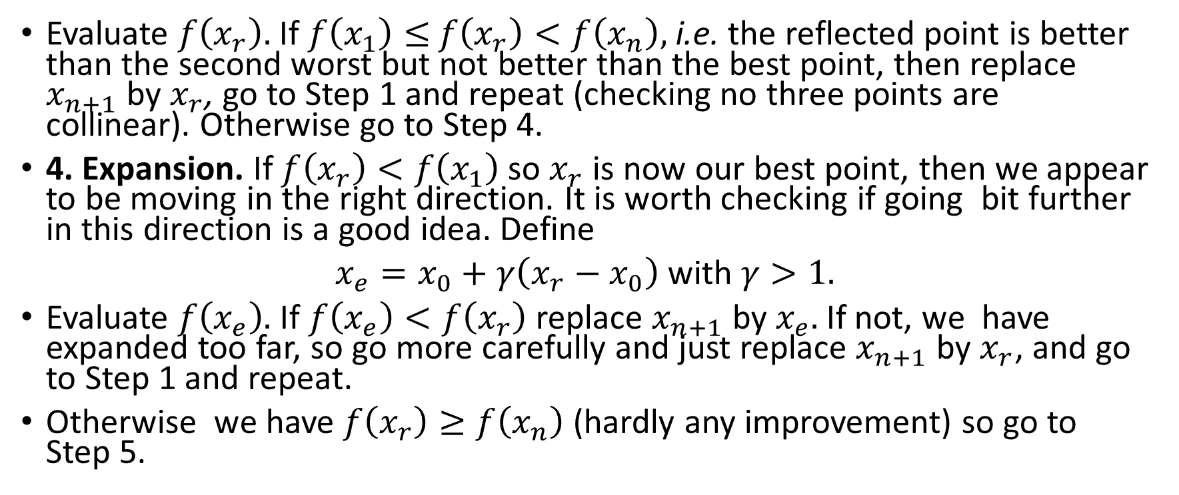
Nelder-Mead Method - 2
Evaluate $f\left(x_{r}\right).$ If $f\left(x_{1}\right)≤$ $f\left(x_{r}\right)<f\left(x_{n}\right),$i.e. the reflected point is better than the second worst but not better than the best point, then replace $x_{n+1}$ by $x_{r}$, go to Step 1 and repeat (checking no three points are collinear). Otherwise go to Step 4.
4. Expansion. If $f\left(x_{r}\right)<f\left(x_{1}\right)$ so $x_{r}$ is now our best point, then we appear to be moving in the right direction. It is worth checking if going bit further in this direction is a good idea. Define
$x_{e}=x_{0}+γ\left(x_{r}−x_{0}\right)$ with $γ>1.$
Evaluate $f\left(x_{e}\right).$ If $f\left(x_{e}\right)<f\left(x_{r}\right)$ replace $x_{n+1}$ by $x_{e}.$ If not, we have expanded too far, so go more carefully and just replace $x_{n+1}$ by $x_{r}$, and go to Step 1 and repeat.
Otherwise we have $f\left(x_{r}\right)≥f\left(x_{n}\right)$(hardly any improvement) so go to Step 5.

Slide 44
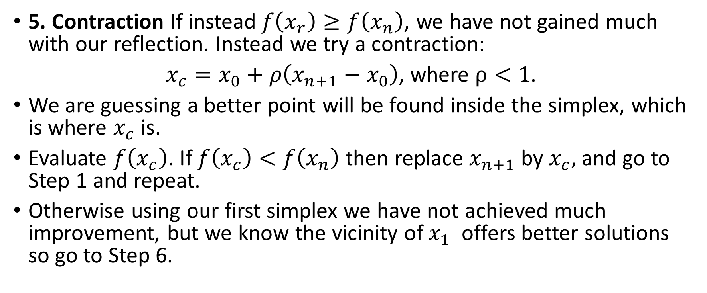
Nelder-Mead Method - 3
5. Contraction If instead$f\left(x_{r}\right)≥f\left(x_{n}\right)$, we have not gained much with our reflection. Instead we try a contraction:
$x_{c}=x_{0}+ρ\left(x_{n+1}−x_{0}\right)$, where $ρ<1$.
We are guessing a better point will be found inside the simplex, which is where $x_{c}$ is.
Evaluate $f\left(x_{c}\right)$. If $f\left(x_{c}\right)<f\left(x_{n}\right)$ then replace $x_{n+1}$ by $x_{c},$ and go to Step 1 and repeat.
Otherwise using our first simplex we have not achieved much improvement, but we know the vicinity of $x_{1}$ offers better solutions so go to Step 6.

Slide 45
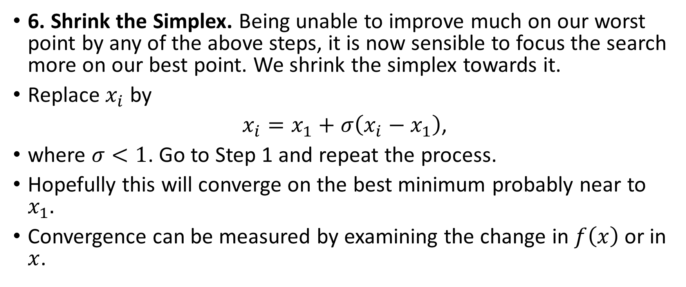
Nelder-Mead Method - 4
6. Shrink the Simplex. Being unable to improve much on our worst point by any of the above steps, it is now sensible to focus the search more on our best point. We shrink the simplex towards it.
Replace $x_{i}$ by
$x_{i}=x_{1}+σ\left(x_{i}−x_{1}\right)$,
where $σ<1$. Go to Step 1 and repeat the process.
Hopefully this will converge on the best minimum probably near to $x_{1}.$
Convergence can be measured by examining the change in $f\left(x\right)$ or in $x$.

Slide 46
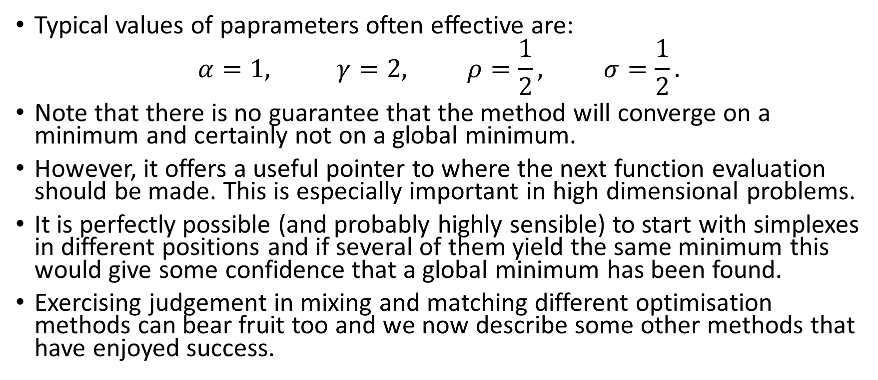
Nelder-Mead Method - 5
Typical values of paprameters often effective are:
$$α=1, γ=2, ρ=\frac{1}{2}, σ=\frac{1}{2}.$$
Note that there is no guarantee that the method will converge on a minimum and certainly not on a global minimum.
However, it offers a useful pointer to where the next function evaluation should be made. This is especially important in high dimensional problems.
It is perfectly possible (and probably highly sensible) to start with simplexes in different positions and if several of them yield the same minimum this would give some confidence that a global minimum has been found.
Exercising judgement in mixing and matching different optimisation methods can bear fruit too and we now describe some other methods that have enjoyed success.

Slide 47
Genetic Algorithms - 1
Genetic Algorithms may be applied to functions of many variables.
The range of these variables is divided (usually evenly) into a finite population of individual points.
Each point is put into 1-1 correspondence with a binary number.
The individual bits of the binary number can be regarded as the genes and the whole binary number as a chromosome.
The function to be optimised is viewed as a ‘survival fitness score’.
The individual with the optimal (or generally near optimal) fitness score is sought.
The genetic algorithm aims to use selective `breeding' of the solutions to produce `offspring' better than the parents by combining information from the chromosomes.
The best half of the population is retained – the rest discarded – survival of the fittest!

Slide 48
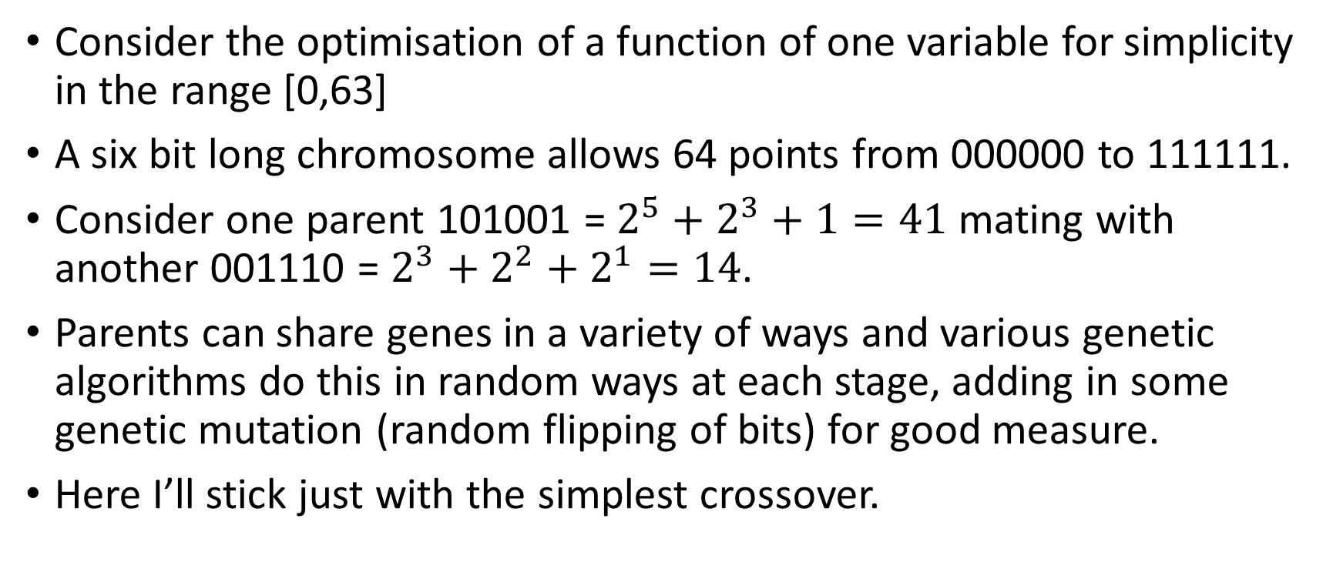
Genetic Algorithms - 2
Consider the optimisation of a function of one variable for simplicity in the range [0,63]
A six bit long chromosome allows 64 points from 000000 to 111111.
Consider one parent 101001 = $2^{5}+2^{3}+1=41$ mating with another 001110 = $2^{3}+2^{2}+2^{1}=14$.
Parents can share genes in a variety of ways and various genetic algorithms do this in random ways at each stage, adding in some genetic mutation (random flipping of bits) for good measure.
Here I’ll stick just with the simplest crossover.

Slide 49
Genetic Algorithms - 3
Parent 1
1 0 1
0 0 1
0 0 1
1 1 0
Parent 2
41
14
Child 1
1 0 1
1 1 0
0 0 1
0 0 1
Child 2
46
9

Slide 50
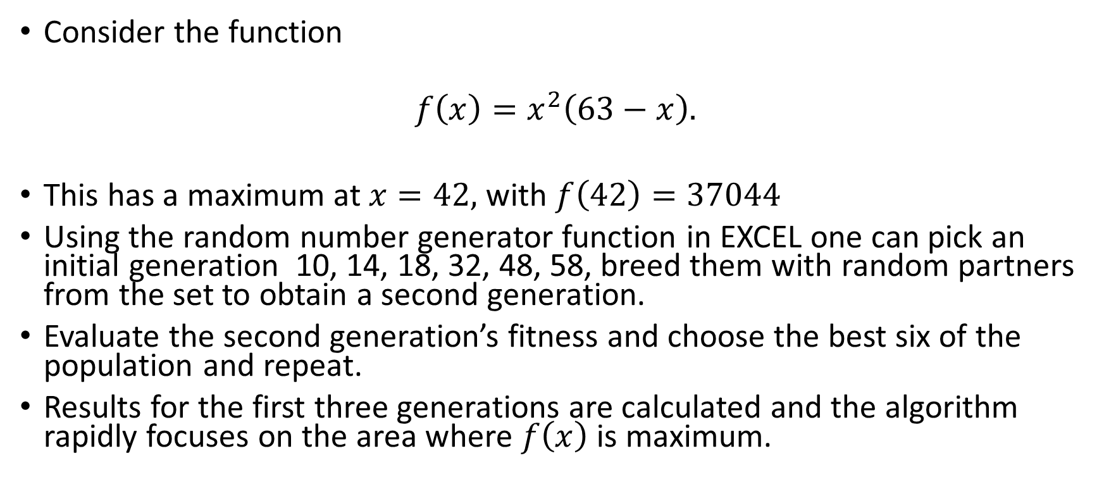
Genetic Algorithms – 4
Consider the function
$$f\left(x\right)=x^{2}\left(63−x\right).$$
This has a maximum at $x=42,$ with $f\left(42\right)=37044$
Using the random number generator function in EXCEL one can pick an initial generation 10, 14, 18, 32, 48, 58, breed them with random partners from the set to obtain a second generation.
Evaluate the second generation’s fitness and choose the best six of the population and repeat.
Results for the first three generations are calculated and the algorithm rapidly focuses on the area where $f\left(x\right)$ is maximum.

Slide 51
Genetic Algorithms – 5

Slide 52
Genetic Algorithms – 6

Slide 53
Simulated Annealing - 1
Simulated Annealing is a probabilistic technique for approximating the global optimum of a function.
It is mainly used where function evaluations are costly and derivatives are not available, e.g. when a large simulation is needed to perform just one evaluation.
The name stems from annealing in metallurgy. This is a technique applying heating and controlled cooling of a material to increase crystal size and reduce defects, by minimising the energy.
It is rather good at finding the highest peak or lowest trough of many, as it provides a clever way of escaping from local maxima or minima.
It is widely applied in industry. I have seen it applied to optimising shaped charge jet performance, but not had hands-on involvement myself. !!
Nonetheless I think you should be aware of this method.

Slide 54
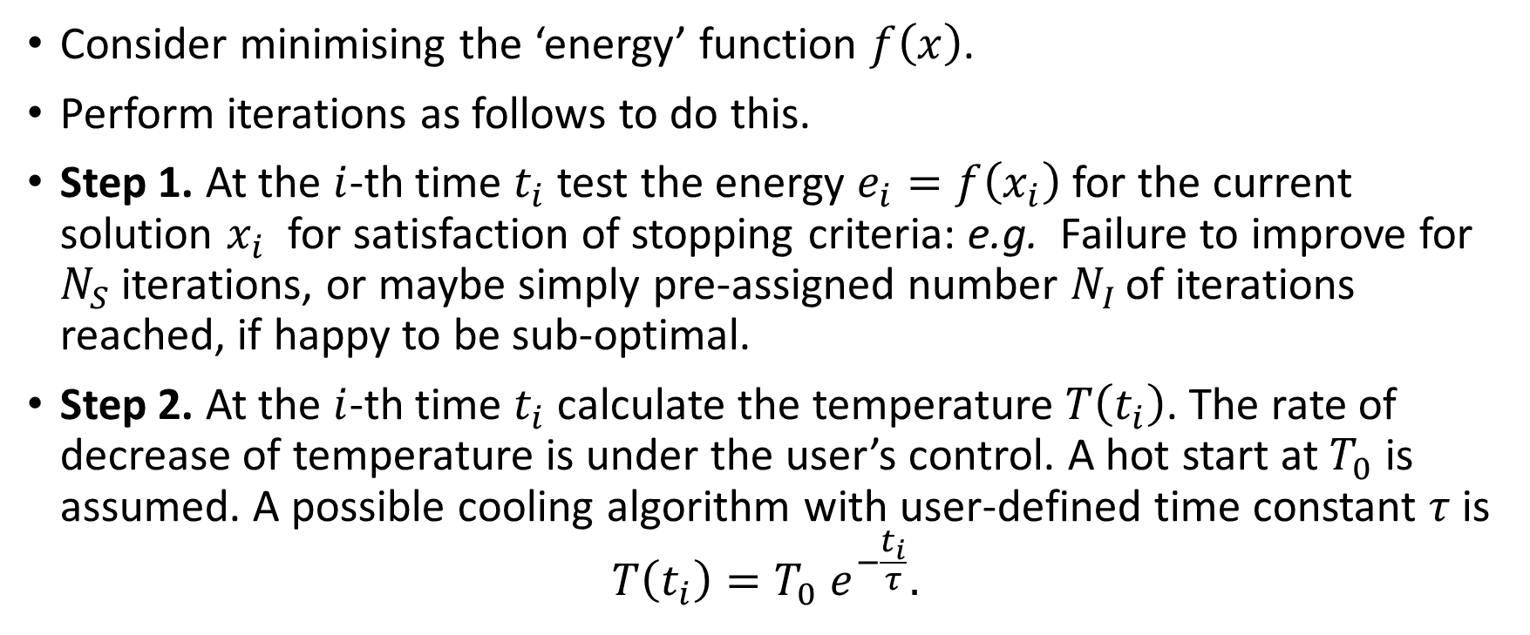
Simulated Annealing - 2
Consider minimising the ‘energy’ function $f\left(x\right)$.
Perform iterations as follows to do this.
Step 1. At the $i$-th time $t_{i}$ test the energy $e_{i}=f\left(x_{i}\right)$ for the current solution $x_{i}$for satisfaction of stopping criteria: e.g. Failure to improve for $N_{S}$ iterations, or maybe simply pre-assigned number $N_{I }$of iterations reached, if happy to be sub-optimal.
Step 2. At the $i$-th time $t_{i}$ calculate the temperature $T\left(t_{i}\right)$. The rate of decrease of temperature is under the user’s control. A hot start at $T_{0}$ is assumed. A possible cooling algorithm with user-defined time constant $τ$ is
$$T\left(t_{i}\right)=T_{0} e^{−\frac{t_{i}}{τ}}.$$

Slide 55
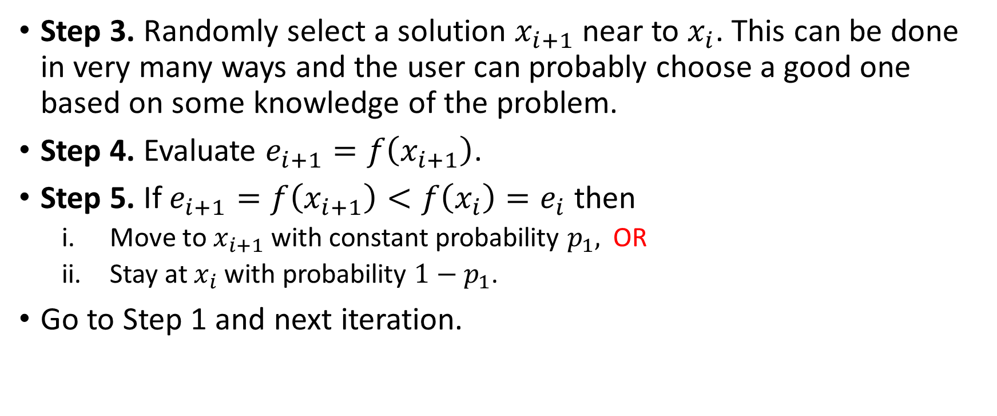
Simulated Annealing - 3
Step 3. Randomly select a solution $x_{i+1}$ near to $x_{i}$. This can be done in very many ways and the user can probably choose a good one based on some knowledge of the problem.
Step 4. Evaluate $e_{i+1}=f\left(x_{i+1}\right)$.
Step 5. If $e_{i+1}=f\left(x_{i+1}\right)<f\left(x_{i}\right)=e_{i}$ then
  Move to $x_{i+1}$ with constant probability $p_{1},$ OR
  Stay at $x_{i}$ with probability $1−p_{1}$.
Go to Step 1 and next iteration.

Slide 56

Simulated Annealing - 4
Step 6. If $e_{i+1}=f\left(x_{i+1}\right)≥f\left(x_{i}\right)=e_{i}$ then
  Move to $x_{i+1}$ with varying probability $p_{2}=p_{2}\left(T,e_{i},e_{i+1}\right)$
  Stay at $x_{i}$ with probability $1−p_{2}$.
Here $p_{2}$ is a function that decreases with temperature:
$p_{2}\left(T,e_{i},e_{i+1}\right)=e^{−\frac{\left(e_{i+1}−e_{i}\right)}{T}}$.
Go to Step 1 and next iteration.
There are many possible ways of varying this method and the user will need to experiment for his or her own application.
Probably wise to use an existing method but test it to check it is working on some examples you know the answer to!

Slide 57
Other Methods !!
The Tabu Search method is designed to get the algorithm away from local minima that are not global minima by carrying a memory of these.
I have not used it myself but have seen it used with success on airport logistics for maximising the number of planes processed in a day.
Particle Swarm Optimisation is a newer method in use in industry, but again I cannot comment from first-hand experience.

